Slide 2
Established in 1982
Initially a grassroots member network within the AAO-HNS
Then:
90% AAO membership in private practice
75% in solo or small single specialty group practices

Slide 3
Open to all Academy members to promote “advocacy and action”
Comprised of local, state, and national Otolaryngological societies from around the United States

Slide 4
Board of Governors (BOG) now serves the entire Academy and specialty
By identifying and responding to local, state, and national legislative, socioeconomic, and public relations issues encountered by all otolaryngologists within our specialty.
By providing organized feedback from membership to Academy leadership
By establishing and maintaining personal connections with all member societies.

Slide 5
Each BOG society has 3 BOG representatives
Governor
Alternate Governor
(formerly the Legislative Affairs Representative)
Alternate Governor
(formerly the Socioeconomic & Grassroots Representative)

Slide 6
Terms of governors and alternate governors are determined by their society
Representatives have specific responsibilities to their society and the BOG
Society BOG representatives are a bridge between their society and the AAO-HNS

Slide 7
Executive Committee
Chair
Spencer Payne, MD (Charlottesville, VA)
Chair-Elect
Lance Manning, MD (Springdale, AR)
Immediate Past Chair
Ken Yanagisawa, MD (New Haven, CT)
Member-at-Large
Troy D. Woodard MD (Cleveland, OH)
Secretary
Karen Rizzo, MD (Lancaster, PA)

Slide 8
BOG Committees
Governance & Society Engagement
Identify common goals and coordinate efforts
Legislative Affairs
Assess, Activate, & Advocate for member needs
Socioeconomic & Grass Roots
Listen and provide solutions for member problems

Slide 9
BOG Committees
Governance & Society Engagement
Chair: Boris Chernobilsky, MD (New York, NY)
Vice-Chair: Samantha Anne, MD (Orange, OH)
Legislative Affairs
Chair: David Boisoneau, MD (Waterford, CT)
Vice-Chair: Jeffrey Brown, MD (Woburn, PA)
Socioeconomic & Grass Roots
Chair: Andrew Coughlin, MD (Omaha, NE)
Vice-Chair: Dale Taylor, MD (Santa Barbara, CA)

Slide 10
Governance & Society Engagement Committee
2019 Highlights
Creating a web-based Society interactive map and encourage Societies to remain active and engaged.
Create a GoSE toolkit to aid members in creating and developing local and State Societies.
Work hand-in-hand with Member-at-Large to solidify interactions and communications between State Societies and their respective Regional Representatives.

Slide 11
Legislative Affairs Committee
2019 Highlights
Distribute Legislative Alerts with successful implementation of simplified mobile-enabled feedback to legislators for key concerns.
text “Otoadvocate” to 313131
Grow Project 535, State Trackers Program, I-GO (In district Grassroots Outreach).
Support ENT PAC.

Slide 12
Socioeconomic & Grassroots Committee
2019 Highlights
New Academy Student Initiative - physicians at grassroots level participate in multiple student programs including high school and medical school observerships. This provides opportunities for early exposure and a better understanding of our roles as Otolaryngologists.
Update SEGR Toolkit with information covering unlisted codes and Category III codes.
Raise member awareness of 3P (Physician Payment Policy workgroup) activities, and foster opportunities to work together, with Paul Imber, DO serving as the BOG representative on 3P.

Slide 13
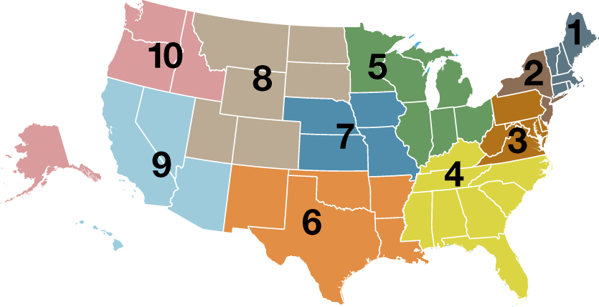
10 Regional Representatives
Enhance and facilitate communication
Region 10 Representative:
Derek Lam, MD
Region 8 Representative:
Andrew Winkler, MD
Region 1 Representative:
Ray Winicki, MD
Region 5 Representative:
Robert Stachler, MD
Region 9 Representative:
Steven T. Kmucha, MD, JD
Region 2 Representative:
Phillip L. Massengill, MD
Region 3 Representative:
Karen Rizzo, MD
Region 7 Representative:
C. W. David Chang, MD
Region 4 Representative:
E. Scott Elledge, MD
Specialty Representative:
Soha N. Ghossaini, MD
Region 6 Representative:
Lance A. Manning, MD

Slide 14
BOG “Tool Box” Initiative
Each BOG Committee has prepared a step-by-step manual to instruct AAO membership in professional engagement
SEGR – Insurance company and Medical Director interaction for coding and payment problems
Legislative Affairs – ‘How to’ develop and promote AAO initiatives through state and national engagement and advocacy
GoSE – Idea ‘incubator’ to generate greater state and local membership numbers and participation

Slide 15
Subspecialty Society Engagement Opportunities
Participate in developing the “tool box” library
Be available to provide relevant informational and subspecialty specific expertise
Be an organized resource for general Academy membership questions
Regional Representatives can connect membership inquiries to and forward suggestions from the engaged subspecialty societies and their named BOG Representatives

Slide 16
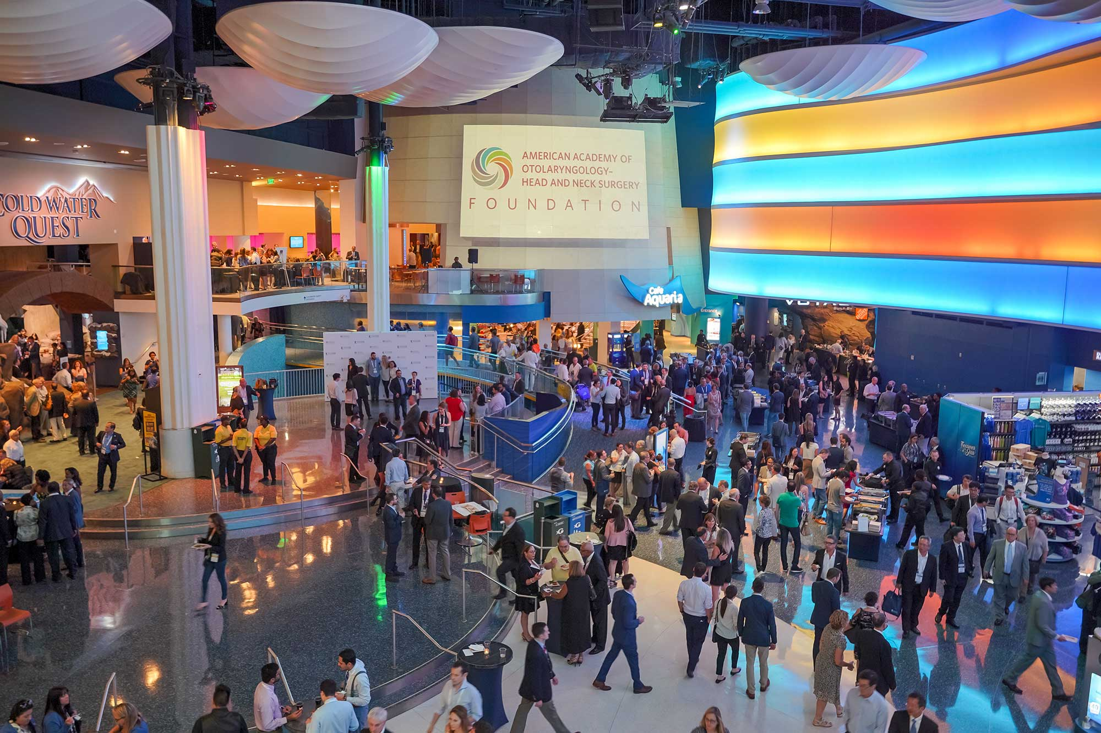
BOG Meetings
ANY AAO-HNS member can attend BOG meetings including the BOG committee meetings and BOG General Assembly
each BOG society has only one voting representative - the Governor or designated alternate (Alternate Governor)
2020 Fall and Spring Meetings
AAO-HNS/F Leadership Forum and BOG Spring Meeting | May 1 – 3 | Alexandria, VA
AAO-HNSF Annual Meeting & OTO Experience | September 13 – 16 | Boston, MA
Saturday, September 12, 11:45 am – 3:45 pm: BOG Committee Meetings
Saturday, September 12, 4:00 pm – 5:30 pm: BOG General Assembly
Saturday, September 12, 5:30 pm – 6:30 pm: BOG Reception

Slide 17
Become Involved with Your Sections
Section for Residents & Fellows-in-Training (SRF)
Composed of residents and fellows who are active members of the Academy as medical graduates in training in otolaryngology-head and neck surgery.
Women in Otolaryngology (WIO) Section
Female Academy members are automatically members of the WIO Section.
Enhances the careers of women otolaryngologists through the creation of professional development, mentoring, and networking programs.
Young Physicians Section (YPS)
Professional home for Academy members who are under 40 years of age or within the first eight years of professional practice after residency and fellowship training.

Slide 18
AAO-HNS/F 2020
LEADERSHIP
FORUM
& BOG SPRING
MEETING
MAY 1 – 3
ALEXANDRIA, VA

