Slide 1
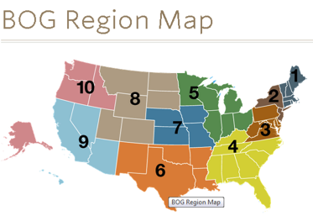
Board of Governors (BOG)
Established in 1982 as a grassroots member network within the AAO-HNS.
Composed of local, state, specialty, and national otolaryngology–head and neck surgery societies.
Organized into 10 Geographic Regions. Each region has an appointed representative to enhance and facilitate communications.
Functions as a conduit of information between BOG members, the BOG Executive Committee, the AAO-HNS/F Boards of Directors, and the general membership.
Notes:
Functions as a conduit of information:
Identify issues impacting the practice of otolaryngology
Make recommendations regarding the programs and policies of the AAO-HNS
Seek out and involve all otolaryngologists
Strengthen the AAO-HNS and otolaryngology societies
Support the general good of patients, the specialty, and the medical profession
Representation in the BOG:
In their liaison role, a society’s designated individuals are primarily responsible for communicating and coordinating information and requests to/from BOG leaders and society members. The BOG Governors are expected to attend the BOG General Assembly during the Leadership Forum & BOG Spring Meeting and the fall annual meeting. In addition, the Legislative and SEGR Representatives are invited to attend their respective BOG committee meetings during the spring and fall meetings.
Organized into 10 Geographic Regions
To enhance and facilitate communications, the BOG reorganized itself into ten (10) geographic regions. These enhancements are particularly helpful in states with inactive or new BOG societies. In addition, a specialty society representative has been added to the 10 regional representatives to foster specialty unity and coordination. As issues arise within BOG societies, we encourage the Governor, Legislative Representative, and/or SEGR Representative to reach out to these regional reps, as well as to collaborate with BOG Executive Committee leaders.

Slide 2
BOG Committees & Representatives
All AAO-HNS active members are eligible to apply to a BOG Committee or attend BOG Committee meetings.
Legislative Affairs Committee
Socioeconomic & Grassroots (SEGR) Committee
Governance & Society Engagement Committee
Each affiliated BOG society has three designated positions to the BOG.
Governor, Legislative Rep, and SEGR Rep

Slide 3
Become Involved in Your Section(s)
Section for Residents & Fellows-in-Training (SRF)
Composed of residents and fellows who are active members of the Academy as medical graduates in training in otolaryngology-head and neck surgery.
Women in Otolaryngology (WIO) Section
Female Academy members are automatically members of the WIO Section.
Enhances the careers of women otolaryngologists through the creation of professional development, mentoring, and networking programs.
Young Physicians Section (YPS)
Professional home for Academy members who are under 40 years of age or within the first eight years of professional practice after residency and fellowship training.
Notes:
SRF—is composed entirely of residents and fellows who are active members of the Academy as medical graduates in training in otolaryngology—head and neck surgery. The SRF functions as an advisory body to the Academy Board of Directors and has been charged to: Communicate issues to residents and fellows; Makes recommendations to the Academy Board of Directors; and Support the specialty of otolaryngology-head and neck surgery as a whole.
WIO—female Academy members are automatically a member of the Section. WIO functions to enhance the careers of women otolaryngologists through the creation of professional development, mentoring, and networking programs and through the promotion of leadership opportunities within the AAO-HNS/F. WIO works to enhance the appeal of otolaryngology for women residents by strengthening and encouraging their leadership role in the SRF; improving their voice in issues unique to training programs and by promoting effective, efficient, and diverse career opportunities; To encourage young women in high school, college, and medical school to pursue a career in otolaryngology; and To collaborate with AAO-HNS/F committees to enhance member engagement, foster leadership development, and by engaging the energy of this membership segment.
YPS—strives to be the professional home for Academy members who are under 40 years of age or within the first eight years of professional practice after residency and fellowship training; foster a community and a sense of belonging; allow for an on-going dialog among young physicians and with the Academy; and provide opportunity for an increased number of young physicians to engage in leadership and committee roles on unique young physician relevant issues.

Slide 4
SAVE THE DATE!

Slide 5
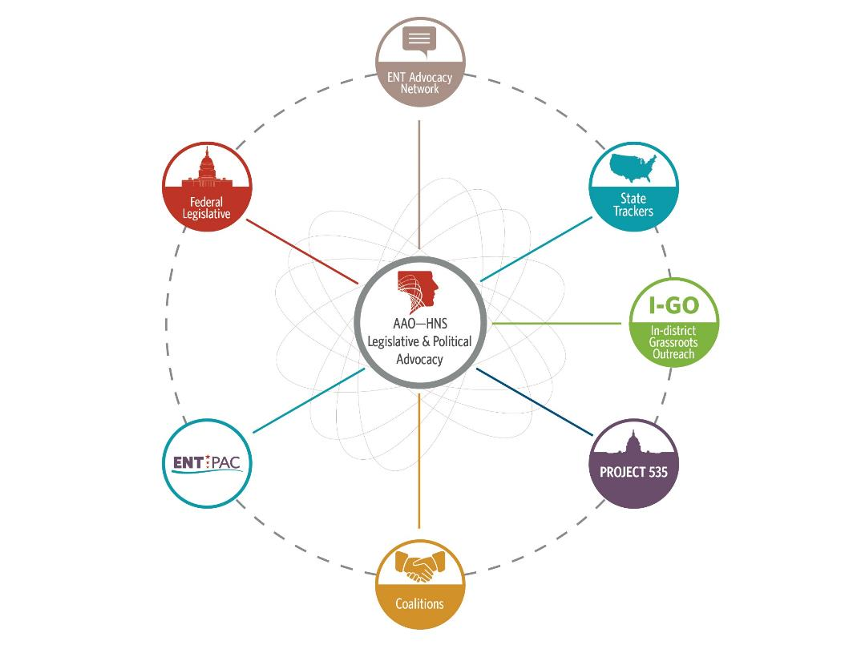
Legislative &
Political Advocacy

Slide 6
Federal Legislative Advocacy:
2017 Priorities
Regulatory/legislative efforts to establish a framework for a category of Over-the-Counter (OTC) hearing aids for mild-to-moderate hearing loss.
Repeal of the Independent Payment Advisory Board (IPAB).
Reauthorization of the Early Hearing Detection and Intervention (EHDI) program.
Opposition to legislation that would inappropriately expand audiology’s scope of practice or re-classify audiologists as “physicians.”
Support for FDA’s authority to regulate ALL tobacco products.
Protecting access to allergy immunotherapy and other drugs/medications via in-office compounding.
Preservation and/or expansion of graduate medical education (GME) funding.
Notes:
Federal Legislative: The AAO-HNS has a number of federal legislative 2017 initiatives, including opposition to legislation that would inappropriately expand audiology’s scope of practice or re-classify audiologists as “physicians,” access to OTC hearing aids, and working closely with lawmakers to ensure the regulations associated with MACRA Implementation align with Congress’ original intent.
For more information, contact the Legislative Advocacy staff at legfederal@entnet.org.

Slide 7
Strengthening our Message:
Coalitions
The AAO-HNS actively participates in numerous coalitions to further strengthen our voice to advance the Academy’s state and federal legislative priorities, including:
Surgical Coalition
Deaf and Hard of Hearing Alliance (DHHA)
Friends of the Congressional Hearing Health Caucus (FCHHC)
Health Coalition on Liability and Access (HCLA)
PARTNERS (tobacco-related issues)
Truth-in-Advertising Coalition
IPAB Repeal Coalition
Coalition for Patient Centered Imaging (CPCI)
GME and Workforce Coalition
Button Battery Taskforce
Notes:
Coalitions: The AAO-HNS actively participates in numerous coalitions to further strengthen our voice to advance the Academy’s state and federal legislative priorities.

Slide 8
Political Advocacy
ENT PAC, the political action committee of the AAO-HNS, is a NON-PARTISAN, ISSUE-DRIVEN entity created to advance and protect the interests of the specialty on Capitol Hill.
The stronger our PAC (dollars raised, number of Investors), the stronger our collective voice on our federal legislative priorities.
Reminder: AAO-HNS membership dues cannot be used for political purposes.
NEW www.entpac.org website launched March 2017.
Login using your AAO-HNS ID and password.
*Contributions to ENT PAC are not deductible as charitable contributions for federal income tax purposes. Contributions are voluntary, and all members of the American Academy of Otolaryngology-Head and Neck Surgery have the right to refuse to contribute without reprisal. Federal law prohibits ENT PAC from accepting contributions from foreign nationals. By law, if your contributions are made using a personal check or credit card, ENT PAC may use your contribution only to support candidates in federal elections. All corporate contributions to ENT PAC will be used for educational and administrative fees of ENT PAC, and other activities permissible under federal law. Federal law requires ENT PAC to use its best efforts to collect and report the name, mailing address, occupation, and the name of the employer of individuals whose contributions exceed $200 in a calendar year.
Notes:
ENT PAC “membership” runs on a calendar-year basis and a list of PAC Investors is posted/updated on the – www.entpac.org – at the end of every month.
ENT PAC staff can be reached at entpac@entnet.org.

Slide 9
State & Grassroots Advocacy
Nearly 130 AAO-HNS physician volunteers monitoring legislation across the nation.
AAO-HNS State Trackers meet monthly during state sessions to collaborate and identify trends.
I-GO - Dedicated to finding opportunities for AAO-HNS members to meet LOCALLY with candidates and elected officials.
Participate in face-to-face meetings, practice visits, fundraisers, townhalls, etc.
Join a network of nearly 2,000 of your colleagues to receive the latest updates on legislative and political activities.
Receive The ENT Advocate monthly – a FREE member benefit!
Notes:
State Trackers – More than 130 physician volunteers who receive daily bill reports in their respective states. Connects our state trackers with state medical and state OTO society staff. The AAO-HNS also maintains a “living” database of otolaryngologists serving on hearing or SLP licensing boards.
I-GO – In-district Grassroots Outreach program – AAO-HNS staff work with members to schedule a local meeting with the Member of Congress. Background materials on the legislator, legislative talking points, and an optional pre-meeting conference call are available. To participate, members should contact govtaffairs@entnet.org.
ENT Advocacy Network – Unlike many AAO-HNS communications, members must “opt-in” to receive frequent legislative updates and updated legislative action alerts/calls to action. Members can sign up online or contact govtaffairs@entnet.org. The ENT Advocate is a monthly online newsletter and includes federal, state, PAC, and grassroots updates.

Slide 10
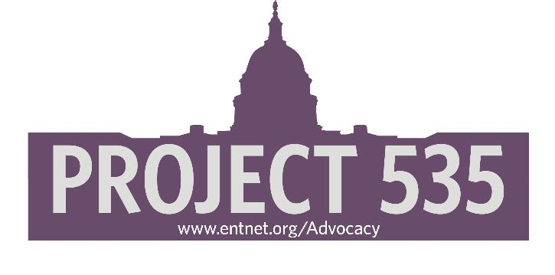
PROJECT 535
BOG-sponsored advocacy initiative launched in September 2015.
Goal: Recruit “key contacts” for all Members of Congress
435 Members of the U.S. House of Representatives
100 Members of the U.S. Senate
Territories (6) also included.
Purpose: By using coordinated email and phone campaigns, we can improve our outreach to federal legislators when major issues impacting the specialty are debated by Congress.
Sign up at www.entnet.org/advocacy. The commitment is minimal, but the impact is immense!

