Slide 1
AAO-HNSF Clinical Practice Guideline: Tympanostomy Tubes
(Published July 2013)

Slide 2
Disclaimer
The clinical practice guideline is not intended as the sole source of guidance in insertion of tympanostomy tubes. Rather, it is designed to assist clinicians by providing an evidence-based framework for decision-making strategies. The guideline is not intended to replace clinical judgment or establish a protocol for all individuals with this condition and may not provide the only appropriate approach to diagnosing and managing this program of care. As medical knowledge expands and technology advances, clinical indicators and guidelines are promoted as conditional and provisional proposals of what is recommended under specific conditions but are not absolute. Guidelines are not mandates. These do not and should not purport to be a legal standard of care. The responsible physician, in light of all circumstances presented by the individual patient, must determine the appropriate treatment. Adherence to these guidelines will not ensure successful patient outcomes in every situation. The American Academy of Otolaryngology-Head and Neck Surgery Foundation emphasizes that these clinical guidelines should not be deemed to include all proper treatment decisions or methods of care or to exclude other treatment decisions or methods of care reasonably directed to obtaining the same results.

Slide 3
Burden
Insertion of tympanostomy tubes is the most common ambulatory surgery performed in children in the United States.
By age 3, nearly 1 in 15 children will have tubes inserted.
Children less than 7 years of age, are at increased risk of otitis media because their immature immune systems and poor function of the eustachian tube
Attendance at day care more than doubles the risk

Slide 4
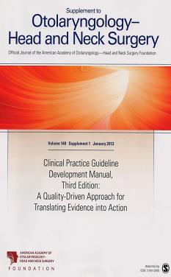
Clinical Practice Guideline Development Manual: Third Edition Rosenfeld, Shiffman, and Robertson
Pragmatic, transparent approach to creating guidelines for performance assessment
Evidence-based, multidisciplinary process leading to publication in 12-18 months
Emphasizes a focused set of key action statements to promote quality improvement
Uses action statement profiles to summarize decisions in recommendations
Otolaryngol Head Neck Surg 2013; 148(Suppl):S1-55

Slide 5
CPG Development
Developed using an explicit and transparent a priori protocol
Create actionable statements based upon the supporting evidence and associated balance of benefit and harm

Slide 6
CPG Goals
Focus on quality improvement opportunities
Define actionable statements for clinicians regardless of discipline to improve care
The guideline is not intended to be comprehensive
The guideline is not intended to limit or restrict care provided by clinicians to individual patients

Slide 7
CPG Leadership
Richard M. Rosenfeld, MD, MPH (Chair)
Seth R. Schwartz, MD, MPH (Methodologist)
Melissa Pynnonen, MD (Assistant Chair)
David Tunkel, MD (Assistant Chair)

Slide 8
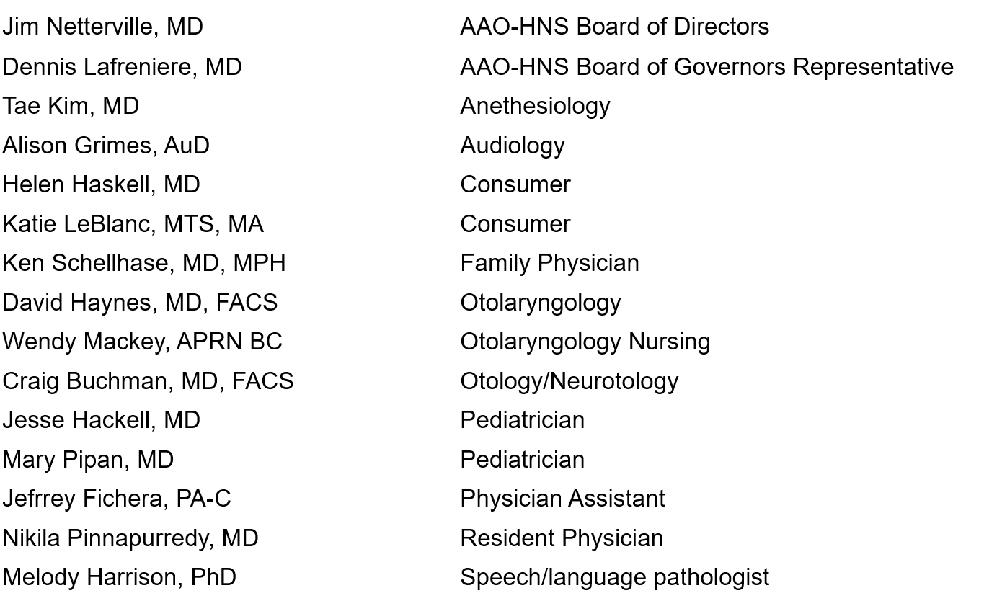
Multi-Disciplinary Panel

Slide 9
Literature Search
Performed by an information specialist from the Cochrane ENT Disorders Group
Clinical Practice Guidelines – 10 identified, four included in the final CPG
Systematic Reviews – 19 identified, 15 included in the final CPG
Randomized Controlled Trials – 171 identified, 113 included in the final CPG

Slide 10
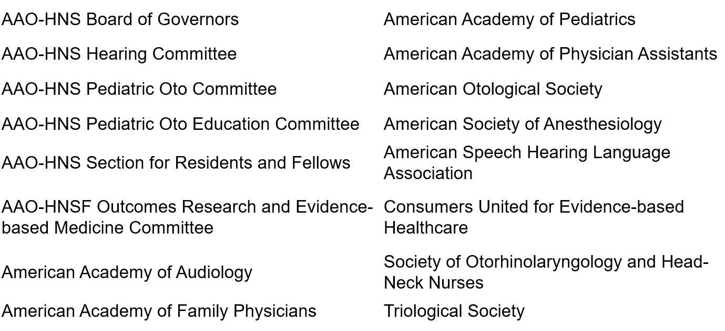
External Peer Review
37 reviewers from the 16 organizations/committees (listed below) submitted 444 comments. Resulted in 248 edits/changes to the draft CPG.

Slide 11
Target Population
Children ages 6 months to 12 years

Slide 12
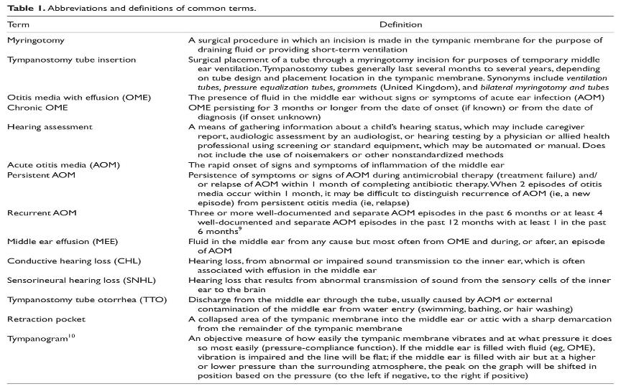
Definitions

Slide 13
Strength of Action Terms/Implied Levels of Obligation
Strength | Definition | Implied Obligation
Strong Recommendation | The benefits of the recommended approach clearly exceed the harms (or, in the case of a strong negative recommendation, the harms clearly exceed the benefits) and the quality of the supporting evidence is high (Grade A or B). | In some clearly identified circumstances, strong recommendations may be made based on lesser evidence when high-quality evidence is impossible to obtain, and the anticipated benefits strongly outweigh the harms. Clinicians should follow a strong recommendation unless a clear and compelling rationale for an alternative approach is present.
Recommendation | The benefits exceed the harms (or, in the case of a negative recommendation, the harms exceed the benefits), but the quality of evidence is not as high (Grade B or C). | In some clearly identified circumstances, recommendations may be made based on lesser evidence when high-quality evidence is impossible to obtain, and the anticipated benefits outweigh the harms. Clinicians should generally follow a recommendation but should remain alert to new information and remain sensitive to patient preferences.
Option | Either the quality of evidence is suspect (Grade D) or well-done studies (Grade A, B, or C) show little clear advantage to one approach versus another. | Clinicians should be flexible in their decision making regarding appropriate practice, although they may set bounds on alternatives; patient preference should have a substantial influencing role.

Slide 14
KAS 1: OME of Short Duration
Clinicians should not perform tympanostomy tube insertion in children with a single episode of OME of less than 3 months duration, from the date of onset (if known) or from the date of diagnosis (if onset is unknown). Recommendation against based on systematic review of observational studies of natural history and an absence of any randomized controlled trials on efficacy of tubes for children with OME less than 2-3 months duration and a preponderance of benefit over harm
Benefits: Avoidance of unnecessary surgery and its risks, avoidance of surgery in children for whom the benefits of tympanostomy tubes have not been studied and are uncertain, avoidance of surgery in children with a condition that has reasonable likelihood of spontaneous resolution, cost savings
Risks, harms, costs: Delayed intervention in children who do not recover spontaneously and or in children who develop recurrent episodes of MEE

Slide 15
KAS 1: OME of Short Duration
Action Statement Profile
Aggregate evidence quality: Grade C, based on a systematic review of observational studies and control groups in RCTs on the natural history of OME and an absence of any RCTs on efficacy of tympanostomy tubes for children with OME less than 2 months duration
Level of confidence in evidence: High
Benefit-harm assessment: Preponderance of benefit
Value judgments: Exclusion of children with OME less than 2 months duration from all published RCTs of tube efficacy was considered compelling evidence to question the value of surgery in this population, especially considering the known risks of tympanostomy tube surgery.
Role of patient (caregiver) preferences: Limited, because of good evidence that otherwise healthy children with OME of short duration do not benefit from tympanostomy tube insertion.
Exceptions: At risk children (Table 2); see Statements 6 and 7 for explicit information on at risk children.
Policy level: Recommendation

Slide 16
KAS 2: Hearing Testing
Clinicians should obtain an age-appropriate hearing test if OME persists for three months or longer OR prior to surgery when a child becomes a candidate for tympanostomy tube insertion. Recommendation based on observational and cross-sectional studies with a preponderance of benefit over harm.
Benefits: Documentation of hearing status, improved decision making regarding the need for surgery in chronic OME, establishment of baseline hearing prior to surgery, detection of coexisting sensorineural hearing loss
Risks, harms, costs: Cost of the audiologic assessment

Slide 17
KAS 2: Hearing Testing
Action Statement Profile
Aggregate evidence quality: Grade C, based on observational and cross-sectional studies assessing the prevalence of conductive hearing loss with OME
Level of confidence in evidence: High
Benefit-harm assessment: Preponderance of benefit
Intentional vagueness: The words age-appropriate audiologic testing are used to recognize that the specific methods will vary with the age of the child, but a full discussion of the specifics of testing is beyond the scope of this guideline
Role of patient (caregiver) preferences: Some, caregivers may decline testing
Policy level: Recommendation

Slide 18
KAS 3: Chronic Bilateral OME with Hearing Difficulty
Clinicians should offer tympanostomy tube insertion to children with bilateral OME for 3 months or longer AND documented hearing difficulties. Recommendation based on randomized controlled trials and observational studies, with a preponderance of benefit over harm.
Benefits: Reduced prevalence of MEE, improved hearing, improved child and caregiver QOL, optimization of auditory access for speech and language acquisition, elimination of a potential barrier to focusing and attention in a learning environment
Risks, harms, costs: Risk of anesthesia, sequelae of the indwelling tympanostomy tubes (e.g. otorrhea, granulation tissue, obstruction), complications after tube extrusion (myringosclerosis, retraction pocket, persistent perforation), failure of or premature tympanostomy tube extrusion, , tympanostomy tube medialization, procedural anxiety and discomfort, and direct procedural costs

Slide 19
KAS 3: Chronic Bilateral OME with Hearing Difficulty
Action Statement Profile
Aggregate evidence quality: Grade B, based on well-designed RCTs showing reduced MEE prevalence and improved hearing after tympanostomy tube insertion; observational studies documenting improved quality of life; and extrapolation of research and basic science principles for optimizing auditory access.
Level of confidence in the evidence: High.
Benefit-harm assessment: Preponderance of benefit over harm
Value judgments: Assumption that optimizing auditory access would improve speech and language outcomes, despite inconclusive evidence regarding the impact of MEE on speech and language development.
Intentional vagueness: The term “hearing difficulty” is used instead of “hearing loss” to emphasize that a functional assessment of how a child uses hearing and engages in their environment is important, regardless of what specific threshold is used to define hearing loss based on audiologic criteria.
Role of patient (caregiver) preferences: Substantial role for shared decision-making regarding the decision to proceed with, or to decline, tympanostomy tube insertion.
Policy level: Recommendation

Slide 20
KAS 4: Chronic OME with Symptoms
Clinicians may perform tympanostomy tube insertion in children with unilateral or bilateral OME for 3 months or longer (chronic OME) AND symptoms that are likely attributable to OME that include, but are not limited to, balance (vestibular) problems, poor school performance, behavioral problems, ear discomfort, or reduced quality of life. Option based on randomized controlled trials and before-and-after studies with a balance between benefit and harm
Benefits: Reduced prevalence of MEE, possible relief of symptoms attributed to chronic OME, elimination of MEE as a confounding factor from efforts to understand the reason or cause of a vestibular problem, poor school performance, behavioral problem, or ear discomfort
Risks, harms, costs: None related to offering surgery, but if performed, tympanostomy tube insertion includes risks from anesthesia, sequelae of the indwelling tympanostomy tubes (otorrhea, granulation tissue, obstruction), complications after tube extrusion (myringosclerosis, retraction pocket, persistent perforation), premature tympanostomy tube extrusion, retained tympanostomy tube, tympanostomy tube medialization, procedural anxiety and discomfort, and direct procedural costs

Slide 21
KAS 4: Chronic OME with Symptoms
Action Statement Profile
Aggregate evidence quality: Grade C, based on before-and-after studies on vestibular function and QOL, RCTs on reduced MEE after tubes for chronic OME, and observational studies regarding the impact of MEE on children as related, but not limited to, school performance, behavioral issues, and speech delay.
Level of confidence in evidence: High for vestibular problems and QOL; medium for poor school performance, behavioral problems, and ear discomfort, because of study limitations and the multifactorial nature of these issues.
Benefit-harm assessment: Equilibrium
Value judgments: Chronic MEE has been associated with problems other than hearing loss; intervening when MEE is identified can reduce symptoms. The group’s confidence in the evidence of a child benefitting from intervention was insufficient to conclude a preponderance of benefit over harm and instead found at equilibrium.
Intentional vagueness: The words “likely attributable” are used to reflect the understanding that the symptoms listed may have multifactorial causes, of which OME may be only one factor, and resolution of OME may not necessarily resolve the problem.
Role of patient (caregiver) preferences: Substantial role for shared decision-making regarding the decision to proceed with, or to decline, tympanostomy tube insertion.
Policy level: Option

Slide 22
KAS 5: Surveillance of Chronic OME
Clinicians should reevaluate, at 3- to 6-month intervals, children with chronic OME who do not receive tympanostomy tubes, until the effusion is no longer present, significant hearing loss is detected, or structural abnormalities of the tympanic membrane or middle ear are suspected. Recommendation based on observational studies, with a preponderance of benefit over harm.
Benefits: Detection of structural changes in the tympanic membrane that may require intervention, detection of new hearing difficulties or symptoms that would lead to reassessing the need for tympanostomy tube insertion, discussion of strategies for optimizing the listening-learning environment for children with OME, as well as ongoing counseling and education of parents/caregiver
Risks, harms, costs: Cost of examination(s)

Slide 23
KAS 5: Surveillance of Chronic OME
Action Statement Profile
Aggregate evidence quality: Grade C, based on observational studies
Level of confidence in evidence: High
Benefit-harm assessment: Preponderance of benefit over harm
Value judgments: Although it is uncommon, untreated OME can cause progressive changes in the tympanic membrane that require surgical intervention. There was an implicit assumption that surveillance and early detection/intervention could prevent complications and would also provide opportunities for ongoing education and counseling of caregivers
Intentional vagueness: The surveillance interval is broadly defined at 3 to 6 months to accommodate provider and patient preference; “significant” hearing loss is broadly defined as one that is noticed by the caregiver, reported by the child, or interferes in school performance or quality of life.
Role of patient (caregiver) preferences: Opportunity for shared decision making regarding the surveillance interval
Policy level: Recommendation

Slide 24
KAS 6: Recurrent AOM Without MEE
Clinicians should not perform tympanostomy tube insertion in children with recurrent acute otitis media who do not have middle ear effusion in either ear at the time of assessment for tube candidacy. Recommendation against based on systematic reviews and randomized controlled trials with a preponderance of benefit over harm.
Benefits: Avoid unnecessary surgery and its risks, avoid surgery in children for whom RCTs have not demonstrated any benefit for reducing AOM incidence or in children with a condition that has reasonable likelihood of spontaneous resolution, cost savings
Risks, harms, costs: Delay in intervention for children who eventually require tympanostomy tubes, need for systemic antibiotics among children who continue to have episodes of recurrent AOM

Slide 25
KAS 6: Recurrent AOM Without MEE
Action Statement Profile
Aggregate evidence quality: Grade A, based on a meta-analysis of RCTs, a systematic review of RCT control groups regarding the natural history of recurrent AOM, and other RCTs.
Level of confidence in evidence: High
Benefit-harm assessment: Preponderance of benefit over harm
Value judgments: Implicit in this recommendation is the ability to reassess children who continue to have AOM despite observation and to perform tympanostomy tube insertion if MEE is present (Statement #7); risk of complications or poor outcomes from delayed tube insertion for children who continue to have recurrent AOM is minimal.
Role of patient (caregiver) preferences: Limited, because of favorable natural history and good evidence that otherwise healthy children with recurrent AOM without MEE do not have a reduced incidence of AOM after tympanostomy tube insertion.
Exceptions: At risk children (see Table 2), children with histories of severe or persistent AOM, immunosuppression; prior complication of otitis media (mastoiditis, meningitis, facial nerve paralysis); multiple antibiotic allergy or intolerance.
Policy level: Recommendation

Slide 26
KAS 7: Recurrent AOM With MEE
Clinicians should offer tympanostomy tube insertion in children with recurrent AOM who have unilateral or bilateral MEE at the time of assessment for tube candidacy. Recommendation based on randomized controlled trials with minimal limitations and a preponderance of benefit over harm
Benefits: Mean decrease of approximately 3 episodes of AOM per year, ability to treat future episodes of AOM with topical antibiotics instead of systemic antibiotics, reduced pain with future AOM episodes, improved hearing during AOM episodes
Risks, harms, costs: Risks from anesthesia, sequelae of the indwelling tympanostomy tubes (otorrhea, granulation tissue, obstruction), complications after tube extrusion (myringosclerosis, retraction pocket, persistent perforation), premature tympanostomy tube extrusion, retained tympanostomy tube tympanostomy tube medialization, procedural anxiety and discomfort, and direct procedural costs

Slide 27
KAS 7: Recurrent AOM With MEE
Action Statement Profile
Aggregate evidence quality: Grade B, based on RCTs with minor limitations
Level of confidence in evidence: Medium; some uncertainty regarding the magnitude of clinical benefit and importance, because of heterogeneity in the design and outcomes of clinical trials.
Benefit-harm assessment: Preponderance of benefit over harm
Value judgments: In addition to the benefits seen in RCTs, the presence of effusion at the time of assessment served as a marker of diagnostic accuracy for AOM
Role of patient (caregiver) preferences: Substantial role for shared decision-making regarding the decision to proceed with, or to decline, tympanostomy tube insertion.
Policy level: Recommendation

Slide 28
KAS 8: At Risk Children
Clinicians should determine if a child with recurrent AOM or with OME of any duration is at increased risk for speech, language, or learning problems from otitis media because of baseline sensory, physical, cognitive, or behavioral factors Recommendation based on observational studies with a preponderance of benefit over harm.
Benefits: Facilitation of future decisions about tube candidacy, identification of children who might benefit from early intervention(including tympanostomy tubes), identification of children who might benefit from more active and accurate surveillance of middle ear status as well as those who require more prompt evaluation of hearing, speech, and language
Risks, harms, costs: None

Slide 29
KAS 8: At Risk Children
Action Statement Profile
Aggregate evidence quality: Grade C, based on observational studies
Level of confidence in evidence: High for Down syndrome, cleft palate, and permanent hearing loss; medium for other risk factors.
Benefit-harm assessment: Preponderance of benefit over harm
Value judgments: Despite the limited high quality evidence about the impact of tubes on this population (nearly all RCTs exclude children who are at risk) the panel considered it important to use at risk status as a factor in decision making about tube candidacy, building on recommendations made in the OME guideline. The panel assumed that at risk children would be less likely to tolerate OME or recurrent AOM than would the otherwise healthy child.
Role of patient (caregiver) preferences: None, since this recommendation deals only with acquiring information to assist in decision making.
Policy level: Recommendation

Slide 30
KAS 9: Tympanostomy Tubes and At Risk Children
Clinicians may perform tympanostomy tube insertion in at risk children with unilateral or bilateral OME that is unlikely to resolve quickly as reflected by a type B (flat) tympanogram or persistence of effusion for 3 months or longer. Option based on a systematic review and observational studies with a balance between benefit and harm.
Benefit: Improved hearing, resolution of MEE in at risk children who would otherwise have a low probability of spontaneous resolution, mitigates a potential obstacle to child development
Risk, harm, cost: Risk of anesthesia, sequelae of the indwelling tympanostomy tubes (otorrhea, granulation tissue, obstruction), complications after tube extrusion (myringosclerosis, retraction pocket, persistent perforation), failure of or premature tympanostomy tube extrusion, tympanostomy tube medialization, procedural anxiety and discomfort, and direct procedural costs

Slide 31
KAS 9: Tympanostomy Tubes and At Risk Children
Action Statement Profile
Aggregate evidence quality: Grade C based on a systematic review of cohort studies regarding natural history of type B tympanograms and observational studies examining the impact of MEE on at risk children
Level of confidence in evidence: Moderate to low, because of methodologic concerns with the conduct, outcome reporting, and follow up of available observational studies.
Benefit-harm assessment: Equilibrium
Value judgments: Despite the absence of controlled trials identifying benefits of tympanostomy tube placement in at risk children (such children were excluded from the reviews cited), the panel agreed that tympanostomy tubes were a reasonable intervention for reducing the prevalence of MEE that would otherwise have a low likelihood of prompt spontaneous resolution. Untreated persistent MEE would place the child at high risk for hearing loss from suboptimal conduction of sound through the middle ear, which could interfere with subsequent speech and language progress.
Role of patient (caregiver) preferences: Substantial role for shared decision-making with caregivers regarding whether or not to proceed with tympanostomy tube insertion
Policy level: Option

Slide 32
KAS 10: Perioperative Education
In the perioperative period, clinicians should educate caregivers of children with tympanostomy tubes regarding the expected duration of tube function, recommended follow up schedule, and detection of complications. Recommendation based on observational studies, with a preponderance of benefit over harm.
Benefits: Define appropriate caregiver expectations after surgery, enable caregivers to recognize complications early, and improve caregiver understanding of the importance of follow up.
Risks, harms, costs: None

Slide 33
KAS 10: Perioperative Education
Action Statement Profile
Aggregate evidence quality: Grade C, based on observational studies with limitations
Level of confidence in evidence: Medium; there is good evidence and strong consensus on the value of patient education and counseling, in general, but evidence on how this education and counseling impacts outcomes of children with tympanostomy tubes is limited.
Benefit-harm assessment: Preponderance of benefit over harm
Value judgments: Importance of patient education in promoting optimal outcomes
Role of patient (caregiver) preferences: None, since this recommendation deals only with providing information for proper management.
Policy level: Recommendation

Slide 34
KAS 11: Acute Tympanostomy Tube Otorrhea
Clinicians should prescribe topical antibiotic eardrops only, without oral antibiotics, for children with uncomplicated acute tympanostomy tube otorrhea. Strong recommendation based on randomized controlled trials with a preponderance of benefit over harm.
Benefits: Increased efficacy by providing appropriate coverage of otorrhea pathogens, including Pseudomonas aeruginosa and methicillin-resistant Staphylococcus aureus (MRSA), avoidance of unnecessary overuse and adverse effects of systemic antibiotics, including bacterial resistance
Risks, harms, costs: Additional expense of topical otic antibiotics compared with oral antibiotics, potential difficulties in drug delivery to the middle ear if presence of obstructing debris or purulence in the ear canal

Slide 35
KAS 11: Acute Tympanostomy Tube Otorrhea
Action Statement Profile
Aggregate evidence quality: Grade B, based on RCTs demonstrating equal efficacy of topical versus oral antibiotic therapy for otorrhea as well as improved outcomes with topical antibiotic therapy when different topical preparations are compared
Level of confidence in evidence: High
Benefit-harm assessment: Preponderance of benefit over harm
Value judgments: Emphasis on avoiding systemic antibiotics due to known adverse events and potential for induced bacterial resistance
Role of patient (caregiver) preferences: Limited, because there is good evidence that topical antibiotic eardrops are safer than oral antibiotics and have equal efficacy
Exceptions: Children with complicated otorrhea, cellulitis of adjacent skin, concurrent bacterial infection requiring antibiotics (eg, bacterial sinusitis, group A strep throat), or those children who are immunocompromised
Policy level: Strong recommendation

Slide 36
KAS 12: Water Precautions
Clinicians should not encourage routine, prophylactic water precautions (use of earplugs or headbands; avoidance of swimming or water sports) for children with tympanostomy tubes. Recommendation against based on randomized controlled trials with limitations, observational studies with consistent effects, and a preponderance of benefit over harm.
Benefits: Allows for normal activity and swimming, reduced anxiety, cost savings
Risk, harm, cost: Potential for slight increase in otorrhea rates in some children

Slide 37
KAS 12: Water Precautions
Action Statement Profile
Aggregate evidence quality: Grade B, based on 1 randomized controlled trial and multiple observational studies with consistent effects
Level of confidence in evidence: High
Benefit-harm assessment: Preponderance of benefit over harm
Value judgments: Importance of not restricting or limiting children’s water activity in the absence of proven, clinically significant benefits of routine water precautions
Intentional vagueness: The word routine is used to soften the recommendation since individual children may benefit from water precautions in specific situations (eg, lake swimming, deep diving, recurrent otorrhea, head dunking in the bathtub, or otalgia from water entry into the ear canal)
Role of patient (caregiver) preferences: Significant role in deciding whether or not to use water precautions based on the child’s specific needs, comfort level, and tolerance of water exposure.
Exceptions: Children with tympanostomy tubes and (1) an active episode of otorrhea or (2) recurrent or prolonged otorrhea episodes, as well as those with a history of problems with prior water exposure
Policy level: Recommendation

Slide 38
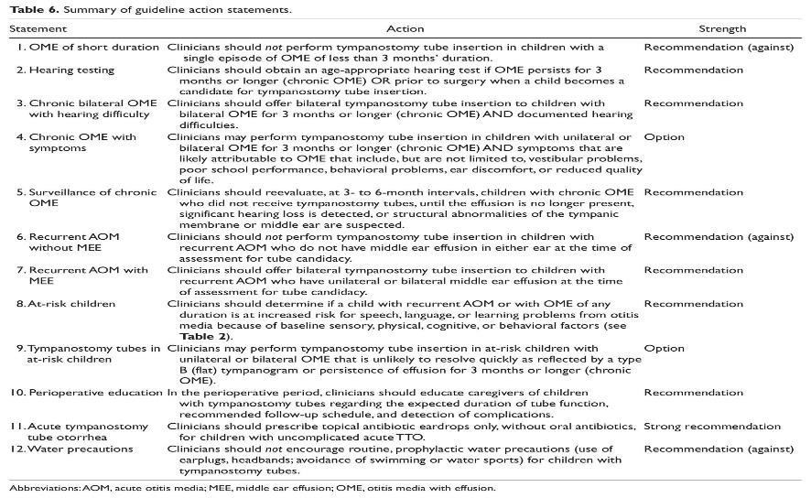
In Summary

Slide 39
Research Needs
Chronic OME with Hearing Difficulty
Identify alternatives to formal audiologic assessment, including clinical measures, so that we can identify children with hearing difficulties
Study of the benefits of postoperative assessment (when, how often, by whom)
Better understand variations in access to audiometry services, particularly access to pediatric audiometry
Better understand differential effect on speech and language outcomes based on children’s age at intervention for hearing loss
Study of actual clinical significance of effects of tympanostomy tubes on long-term HLs and the presence of tympanic membrane structural changes

Slide 40
Research Needs (cont’d)
Chronic OME with Symptoms
Study of differences in effects of OME on children of varying ages
Study of effects of unilateral versus bilateral OME
Better understand the effect of unilateral OME on outcomes: vestibular, school performance, behavior, and ear discomfort
Among children with OME, obtain data on the magnitude and effect size of the long-term hearing deficits well as the presence of tympanic membrane structural changes
Among children with OME, study of the long-term effects of middle ear fluid on the ear drum in absence of hearing issues—determine the natural history of asymptomatic middle ear fluid role for more aggressive management of ear disease

Slide 41
Research Needs (cont’d)
Recurrent AOM without MEE
Research is needed to develop criteria to identify the subset of recurrent AOM patients, without current effusion, who will develop additional ear infections or long-term effusions in the future
Recurrent AOM with MEE
Improve documentation of AOM diagnosis and recurrent AOM diagnostic accuracy
Determine whether the precision with which AOM is diagnosed changes the predicted effectiveness of tympanostomy tubes for recurrent AOM; determine whether studies that demand such diagnostic accuracy and stricter entry criteria show a greater benefit for tympanostomy tubes in children with recurrent AOM
Characterize QOL for recurrent AOM with tympanostomy tubes versus without tube placement
Randomized controlled trials to provide effect sizes for benefit of surgery over observation among this patient population; existing studies are deficient in that they have not clearly separated patients with AOM based on presence or absence of fluid at diagnosis

Slide 42
Research Needs (cont’d)
Distinguishing At-Risk Children
Need better data on the prevalence of at-risk conditions and strategies to identify at-risk children
Need epidemiological evidence for the prevalence of MEE and sequelae of MEE in at-risk children with conditions other than Down syndrome or cleft palate as well as the acceptability, effectiveness, and consequences of various treatment strategies
Among at-risk children with OME of medium duration, clarify the role for more aggressive management of ear disease

Slide 43
Research Needs (cont’d)
Tympanostomy Tubes and At-Risk Children
Better understand the impact of tympanostomy tube placement among children with speech/language delay
Better understand the indications and outcomes for tympanostomy tube placement in children with Down syndrome or with cleft palate, since existing randomized trials cannot be generalized to these populations; ideally, these studies should be prospective, include long-term follow-up, distinguish children younger than 24 months from older children, and have children treated with tympanostomy tubes matched to control children by age and HLs
Additional data regarding the efficacy of tubes in preventing sequelae of MEE in at-risk patients
Compare the efficacy of hearing aids versus tympanostomy tubes for at-risk children with chronic OME and hearing loss
Determine the role of long-term versus short-term tubes in children with cleft palate or Down syndrome.
Develop educational materials for patients, parents/caregivers, and primary care providers and surgical/medical specialists to raise awareness of the at-risk status of these patients
Assess whether at-risk children have the same risk profile for surgical and anesthetic complications

Slide 44
Research Needs (cont’d)
Hearing Resting
Potential implementation hurdles with regard to access to hearing testing and audiometry; need a study to understand possible barriers to audiologic testing
Determine the role for formal audiologic testing versus a hearing screening test—such as performed by primary care physicians—for follow-up for otherwise low-risk children
Validation of a clinical proxy for detecting the probable presence of hearing loss when audiology is not available or is unreliable
Assess the validity of parental/caregiver reports regarding improved hearing following tube placement and whether there is added benefit of objective assessment
Evidence for best use of postoperative audiologic assessment; determine patient population needs postoperative audiologic assessment: assess all children, only those with preoperative hearing loss, or only those children with parent/caregiver concern regarding persistent hearing loss

Slide 45
Research Needs (cont’d)
Acute TTO
Determine the impact of tympanostomy tube placement on middle ear bacteriology and whether these changes affect selection of treatment of AOM after tympanostomy tubes
Determine the ideal duration of topical therapy for posttympanostomy otorrhea
In the setting of recurrent, persistent, or chronic otorrhea, determine when is it advisable to remove a tube
Water Precautions
Studies of clinical indicators (swimming locale, host factors such as age, number of AOM episodes, immune status, etc.) for more routine recommendation of water precautions after tubes

Slide 46
Research Needs (cont’d)
Perioperative Education
Research is needed to characterize the effectiveness of various methods of perioperative education about tubes; modalities to include voice, written, video, web-based, other; timing to include preoperative, at surgery, postoperative; educators to include nurse, surgeon, primary care physician, other
Anesthesia
Need for more information about the morbidity and mortality of general mask anesthesia for tympanostomy tube placement in children

Slide 47
Choosing Wisely®
It is an initiative of the American Board of Internal Medicine (ABIM) Foundation.
Aims to encourage discussions between physicians and patients about appropriate care.
Each of the campaign’s organization partners is asked to identify (initially) 5 items within its specialty that physicians and patients should question. The AAO-HNSF list has now grown to 10 items.
The AAO-HNSF’s list of recommendations were carefully selected after a review of the current evidence that included AAO-HNSF clinical practice guidelines.
More information is available at www.entnet.org/ChoosingWisely
What is Choosing Wisely®?

Slide 48
AAO-HNSF List of 10 Things Physicians and Patients Should Question
The Initial List

Slide 49
AAO-HNSF List of 10 Things Physicians and Patients Should Question
The Second List

Slide 50
AAO-HNSF List of 10 Things Physicians and Patients Should Question
Oral antibiotics have significant adverse effects and do not provide adequate coverage of the bacteria that cause most episodes; in contrast, topically administered products do provide coverage for these organisms. Avoidance of oral antibiotics can reduce the spread of antibiotic resistance and the risk of opportunistic infections.
What Statement Relates to this Clinical Practice Guideline?
Ear fluid of short duration is likely to resolve spontaneously. The child should be monitored to ensure resolution of the fluid. In children with comorbid conditions or speech delay, earlier tube placement may be appropriate.

Slide 51
Thank you for your attention
QUESTIONS?

