Slide 1
AAO-HNSF Clinical Practice Guideline: Sudden Hearing Loss (Update)
Update to 2012 Guideline
Publication Date: August 1, 2019

Slide 2
Disclaimer
The clinical practice guideline is not intended as the sole source of guidance in managing patients with SHL. Rather, it is designed to assist clinicians by providing an evidence-based framework for decision-making strategies. The guideline is not intended to replace clinical judgment or establish a protocol for all individuals with this condition and may not provide the only appropriate approach to managing this problem. As medical knowledge expands and technology advances, clinical indicators and guidelines are promoted as conditional and provisional proposals of what is recommended under specific conditions but are not absolute. Guidelines are not mandates. These do not and should not purport to be a legal standard of care. The responsible physician, in light of all circumstances presented by the individual patient, must determine the appropriate treatment. Adherence to these guidelines will not ensure successful patient outcomes in every situation. The AAO-HNSF emphasizes that these clinical guidelines should not be deemed to include all proper treatment decisions or methods of care or to exclude other treatment decisions or methods of care reasonably directed to obtaining the same results.

Slide 3
AAO-HNSF Guideline Update Group
Sujana S. Chandrasekhar, MD, Chair
Betty Tsai Do, MD, Assistant Chair
Seth R. Schwartz, MD, MPH, Methodologist
Laura Bontempo, MD, MEd, American Academy of Emergency Medicine (AAEM)
Erynne A. Faucett, MD, AAO-HNSF Section for Residents and Fellows (SRF)
Sandra A. Finestone, PsyD, Consumers United for Evidence-based Healthcare (CUE)
Deena B. Hollingsworth, MSN, FNP-BC, CORLN, Society of Otorhinolaryngology Head-Neck Nurses
David M. Kelley, MD, American Academy of Family Physicians
Steven Kmucha, MD, JD, AAO-HNSF Board of Governors
Gul Moonis, MD, American College of Radiology (ACR)
Gayla L. Poling, PhD, CCC-A, American Speech-Language Hearing Association (ASHA)
J. Kirk Roberts, MD, American Academy of Neurology (AAN)
Robert J. Stachler, MD, AAO-HNSF Physician Payment Policy (3P) Workgroup
Daniel M. Zeitler, MD, AAO-HNSF Hearing Committee
Maureen D. Corrigan, AAO-HNSF Staff Liaison
Lorraine C. Nnacheta, MPH, DrPH, AAO-HNSF Staff Liaison
Lisa Satterfield, MS, MPH, AAO-HNSF Staff Liaison

Slide 4
Clinical Practice Guideline Development Manual: Third Edition Rosenfeld, Shiffman, and Robertson
Pragmatic, transparent approach to creating guidelines for performance assessment
Evidence-based, multidisciplinary process leading to publication in 12-18 months
Emphasizes a focused set of key action statements to promote quality improvement
Uses action statement profiles to summarize decisions in recommendations

Slide 5
Clinical Practice Guidelines (CPG) Goals
Focus on quality improvement opportunities
Define actionable recommendations for clinicians regardless of discipline to improve care
The guideline is not intended to be comprehensive
The guideline is not intended to limit or restrict care provided by clinicians to individual patients

Slide 6
What is Sudden Hearing Loss (SHL)?
SHL definition:
Rapid-onset subjective sensation of hearing impairment in one or both ears.
The hearing loss in SHL may be conductive (CHL), sensorineural (SNHL), or mixed (MHL).
This CPG Update is limited to SSNHL, defined as:
A subset of SHL that is
a) sensorineural in nature,
b) occurs within a 72-hour window and
c) consists of a decrease in hearing of >30 dB affecting at least three consecutive frequencies
Idiopathic SSNHL – ISSNHL - defined as:
SSNHL with no identifiable cause despite adequate investigation

Slide 7
Burden of Sudden Hearing Loss
The incidence of SSNHL in the U.S. is 5 to 27 per 100,000 people annually
Some estimates range as high as 160 per 100,000.
The US data may be underestimated:
Individuals who experience mild SHL and/or quick, spontaneous resolution may not seek medical care.
Most patients with SHL begin their medical journey at an emergency room, walk-in/urgent care clinic, or at their primary care physician’s office.
Conservatively, this represents between 15,000 to 60,000 patients seen in urgent, emergency, or primary care for this problem annually.
Patients with sudden unilateral hearing loss have immediate difficulty with both conversation on the involved side, and overall hearing in noisy environments.
In SSNHL, hearing asymmetry often results in the inability to localize sound
Frustrating and disorienting to the listener
May pose safety concerns

Slide 8
Purpose & Target Audience
PURPOSE: The primary purpose of this guideline is to provide clinicians with evidence-based recommendations in evaluating patients with SHL, with particular emphasis on managing SSNHL.
TARGET PATIENT: adults aged 18 and older with sudden hearing loss.
TARGET AUDIENCE: The guideline is intended for all clinicians who are likely to diagnose and manage adults aged 18 and older with sudden hearing loss and applies to any setting in which an adult with sudden hearing loss would be identified, managed, or monitored.

Slide 9
What’s new?
Incorporation of new evidence profiles include:
QI opportunities, confidence in the evidence, and differences of opinion.
27 new systematic reviews
26 new randomized controlled trials included.
Highlighting the urgency of evaluation and initiation of treatment.
Terminology of unclear statements clarified.
SSNHL means idiopathic SSNHL (ISSNHL): >90% of SSNHL is ISSNHL.
Addition of an algorithm outlining key action statements.
Enhanced emphasis on patient education and shared decision making with tools provided.

Slide 10
Patient has sudden hearing loss.

Slide 11
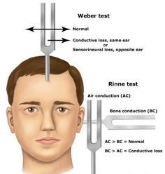
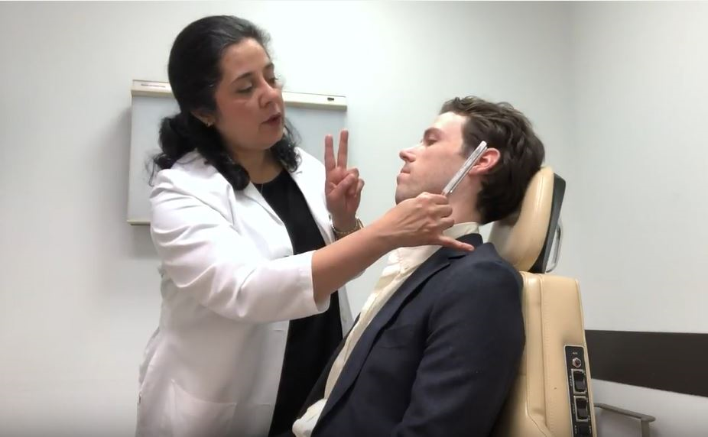
STATEMENT 1. EXCLUSION OF CHL
STATEMENT 1: EXCLUSION OF CHL: Clinicians should distinguish SNHL from CHL when a patient first presents with SHL. Strong recommendation based on systematic reviews and cross-sectional studies with a preponderance of benefit over harm.
Benefit: Guide the choice of appropriate diagnostic tests, avoid misdiagnosis, improve diagnostic accuracy, ensure that treatment is consistent with diagnosis, guide patient expectations, identify CHL that can be treated and resolved.
Risks, harms, costs: None
https://youtu.be/K2uDW5CoGNY

Slide 12
STATEMENT 1. EXCLUSION OF CHL
Action Statement Profile
Quality improvement opportunity: Identifying patients who are appropriate for the guideline rec­ommendations and those with CHL who may ben­efit from other therapies.
Aggregate evidence quality: Grade B, based on evidence that a common cause of CHL, cerumen impaction, can be treated effectively to improve hearing. Grade C, for evidence that CHL and SNHL can be distinguished by history, examina­tion, and tuning fork tests.
Level of confidence in evidence: High
Benefits-harm assessment: Preponderance of bene­fit over harm
Value judgments: Panel consensus that despite a lack of systematic research evidence supporting this action, distinguishing SNHL was an essential first step in appropriate subsequent management
Intentional vagueness: None
Role of patient preference: None
Exceptions: None
Policy Level: Strong recommendation
Differences of opinion: None

Slide 13
STATEMENT 2. MODIFYING FACTORS
STATEMENT 2: MODIFYING FACTORS: Clinicians should assess patients with presumptive SSNHL through history and physical examination for bilateral SHL, recur­rent episodes of SHL, and/or focal neurologic findings. Recommendation based on observational studies with a preponderance of benefit over harm.
Benefit: Identification of patients with a high likelihood of alternative and potentially serious underlying cause, who require specialized assess­ment and management.
Risks, harms, costs: Time of assessment.

Slide 14
STATEMENT 2. MODIFYING FACTORS
Action Statement Profile
Quality improvement opportunity: Identify patients with potentially serious alternative condi­tions for whom the subsequent guideline recom­mendations do not apply.
Aggregate evidence quality: Grade C, based on observational studies and case series studies
Level of confidence in evidence: High
Benefits-harm assessment: Preponderance of bene­fit over harm
Value judgments: None
Intentional vagueness: None
Role of patient preference: None
Exceptions: None
Policy Level: Recommendation
Differences of opinion: None

Slide 15
Patient has Sudden HL. What tests should NOT be ordered in the Emergency Room?

Slide 16
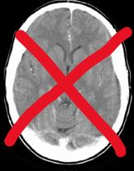
STATEMENT 3. COMPUTED TOMOGRAPHY
STATEMENT 3: COMPUTED TOMOGRAPHY: Clinicians should not order routine computed tomography (CT) of the head in the initial evaluation of a patient with presumptive SSNHL. Strong recommendation against based on systematic reviews with a preponderance of benefit over harm for not obtaining CT.
Benefit: Avoidance of radiation, cost savings, reduced incidental findings, less inconvenience for the patient, avoiding false sense of security from false-negative scan.
Risks, harms, costs: None

Slide 17
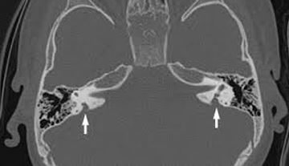
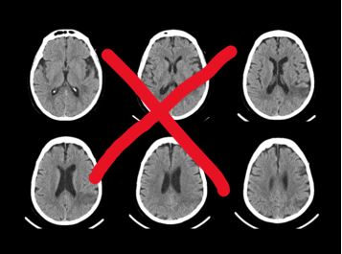
STATEMENT 3. COMPUTED TOMOGRAPHY
Action Statement Profile
Quality improvement opportunity: Avoiding unnecessary imaging
Aggregate evidence quality: Grade B, based on systematic reviews and appropriateness criteria from the American College of Radiology (ACR), plus observational studies clearly documenting the potential harms of radiation and side effects of intravenous (IV) contrast
Level of confidence in evidence: High
Benefits-harm assessment: Preponderance of benefit over harm.
Value judgments: None
Intentional vagueness: The word ‘‘routine’’ in radiology parlance means thick-cut CT of the head. Additionally, this indicates that while head CT to rule out intracranial bleed is not warranted in the absence of targeted neurologic findings, targeted imaging may be indicated if signs or clinical findings suggest an underlying etiology that is being explored. The panel recognizes that the terms ‘‘initial evaluation’’ are vague, but the intent is to discourage the routine use of CT scanning of the head/brain when patients initially present with SSNHL
Role of patient preference: Small
Exceptions: Patients with focal neurologic findings
Policy Level: Strong recommendation
Differences of opinion: None

Slide 18
What test should be ordered? And how soon?

Slide 19
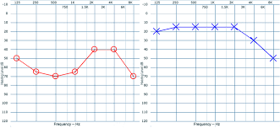
STATEMENT 4. AUDIOMETRIC CONFIRMATION OF SSNHL
STATEMENT 4. AUDIOMETRIC CONFIRMATION OF SSNHL: In patients with SHL clinicians should obtain, or refer to a clinician who can obtain, audiometry as soon as possible (within 14 days of symptom onset) to confirm the diagnosis of SSNHL. Recommendation based on RCTs with a preponderance of benefit over harm.
Benefit: Guiding treatment, identifying urgent conditions that require prompt management, ensuring that interventions for SSNHL are offered to those patients who meet appropriate audiometric criteria for diagnosis.
Risks, harms, costs: Potential delay in treatment until audiometry is obtained; direct cost of audiometry

Slide 20
STATEMENT 4. AUDIOMETRIC CONFIRMATION OF SSNHL
Action Statement Profile
Quality improvement opportunity: Ensuring an accurate diagnosis (National quality strategy: Prevention and Treatment of Leading Causes of Morbidity and Mortality; Effective Communication and Care Coordination)
Aggregate evidence quality: Grade C, based on criteria used in RCTs assessing the benefits and timing for intervention for SSNHL
Level of confidence in evidence: High
Benefits-harm assessment: Preponderance of benefit over harm
Value judgments: Treatments are more likely to be effective if offered early. The expediency of diagnosis is necessary to ensure that treatment can be offered within a reasonable therapeutic window.
Intentional vagueness: Although most of the group felt that earlier is better, the words ‘‘as soon as possible (within 14 days of symptom onset)’’ were used, given that barriers to access to care may make it unreasonable to set an earlier time point.
Role of patient preference: None
Exceptions: When audiometry is not available, clinical judgment should be used, based on history, examination, and tuning fork evaluation. Lack of audiometry should not preclude discussion of, and initiation of, treatment.
Policy Level: Recommendation
Differences of opinion: While everyone in the group agreed that audiometry is necessary, there were differences of opinion regarding how expediently the test should be obtained. Some members felt that it should be within 72 hours while others felt within 2 weeks was adequate. We agreed on the current language that sets an outside limit on how long it can be, while encouraging earlier testing if feasible.

Slide 21
We’ve got to get some blood tests, right?

Slide 22
STATEMENT 5. LABORATORY TESTING
STATEMENT 5. LABORATORY TESTING: Clinicians should not obtain routine laboratory tests in patients with SSNHL. Strong recommendation against based on 1 large cross-sectional study and a large number of other studies as well as a preponderance of benefit over harm.
Benefit: Cost containment, avoidance of stress and anxiety of patient, avoidance of false positives
Risks, harms, costs: Missed diagnosis

Slide 23
STATEMENT 5. LABORATORY TESTING
Action Statement Profile
Quality improvement opportunity: Avoidance of unnecessary testing (National quality strategy: Making Quality Care More Affordable)
Aggregate evidence quality: Grade B, based on cross-sectional studies and case series showing no benefit
Level of confidence in evidence: High
Benefits-harm assessment: Preponderance of benefit over harm
Value judgments: Minimizing testing and the risks of false positives outweigh the value of finding a potential cause
Intentional vagueness: The word ‘‘routine’’ was to discourage a nontargeted approach to use of laboratory assessment. It is recognized that specific laboratory tests may be useful in assessing these patients based on specific individual patient conditions
Role of patient preference: Small
Exceptions: None
Policy Level: Strong recommendation
Differences of opinion: None

Slide 24
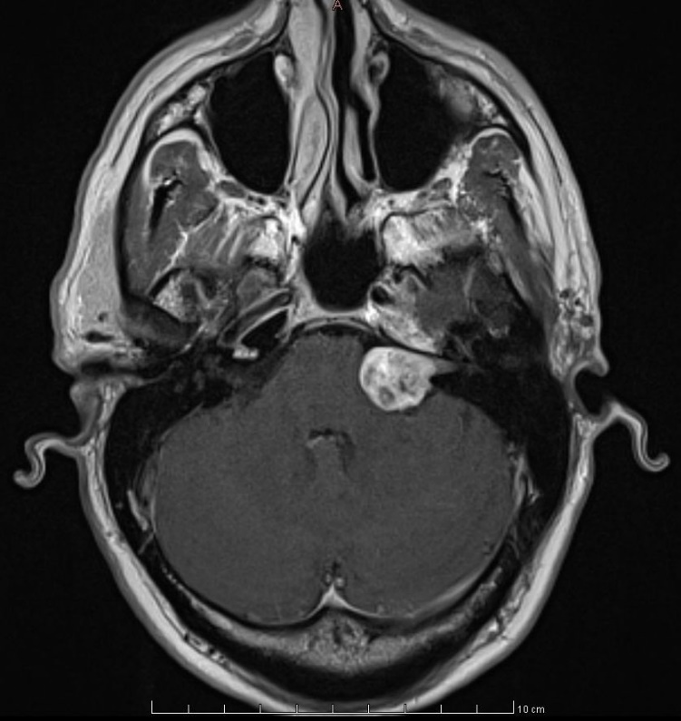
STATEMENT 6. RETROCOCHLEAR PATHOLOGY
STATEMENT 6. RETROCOCHLEAR PATHOLOGY: Clinicians should evaluate patients with SSNHL for retrocochlear pathology by obtaining an MRI or auditory brainstem response (ABR). Recommendation based on observational studies and a meta-analysis with a preponderance of benefit over harm.
Benefit: Identify vestibular schwannoma or other tumors in the IAC or cerebellopontine angle, identify conditions that might benefit from early treatment, patient peace of mind, supporting idiopathic diagnosis
Risks, harms, costs: Procedure specific risks/costs, anxiety, and stress

Slide 25
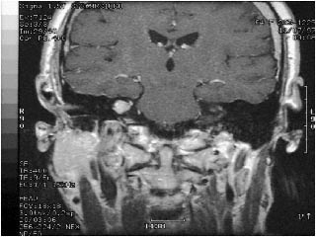
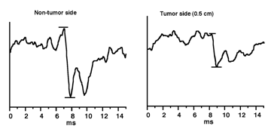
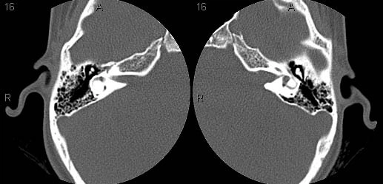
STATEMENT 6. RETROCOCHLEAR PATHOLOGY
Action Statement Profile
Quality improvement opportunity: Identify an underlying cause of the hearing loss that may have other implications and treatment recommendations (National quality strategy: Prevention and Treatment of Leading Causes of Morbidity and Mortality)
Aggregate evidence quality: Grade B for MRI, Grade C for ABR based on observational studies and a meta-analysis
Level of confidence in evidence: High
Benefits-harm assessment: Preponderance of benefit over harm
Value judgments: Although the panel agreed that MRI is the most sensitive means for diagnosing retrocochlear pathology, there was no consensus that identifying this pathology would in all cases influence outcomes. The panel therefore concluded that ABR (with follow-up MRI if abnormal) would be an acceptable alternative for initial assessment for retrocochlear pathology in SSNHL as long as there is appropriate counseling about the limitations of this modality.
Intentional vagueness: The time frame and the health care professional responsible for ordering tests to assess for retrocochlear pathology are not specified. The panel felt that this should happen at some point in the care of the patient and that this would most likely be ordered by the treating otolaryngologist or otologist/neurotologist.
Role of patient preference: Small in deciding whether or not to assess for retrocochlear pathology; large in making shared decisions with the clinician for using MRI or ABR as the diagnostic test.
Exceptions: None
Policy Level: Recommendation
Differences of opinion: None

Slide 26
What about a patient with SSNHL who recovers their hearing? Do they need an MRI too?
Vestibular Schwannoma Prevalence in SSNHL patients
Sudden HL in 10 -20% of acoustic neuroma
Improvement in 26 pts (28%)
Of those treated 51% improved
Many had other risk factors for ISSNHL
No significant effect of
treatment type
audio or ENG findings
tumor size
Overall Abnormal MRI Findings in SSNHL = 11%-31%

Slide 27
STATEMENT 7. PATIENT EDUCATION
STATEMENT 7. PATIENT EDUCATION: Clinicians should educate patients with SSNHL about the natural history of the condition, the benefits and risks of medical interventions, and the limitations of existing evidence regarding efficacy. Strong recommendation based on systematic reviews with a preponderance of benefit over harm.
Benefit: Facilitate shared decision making, increase patient adherence to proposed therapy, empower patients, informed consent, link evidence to clinical decisions
Risks, harms, costs: Time spent, miscommunication, patients get overwhelmed, patient anxiety

Slide 28
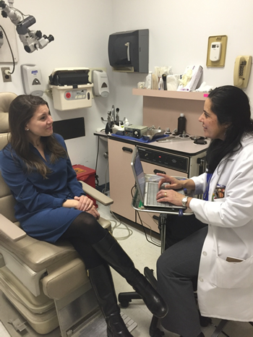
STATEMENT 7. PATIENT EDUCATION
Action Statement Profile
Quality improvement opportunity: Improve awareness of the natural history of SHL and the myriad treatment options to improve patient involvement in shared decision making (National Quality Strategy: Health and Well-being of Communities; Effective Communication and Care Coordination)
Aggregate evidence quality: Grade B, based on systematic reviews
Level of confidence in evidence: High
Benefits-harm assessment: Preponderance of benefit over harm
Value judgments: Based on the unclear benefit of primary treatments for SHL, patients should be informed regarding the uncertainty in treatment effectiveness to make an informed treatment decision
Intentional vagueness: None
Role of patient preference: Large
Exceptions: None
Policy Level: Strong recommendation
Differences of opinion: None

Slide 29
STATEMENT 8. INITIAL CORTICOSTEROIDS
STATEMENT 8. INITIAL CORTICOSTEROIDS: Clinicians may offer corticosteroids as initial therapy to patients with SSNHL within 2 weeks of symptom onset. Option based on systematic reviews of RCTs and new RCTs and a balance of benefit and harm.
Benefit: Hearing improvement
Risks, harms, costs:
Systemic steroids: Suppression of hypothalamicpituitary-adrenal axis and Cushing’s-like syndrome (minimal with 10- to 14-day treatment); aseptic necrosis of the hip; hyperglycemia; low cost
IT corticosteroids: minimal systemic effect; local reactions of pain, tympanic membrane perforation, transient dizziness; high cost and multiple office visits

Slide 30
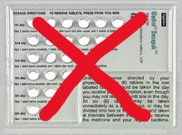
STATEMENT 8. INITIAL CORTICOSTEROIDS
Action Statement Profile
Quality improvement opportunity: More selective and appropriate use of a treatment option with modest potential benefit but only when used appropriately (National quality strategy: Prevention and Treatment of Leading Causes of Morbidity and Mortality; Effective Communication and Care Coordination)
Aggregate evidence quality: Grade C, based on RCTs and systematic reviews of randomized trials downgraded for methodological limitations and again for inconsistent results
Level of confidence in evidence: Medium
Benefits-harm assessment: Balance of benefit and harm
Value judgments: Even a small possibility of hearing improvement makes this a reasonable treatment to offer patients, considering the profound impact on QOL that hearing improvement may offer
Intentional vagueness: None
Role of patient preference: Large role for shared decision making with patients
Exceptions: Systemic steroids: medical conditions affected by corticosteroids, such as insulin dependent or poorly controlled diabetes, tuberculosis, peptic ulcer disease, among others
Policy Level: Option
Differences of opinion: While all members of the GUG favored having steroids as an option as early as possible, several group members were reluctant to endorse the 2-week time frame due to concerns that patients presenting later may be denied therapy. We ultimately agreed to leave the time frame of 2 weeks to encourage patients and clinicians to seek care early if they choose to be treated.
Correct Dose of Oral Steroids is Prednisone 1 mg/kg/day x 7-10 days, then taper.

Slide 31
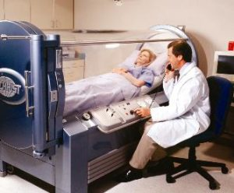
STATEMENT 9a. INITIAL THERAPY WITH HYPERBARIC OXYGEN THERAPY STATEMENT 9b. SALVAGE THERAPY WITH HYPERBARIC OXYGEN THERAPY
STATEMENT 9a. INITIAL THERAPY WITH HYPERBARIC OXYGEN THERAPY: Clinicians may offer, or refer to a clinician who can offer, hyperbaric oxygen therapy (HBOT) combined with steroid therapy within 2 weeks of onset of SSNHL. Option based on systematic reviews of RCTs with a balance between benefit and harm.
STATEMENT 9b. SALVAGE THERAPY WITH HYPERBARIC OXYGEN THERAPY: Clinicians may offer, or refer to a clinician who can offer, hyperbaric oxygen therapy (HBOT) combined with steroid therapy as salvage within 1 month of onset of SSNHL. Option based on systematic reviews of RCTs and new RCTs with a balance of benefit and harm.
Benefit: Hearing improvement
Risks, harms, costs: Costs, patient time/effort, patient anxiety and stress, hyperbaric-associated complications such as barotrauma, oxygen toxicity, worsening of cataracts, fatigue, seizure, and death

Slide 32
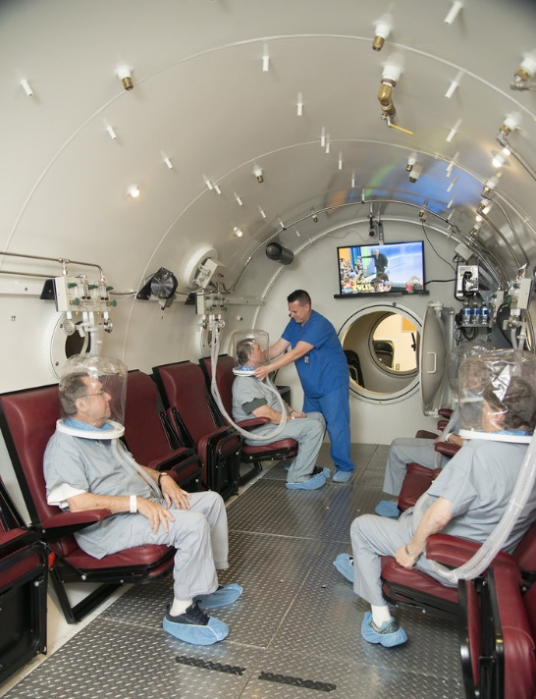
STATEMENT 9a. INITIAL THERAPY WITH HYPERBARIC OXYGEN THERAPY STATEMENT 9b. SALVAGE THERAPY WITH HYPERBARIC OXYGEN THERAPY
Action Statement Profile
Quality improvement opportunity: To allow the use of HBOT, which may have some limited benefit early after SHL as a potential option for primary or salvage therapy (National quality strategy: Prevention and Treatment of Leading Causes of Morbidity and Mortality; Effective Communication and Care Coordination; Patient Safety)
Aggregate evidence quality: Grade B, based on systematic review of RCTs with methodological limitations and new RCTs with limitations
Level of confidence in evidence: Medium
Benefits-harm assessment: Balance of benefit and harm
Value judgments: Although HBOT may not be readily available in all regions, the panel felt that the level of evidence for hearing improvement, albeit modest and imprecise, was sufficient to include HBOT as an option for patients with SSNHL
Intentional vagueness: None
Role of patient preference: Large role for shared decision making
Exceptions: None
Policy Level: Option
Differences of opinion: None

Slide 33
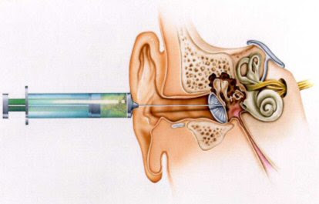
STATEMENT 10. IT STEROIDS FOR SALVAGE THERAPY
STATEMENT 10. IT STEROIDS FOR SALVAGE THERAPY: Clinicians should offer, or refer to a clinician who can offer, IT steroid therapy when patients have incomplete recovery from SSNHL 2 to 6 weeks after onset of symptoms. Recommendation based on systematic reviews of RCTs with a preponderance of benefit over harm.
Benefit: Hearing recovery
Risks, harms, costs: Perforation, discomfort, cost, patient anxiety

Slide 34
STATEMENT 10. IT STEROIDS FOR SALVAGE THERAPY
Action Statement Profile
Quality improvement opportunity: Encouraging the use of IT steroids, which may be effective to provide additional hearing recovery in patients with an incomplete response to initial therapy (National quality strategy: Prevention and Treatment of Leading Causes of Morbidity and Mortality)
Aggregate evidence quality: Grade B, based on RCTs with limitations and systematic reviews of RCTs with limitations
Level of confidence in evidence: High
Benefits-harm assessment: Preponderance of benefit over harm
Value judgments: None
Intentional vagueness: Patients qualifying for salvage therapy have had an incomplete recovery of hearing after 2 weeks from onset regardless of initial therapy. Incomplete recovery is not clearly defined, as there is limited guidance from the literature as to what level of residual hearing loss qualifies a patient for salvage. The GUG recognized that varying degrees of hearing loss will affect patients differently. This may govern the aggressiveness of the decision to pursue further therapy
Role of patient preference: Large role for shared decision making
Exceptions: None
Policy Level: Recommendation
Differences of opinion: None

Slide 35
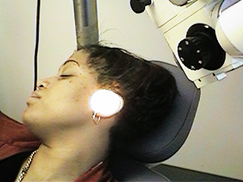
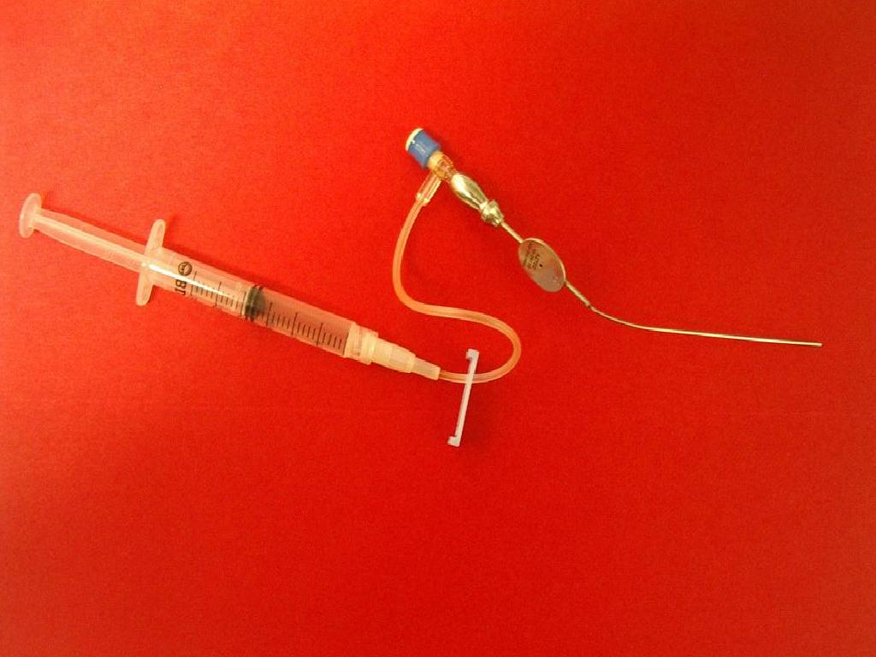
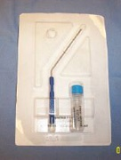
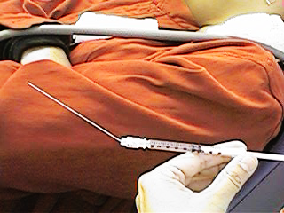
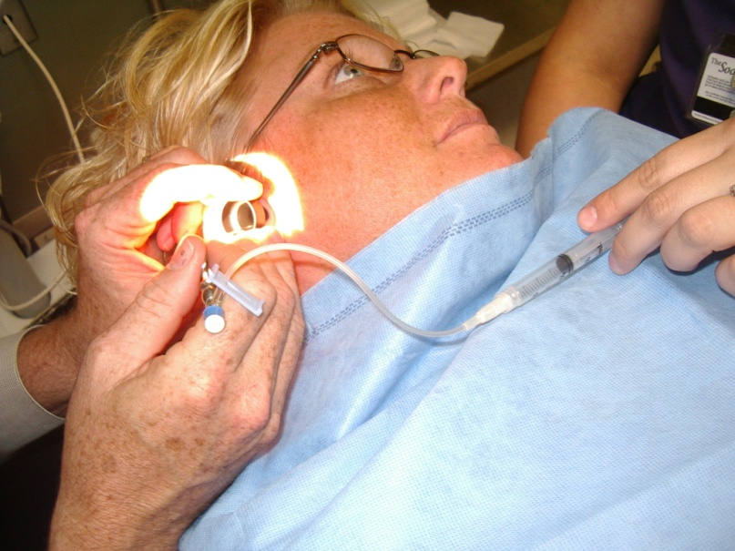
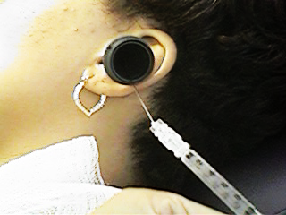
Intratympanic Steroid Injection Techniques

Slide 36
STATEMENT 11. OTHER PHARMACOLOGIC THERAPY
STATEMENT 11. OTHER PHARMACOLOGIC THERAPY: Clinicians should not routinely prescribe antivirals, thrombolytics, vasodilators, or vasoactive substances to patients with SSNHL. Strong recommendation against based on systematic reviews of RCTs with a preponderance of harm over benefit.
Benefit: Avoidance of unnecessary treatment, avoid adverse events of unnecessary treatment, cost saving
Risks, harms, costs: None

Slide 37
STATEMENT 11. OTHER PHARMACOLOGIC THERAPY
Action Statement Profile
Quality improvement opportunity: Avoidance of ineffective treatment(s) and associated risks, complications, side effects, costs, and potential adverse interactions with effective therapies (National quality strategy: Patient Safety; Prevention and Treatment of Leading Causes of Morbidity and Mortality)
Aggregate evidence quality: Grade B, based on systematic reviews of RCTs
Level of confidence in evidence: High
Benefits-harm assessment: Preponderance of harm over benefit
Value judgments: None
Intentional vagueness: The word ‘‘routine’’ is used to avoid setting a legal standard recognizing that there may be patient-specific indications for 1 of these therapies that may be reasonable to try on an individualized basis, with shared decision making
Role of patient preference: None
Exceptions: None
Policy Level: Strong recommendation
Differences of opinion: None

Slide 38
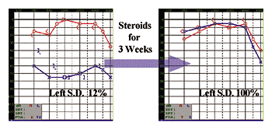
STATEMENT 12. OUTCOMES ASSESSMENT
STATEMENT 12. OUTCOMES ASSESSMENT: Clinicians should obtain follow-up audiometric evaluation for patients with SSNHL at the conclusion of treatment and within 6 months of completion of treatment. Recommendation based on observational studies with a preponderance of benefit over harm.
Benefit: Assess outcome of intervention, identify patients who may benefit from audiologic rehabilitation, identify cause of hearing loss, identify progressive hearing loss, improve counseling
Risks, harms, costs: Procedural cost

Slide 39
STATEMENT 12. OUTCOMES ASSESSMENT
Action Statement Profile
Quality improvement opportunity: Following patients with SHL may allow for identification of underlying causes not evident at presentation and will allow for appropriate rehabilitation of hearing loss in those that fail to recover hearing (National quality strategy: Effective Communication and Care Coordination)
Aggregate evidence quality: Grade C, based on observational studies
Level of confidence in evidence: High
Benefits-harm assessment: Preponderance of benefit over harm
Value judgments: The patient perception of hearing recovery is not always completely accurate, and patients may be unaware of a residual hearing impairment that could be identified through audiometric assessment. Patients who report subjective hearing improvement may still derive additional benefits from objective testing
Intentional vagueness: None
Role of patient preference: Small
Exceptions: None
Policy Level: Recommendation
Differences of opinion: While the entire group agreed that a hearing test at the conclusion of therapy is warranted, there was some disagreement about when a longer-term follow-up audiogram should be obtained.

Slide 40
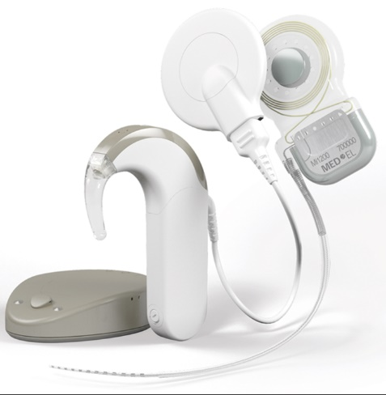
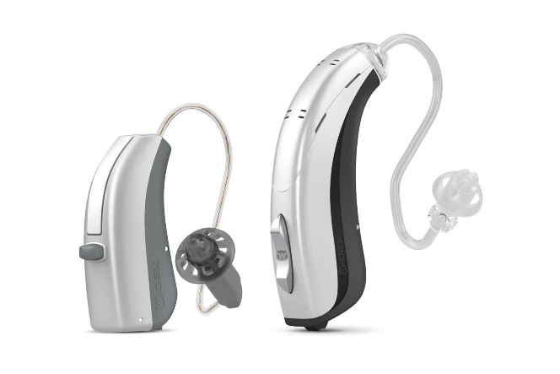
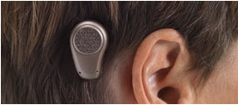
STATEMENT 13. REHABILITATION
STATEMENT 13. REHABILITATION: Clinicians should counsel patients with SSNHL who have residual hearing loss and/or tinnitus about the possible benefits of audiologic rehabilitation and other supportive measures. Strong recommendation based on systematic reviews and observational studies with a preponderance of benefit over harm.
Benefit: Improved awareness of options that may improve QOL, functionality, hearing, and tinnitus and offer emotional support
Risks, harms, costs: Time and cost of counseling

Slide 41
STATEMENT 13. REHABILITATION
Action Statement Profile
Quality improvement opportunity: To inform patients about strategies to help manage residual hearing loss and tinnitus (National quality strategy: Effective Communication and Care Coordination; Prevention and Treatment of Leading Causes of Morbidity and Mortality; Health and Well-being of Communities)
Aggregate evidence quality: Grade B, based on systematic reviews and observational studies
Level of confidence in evidence: High
Benefits-harm assessment: Preponderance of benefit over harm
Value judgments: None
Intentional vagueness: None
Role of patient preference: Large
Exceptions: None
Policy Level: Strong recommendation
Differences of opinion: None, but 2 panelists were recused from the discussion regarding cochlear implants as rehabilitation for tinnitus and single sided deafness, as they are investigators on industry-funded studies of that technology

Slide 42
New Algorithm
Algorithm showing the interrelationship of guideline key action statements

Slide 43
Patient Handouts
Visit www.entnet.org/SHLCPG to access the patient handouts

Slide 44
Research Needs Identified
Determine a standardized and evidence-based definition of SSNHL.
Determine the actual incidence of SSNHL in the United States.
Investigate the impact of ethnicity and socioeconomic status on timeliness of diagnosis and treatment, treatment outcome, and rehabilitation
Investigate the effectiveness of systemic corticosteroid treatment versus a placebo. The panel believes that such a clinical trial should be conducted due to the equipoise of existing data.
Investigate the benefit of HBOT. Current evidence regarding this treatment options is equivocal. Additionally, there is a bias among US physicians and payers not to offer this therapy. Standardized treatment protocols and outcomes assessments are needed for HBOT for ISSNHL.
Development of standardized outcome criteria to aid the comparison of clinical studies.
The use of IT steroids, as primary and salvage therapy, needs to be further studied. Particularly, the optimal medications, dosage, concentrations, timing, and administration schedules for IT therapy need investigation. The panel believes that differing concentrations of steroid in injected solutions, ranging from 4 mg/mL to 24 mg/mL of dexamethasone, for example, contribute to the inhomogeneity of study outcomes.
Develop criteria to determine at what level of hearing recovery IT steroids would be offered as salvage.
Determine the percentage of patients who gain serviceable hearing as a result of treatment. Here we emphasize the importance of WRS percentages, acknowledging that even a severe pure tone loss but with good or better word recognition ability is a good outcome.
Investigate the use of ‘combined therapy’ (ie, oral and IT steroids) in patients with SSNHL.
Develop long term follow-up protocols for patients with SSNHL.
Evaluate therapies with standardized definitions and treatment protocols across studies.
Develop a protocol with stacked ABR to better detect small retrocochlear lesions, which is usable in the routine clinical audiologic setting.
Investigate the effectiveness of targeted laboratory assessment in determining the etiology of SSNHL.
Investigate Association of SHL with other risk factors, such as stroke and coagulopathies.
Investigate new agents for the treatment of SSNHL.

Slide 45
The AAO-HNSF Maureen Hannley Research Grant
Mechanism of the CORE Grants Program
$50,000 over one year
Purpose:
Designed to fill “research gaps” identified by the AAO-HNSF clinical practice guideline panels.
Support the career development of investigators who have made a commitment to focus their research endeavors on patient-oriented research.
If you are interested in applying for an AAO-HNSF Maureen Hannley Research Grant, check out the CORE Grants webpage

Slide 46
All CPG Resources Available at www.entnet.org/SHLCPG

Slide 47
QUESTIONS?
Thank you for your attention

