Slide 1
AAO-HNSF Clinical Practice Guideline (Update): Earwax (Cerumen Impaction)
Update to 2008 Guideline
Publication date: January 3, 2017

Slide 2
Disclaimer
The clinical practice guideline is not intended as the sole source of guidance in managing patients with earwax (cerumen impaction). Rather, it is designed to assist clinicians by providing an evidence-based framework for decision-making strategies. The guideline is not intended to replace clinical judgment or establish a protocol for all individuals with this condition and may not provide the only appropriate approach to diagnosing and managing this program of care. As medical knowledge expands and technology advances, clinical indicators and guidelines are promoted as conditional and provisional proposals of what is recommended under specific conditions but are not absolute. Guidelines are not mandates. These do not and should not purport to be a legal standard of care. The responsible physician, in light of all circumstances presented by the individual patient, must determine the appropriate treatment. Adherence to these guidelines will not ensure successful patient outcomes in every situation. The American Academy of Otolaryngology-Head and Neck Surgery Foundation emphasizes that these clinical guidelines should not be deemed to include all proper treatment decisions or methods of care or to exclude other treatment decisions or methods of care reasonably directed to obtaining the same results.

Slide 3
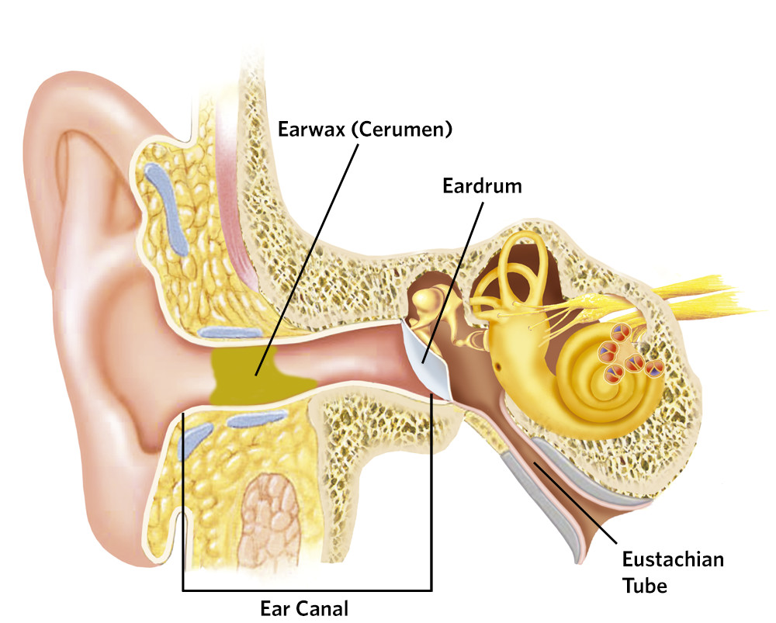
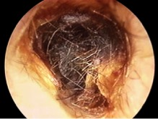
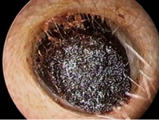
What is Earwax (cerumen)?
Cerumen or “earwax” is a naturally occurring substance that cleans, protects, and lubricates the external auditory canal. It is also the primary reason why the ear canal can become obstructed.

Slide 4
Burden of Earwax (cerumen)
Estimates range prevalence of cerumen impaction from 6 to18 million in the United States.
For 2012, $46.9 million was spent on 1.3 million cerumen disimpactions.
Estimates suggest that 19-65% of patients over 65 years old have cerumen impaction.
In the developmentally delayed adult population, 28-36% have excessive or impacted cerumen. Presence of cerumen impaction has been associated with hearing loss and diminished cognitive function in these populations

Slide 5
Complications
Estimated 1 in 1000 ear irrigations result in one of the following complications:
Tympanic membrane perforation
Ear canal laceration
Infection of the ear
Bleeding
Hearing loss.
Otitis externa (sometimes secondary to external auditory canal trauma)
Pain
Dizziness
Syncope
We estimate that 8,000 complications occur annually and likely require further medical services.

Slide 6
Why Bother with an Update?
National Academies of Sciences, Engineering, and Medicine (formerly Institute of Medicine) Clinical Practice Guidelines We Can Trust Standard 8 states:
Literature should be monitored regularly following CPG publication to identify the emergence of new, potentially relevant evidence and to evaluate the continued validity of the CPG.
The AAO-HNSF strives to update every 5-years.

Slide 7
What’s New? Part 1
Addition of consumer advocate to guideline update group
New evidence from 1 guideline, 4 systematic reviews, and 5 RCTs;
Emphasis on patient education and shared decision-making;
Expanded action statement profiles with quality improvement opportunities, confidence in the evidence, intentional vagueness, and differences of opinion
Enhanced external review process to include public comment and journal peer review; and
New algorithm to clarify decision making
3 new key action statements.

Slide 8
What’s New? Part 2
3 new key action statements on managing cerumen impaction that focus on:
primary prevention,
contraindicated intervention, and
referral and coordination of care.

Slide 9
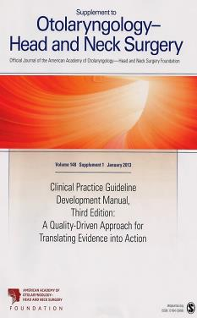
Clinical Practice Guideline Development Manual: Third Edition Rosenfeld, Shiffman, and Robertson
Pragmatic, transparent approach to creating guidelines for performance assessment
Evidence-based, multidisciplinary process leading to publication in 12-18 months
Emphasizes a focused set of key action statements to promote quality improvement
Uses action statement profiles to summarize decisions in recommendations
Otolaryngol Head Neck Surg 2013; 148(Suppl):S1-55

Slide 10
Clinical Practice Guidelines (CPG) Goals
Focus on quality improvement opportunities
Define actionable recommendations for clinicians regardless of discipline to improve care
The guideline is not intended to be comprehensive
The guideline is not intended to limit or restrict care provided by clinicians to individual patients

Slide 11
AAO-HNSF Guideline Update Group
Seth R. Schwartz, MD, MPH, Chair Anthony E. Magit, MD, MPH, Assistant Chair Richard M. Rosenfeld, MD, MPH, Methodologist Bopanna B. Ballachanda, PhD, Speech-Language Jesse M. Hackell, MD, Pediatrics Helene J. Krouse, PhD, RN, Nursing Claire M. Lawlor, MD, AAO-HNS SRF | Kenneth Lin, MD, MPH, Family Medicine Kourosh Parham, MD, PhD, Geriatric Otolaryngology David R. Stutz, MD, Geriatrics Sandra Walsh, Consumer Erika A. Woodson, MD, ANS & AAO-HNS Education Ken Yanagisawa, MD, AAO-HNS BOG Gene Cunningham, MHS, Staff Liaison

Slide 12
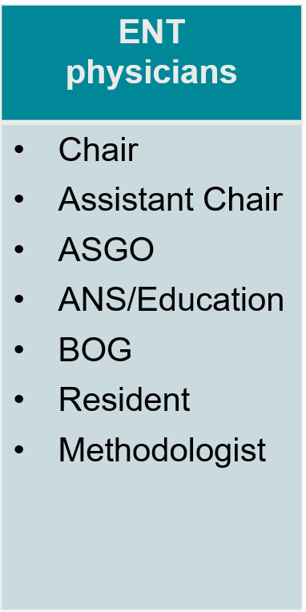
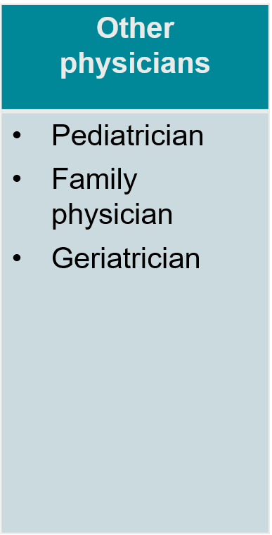
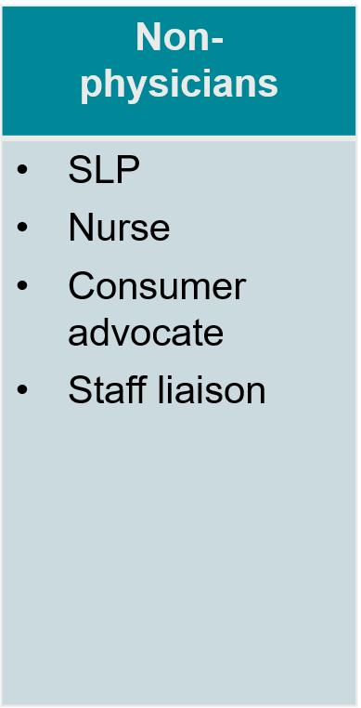
AAO-HNSF Guideline Update Group

Slide 13
Purpose & Target Audience
PURPOSE: To help clinicians identify patients with cerumen impaction who may benefit from intervention, and to promote evidence-based management and to highlight needs and management options in special populations or in patients who have modifying factors.
TARGET PATIENT: Over 6 months of age with a clinical diagnosis of cerumen impaction.
TARGET AUDIENCE: All clinicians who are likely to diagnose and manage patients with cerumen impaction and applies to any setting in which cerumen impaction would be identified, monitored, or managed.
EXCLUSIONS: Does not apply to patients with cerumen impaction associated with the following conditions: dermatologic diseases of the ear canal; recurrent otitis externa; keratosis obturans; prior radiation therapy affecting the ear; previous tympanoplasty/myringoplasty or canal wall down mastoidectomy or other surgery affecting the ear canal.

Slide 14
Literature Search
Performed by an information specialist.
New evidence included:
Clinical Practice Guidelines: 1
Systematic Reviews: 6
Randomized Control Trials: 5
Observational Studies: 76

Slide 15
Strength of Action Terms/Implied Levels of Obligation

Slide 16
Statement 1. Primary Prevention
Clinicians should explain proper ear hygiene to prevent cerumen impaction when patients have an accumulation of cerumen. Recommendation based on observational studies and a preponderance of benefit over harm.
Aggregate evidence quality: C, based on preponderance of survey studies and one prospective pilot study
Benefit: Promote safe and effective self-care behaviors in ear hygiene; Prevent self-inflicted harms such as abrasions, cuts, and impaction; Reduction in health care utilization
Value judgments: Perception by the group that patients over-manipulate the ears (i.e. Cotton swabs use), and that there is benefit in educating patients about proper ear hygiene.

Slide 17
Statement 1. Primary Prevention

Slide 18
Statement 2A. Diagnosis of Cerumen Impaction
Clinicians should diagnose cerumen impaction when an accumulation of cerumen seen with otoscopy 1) is associated with symptoms, or 2) prevents needed assessment of the ear, or 3) both. Recommendation based on diagnostic studies with minor limitations and a preponderance of benefit over harm.
Aggregate evidence quality: Grade B, diagnostic studies with minor limitations regarding impact of cerumen on hearing and visualizations and Grade C with respect to signs and symptoms associated with cerumen impaction
Benefit: Identify individuals with cerumen impaction who require intervention including those with otologic symptoms and those who require diagnostic assessment (raise awareness of the consequences of cerumen impaction - e.g. cerumen impaction may prevent caloric stimulation during electronystagmography)
Value judgments: Emphasis on clinical symptoms and signs for initial diagnosis; importance of
avoiding unnecessary diagnostic tests; consensus on using the term cerumen impaction to imply
cerumen that requires treatment

Slide 19
Statement 2B. Modifying Factors
Clinicians should assess the patient with cerumen impaction by history and/or physical examination for factors that modify management such as one or more of the following: anticoagulant therapy, immunocompromised state, diabetes mellitus, prior radiation therapy to the head and neck, ear canal stenosis, exostoses, non-intact tympanic membrane. Recommendation based on observational studies with a preponderance of benefit over harm.
Aggregate evidence quality: Grade C, recommendations regarding diabetes mellitus and prior radiation therapy; Grade D, recommendations regarding immunocompromised state, anticoagulation, and anatomic abnormalities of the ear canal and tympanic membrane
Value judgments: consensus that identifying modifying factors and modifying management will improve outcomes

Slide 20
Statement 3A. Need for Intervention If Impacted
Clinicians should treat, or refer to another clinician who can treat, cerumen impaction, when identified. Strong recommendation based on randomized controlled trials with heterogeneity with a preponderance of benefit over harm.
Aggregate evidence quality: Grade B, randomized controlled trials with heterogeneity
Harms, risks, costs: potential complications related to treatment. Direct cost of managing the impaction

Slide 21
Statement 3B. Non-Intervention If Asymptomatic
Clinicians should not routinely treat cerumen in patients who are asymptomatic and whose ears can be adequately examined. Recommendation based on control groups in randomized trials and observational studies, and a preponderance of benefit over harms.
Aggregate evidence quality: Grade C, control groups in randomized trials and observational studies
Value judgments: Presence of cerumen is not in itself harmful and may not progress to impaction and in fact may resolve spontaneously. If it progresses it can be managed at that time.
Intentional vagueness: The word “routinely” was added to this statement to acknowledge that there may be circumstances where cerumen removal may be offered anyway, such as in a patient with hearing aids.
Role of patient preferences: substantial role for shared decision-making. The patient may still opt for removal of the cerumen
Exceptions: Medical reasons for exceptions to this statement include, but are not limited to, history of recurrent cerumen impaction

Slide 22
Statement 3C. Need for Intervention in Special Populations
Clinicians should identify patients with obstructing cerumen in the ear canal who may not be able to express symptoms (young children and cognitively impaired children and adults) and promptly evaluate the need for intervention. Recommendation based on cohort and observational studies with a preponderance of benefit over harm.
Aggregate evidence quality: Grade C, cohort and observational studies
Benefits: Improved hearing and functional health status, improved evaluation of external auditory canal, tympanic membrane, and middle ear
Harms, risks, costs: Potential over-treatment of cerumen that is asymptomatic; evaluation and treatment costs; substantial administrative burden in settings with a high prevalence of cognitively impaired individuals, such as nursing homes and institutional facilities
Intentional vagueness: The term “young children” does not specify age, but rather indicates children who are unable or too immature to express symptoms or who fail to disclose real symptoms out of fear of treatment. Additionally, the term promptly does not specify a time frame but allows for clinical judgment as to how expedient the evaluation should be

Slide 23
Statement 4. Intervention in Hearing Aid Users
Clinicians should perform otoscopy to detect the presence of cerumen in patients with hearing aids during a healthcare encounter. Recommendation based on cohort and observational studies with a preponderance of benefit over harm.
Aggregate evidence quality: Grade C, observational studies
Benefits: prevent hearing aid dysfunction and associated repair costs
Harms, risks, costs: over-treatment of asymptomatic cerumen
Value judgments: Cerumen can have a disproportionate effect on patients with hearing aids due to their underlying hearing loss and the impact of the cerumen on the hearing aid even if there is not an actual impaction
Intentional vagueness: The term “healthcare encounter” is somewhat vague but is intended to indicate any time that a patient with a hearing aid is assessed by a health care worker

Slide 24
Statement 5A. Recommend Interventions
Clinicians should treat, or refer to a clinician who can treat, the patient with cerumen impaction with an appropriate intervention, which may include one or more of the following: cerumenolytic agents, irrigation, or manual removal requiring instrumentation. Recommendation based on randomized controlled trials and observational studies with a preponderance of benefit over harm.
Aggregate evidence quality: Grade B, randomized controlled trials with limitations and cohort studies
Intentional vagueness: This does not specify one method as superior as studies have not compared them head to head and all may be effective
Exceptions: Irrigation and cerumenolytics should not be used in the setting of a non-intact tympanic membrane

Slide 25
Statement 5B. Contraindicated Intervention (Ear Candling/Coning)
Clinicians should recommend against ear candling/coning for treating or preventing cerumen impaction. Recommendation against based on randomized controlled trials and observational studies with a preponderance of benefit over harm.
Aggregate Evidence Quality: Grade C
Benefits: Avoid ineffective therapy; Avoid harms; Cost savings; Prevent delay of effective therapy

Slide 26
Statement 6. Cerumenolytic Agents
Clinicians may use cerumenolytic agents (including water or saline solution) in the management of cerumen impaction. Option based on limited randomized trials with a balance of benefit and harm.
Aggregate evidence quality: Grade C, Individual treatment arms of randomized trials showing beneficial outcomes, one RCT suggesting better outcomes over no treatment
Harms, risks, costs: potential external otitis, allergic reactions, and otalgia; cost of cerumenolytic agents other than water or saline solution, cost of procedure if performed in an office setting
Value judgments: the panel values cost control and safety in view of limited data on absolute and comparative efficacy
Exceptions: Medical reasons for exceptions to this statement include, but are not limited to, persons with a history of allergic reactions to any component, persons with infection of the ear canal or active dermatitis, and persons with a non-intact tympanic membrane

Slide 27
Statement 7. Irrigation
Clinicians may use irrigation in the management of cerumen impaction. Option based on randomized controlled trials with heterogeneity and with a balance of benefit and harm.
Aggregate evidence quality: Grade B, One RCT verifying absolute efficacy but multiple treatment arms of comparative studies verifying benefit over cerumenolytic alone
Harms, risks, costs: External otitis, vertigo, tympanic membrane perforation, otalgia, temporal bone osteomyelitis; cost of supplies and procedure
Value judgments: panel enthusiasm was tempered by the lack of appropriate head to head trials comparing irrigation to manual removal or cerumenolytics
Exceptions: Medical reasons for exceptions to this statement include, but are not limited to: patients with non-intact tympanic membrane, active dermatitis or infection of the ear canal and surrounding tissue, previous intolerance or adverse reaction to this technique, anatomic abnormalities of the ear canal, or history of surgery of the ear or ear canal including ear tubes.

Slide 28
Statement 8. Manual Removal
Clinicians may use manual removal requiring instrumentation in the management of cerumen impaction. Option based on case series and expert opinion with a balance of benefit and harm.
Aggregate evidence quality: Grade C, observational case series and expert opinion
Harms, risks, costs: bleeding, laceration, tympanic membrane perforation, otalgia; procedural cost; equipment cost
Value judgments: Recommendation acknowledges widespread practice of manual removal but this is tempered by the relative absence of evidence

Slide 29
Statement 9. Outcomes Assessment
Clinicians should assess patients at the conclusion of in-office treatment of cerumen impaction and document the resolution of impaction. If the impaction is not resolved, the clinician should use additional treatment. If full or partial symptoms persist despite resolution of impaction, the clinician should evaluate the patient for alternative diagnoses. Recommendation based on randomized controlled trials with limitations supporting a failure of clearance of cerumen in some cases and randomized controlled trials with limitations and a preponderance of benefit over harm.
Aggregate evidence quality: Grade C. Observation in treatment arms of several randomized trials show that retreatment is sometimes necessary and can be effective; first principles support evaluation for efficacy after treatment
Value judgments: importance of clinician assessment after treatment; avoid misdiagnosis
Intentional vagueness: The term “additional treatment” does not specify what type of treatment. Additional treatment can be repeating the same treatment or trying an alternative method (i.e. Manual removal if irrigation was tried first, or use of softening agents if not used initially)

Slide 30
Statement 10. Referral and Coordination of Care
Clinicians should refer patients with persistent cerumen impaction after unsuccessful management by the initial clinician to a clinician with specialized equipment and training for cleaning and evaluating the ear canal and tympanic membrane. Recommendation based on individual arms of randomized trials and preponderance of benefit over harm.
Aggregate Evidence Quality: Grade C
Value Judgments: Skill and instruments will promote a better outcome. The level of care that can be rendered can be limited by the available equipment and training
Intentional Vagueness: The specialized equipment and training is vague but may include access to binocular microscopy, suction, microinstruments, or access to the operating room. Type of training is not specified but this refers to someone with advanced capabilities of removing cerumen. Unsuccessful treatment may entail a repeat visit or multiple treatments by the initial clinician to allow for use of softening agents or spontaneous improvement of impacted cerumen.

Slide 31
Statement 11. Secondary Prevention
Clinicians may educate/counsel patients with cerumen impaction/excessive cerumen regarding control measures. Option based on survey and comparative studies with unclear balance of benefit vs. harm.
Aggregate evidence quality: Grade C; observational studies, experimental pilot studies, and expert opinion
Benefits: prevent development of cerumen impaction or recurrent cerumen impaction
Harms, risks, costs: time for counseling and potential risk of preventive measures if used
Intentional vagueness: The term “excessive cerumen” is used to indicate when cerumen is present but not actively causing symptoms to allow the clinician freedom to counsel patients who appear to be at risk for cerumen impaction even when the ear is not actually impacted

Slide 32
New Algorithm
Algorithm showing the interrelationship of guideline key action statements

Slide 33
Research Needs
Establish a universal definition of cerumen impaction to make comparisons of management strategies more meaningful.
Assess the natural history of cerumen impactions by performing observational studies in untreated populations, including the elderly, children, and developmentally delayed patients.
Conduct studies assessing the role of preventive measures, such as emollients and ear hygiene, on the development of cerumen impactions.
Assess the various methods of cerumen removal, either as single interventions or combined interventions, through well-designed large-scale RCTs.
Determine the efficacy of manual removal of cerumen through prospective studies.
Assess comparative impact of different cerumenolytic agents through well-designed clinical trials.

Slide 34
Research Needs (cont’d)
Evaluate the efficacy of prophylactic topical antibiotics in preventing otitis externa when local trauma occurs during cerumen removal.
Conduct a financial analysis comparing the various methods of cerumen management
Determine the relative efficacy of cerumenolytic agents and irrigation for adult, elderly, and pediatric patients and for patients at high risk for complications related to cerumen removal due to underlying conditions (ie, diabetes, coagulopathies)
Evaluate the impact of cerumen removal on the resolution of symptoms, such as itching, hearing loss, pain, fullness, tinnitus, and vertigo, through prospective clinical studies.
Establish that studies evaluating cerumen removal should document adverse events
Assess variation in outcomes for cerumen removal relative to the type of health care provider managing the patient (ie, nurse, physician assistant, physician, medical assistant)
Conduct financial analyses of the relative costs for cerumen management when performed by different types of health care providers.

Slide 35
Thank you for your attention
QUESTIONS?

