Slide 1
AAO-HNSF Clinical Practice Guideline: Update: Acute Otitis Externa
(Published February 2014)

Slide 2
Disclaimer
The clinical practice guideline is not intended as the sole source of guidance in managing patients with acute otitis externa. Rather, it is designed to assist clinicians by providing an evidence-based framework for decision-making strategies. The guideline is not intended to replace clinical judgment or establish a protocol for all individuals with this condition and may not provide the only appropriate approach to diagnosing and managing this program of care. As medical knowledge expands and technology advances, clinical indicators and guidelines are promoted as conditional and provisional proposals of what is recommended under specific conditions but are not absolute. Guidelines are not mandates. These do not and should not purport to be a legal standard of care. The responsible physician, in light of all circumstances presented by the individual patient, must determine the appropriate treatment. Adherence to these guidelines will not ensure successful patient outcomes in every situation. The American Academy of Otolaryngology-Head and Neck Surgery Foundation emphasizes that these clinical guidelines should not be deemed to include all proper treatment decisions or methods of care or to exclude other treatment decisions or methods of care reasonably directed to obtaining the same results.

Slide 3
Burden
Also known as “swimmer’s ear” or “tropical ear,” AOE is one of the most common infections encountered by clinicians, with regional variations based on age and geography.
Ambulatory visits for AOE were most common in the South (9.1 per 1000 population) and least common in the West (4.3 per 1000 population)
Medical costs include physician visits and prescriptions for analgesics and systemic medications, such as antibiotics, steroids, or both.
Direct costs are estimated at about half a billion dollars annually, and ambulatory care providers spent about 600,000 hours treating AOE. The indirect costs of AOE have not been calculated but are likely to be substantial because of severe and persistent otalgia that limits activities, especially work.

Slide 4
Clinical Practice Guideline Development Manual: Third Edition Rosenfeld, Shiffman, and Robertson
Pragmatic, transparent approach to creating guidelines for performance assessment
Evidence-based, multidisciplinary process leading to publication in 12-18 months
Emphasizes a focused set of key action statements to promote quality improvement
Uses action statement profiles to summarize decisions in recommendations
Otolaryngol Head Neck Surg 2013; 148(Suppl):S1-55

Slide 5
CPG Leadership
Rich Rosenfeld, MD, MPH (Chair)
Seth Schwartz, MD, MPH (Methodologist)

Slide 6
Multi-Disciplinary Panel
C. Ron Cannon MD, Otolaryngology
Peter S. Roland MD, Otolaryngology
Geoffrey R. Simon MD, Pediatrics
K. Ashok Kumar, MD, FRCS, FAAFP, Family physician
William W. Huang, MD, MPH, Dermatology
Helen W. Haskell, MA Consumer Advocate

Slide 7
CPG Development
Developed using an explicit and transparent a priori protocol
Create actionable statements based upon the supporting evidence and associated balance of benefit and harm

Slide 8
CPG Goals
Focus on quality improvement opportunities
Define actionable statements for clinicians regardless of discipline to improve care
The guideline is not intended to be comprehensive
The guideline is not intended to limit or restrict care provided by clinicians to individual patients

Slide 9
Literature Search
Performed by an information specialist
Clinical Practice Guidelines – 6 identified, 0 included in the final CPG
Systematic Reviews – 44 identified, 2 included in the final CPG
Randomized Controlled Trials – 52 identified, 12 included in the final CPG

Slide 10
External Peer Review
18 reviewers from the 11 organizations/committees (listed below) submitted 135 comments. Resulted in 61 edits/changes to the draft CPG.
AAO-HNS Otology & Neurotology Education Committee
American Otological Society
AAO-HNS Pediatric Otolaryngology Committee
American Society of Pediatric Otolaryngology
AAO-HNS Pediatric Otolaryngology Education Committee
American Neurotology Society
AAO-HNS Infectious Disease Committee
American Academy of Pediatrics
American Academy of Dermatology
American Academy of Family Physicians
Consumers United for Evidence-based Healthcare (CUE)

Slide 11
Differences from Prior Guideline
This clinical practice guideline is as an update, and replacement, for an earlier guideline published in 2006 by the American Academy of Otolaryngology—Head and Neck Surgery Foundation. Changes in content and methodology from the prior guideline include the following:
Addition of a dermatologist and consumer advocate to the guideline development group
Expanded action statement profiles to explicitly state confidence in the evidence, intentional vagueness, and differences of opinion
Enhanced external review process to include public comment and journal peer review
New evidence from 12 randomized controlled trials and 2 systematic reviews
Review and update of all supporting text
Emphasis on patient education and counseling with new tables that list common questions with clear, simple answers and provide instructions for properly administering ear drops

Slide 12
Target Population
Children and Adults

Slide 13
Strength of Action Terms/Implied Levels of Obligation
Strength | Definition | Implied Obligation
Strong Recommendation | The benefits of the recommended approach clearly exceed the harms (or, in the case of a strong negative recommendation, the harms clearly exceed the benefits) and the quality of the supporting evidence is high (Grade A or B). | In some clearly identified circumstances, strong recommendations may be made based on lesser evidence when high-quality evidence is impossible to obtain, and the anticipated benefits strongly outweigh the harms. Clinicians should follow a strong recommendation unless a clear and compelling rationale for an alternative approach is present.
Recommendation | The benefits exceed the harms (or, in the case of a negative recommendation, the harms exceed the benefits), but the quality of evidence is not as high (Grade B or C). | In some clearly identified circumstances, recommendations may be made based on lesser evidence when high-quality evidence is impossible to obtain, and the anticipated benefits outweigh the harms. Clinicians should generally follow a recommendation but should remain alert to new information and remain sensitive to patient preferences.
Option | Either the quality of evidence is suspect (Grade D) or well-done studies (Grade A, B, or C) show little clear advantage to one approach versus another. | Clinicians should be flexible in their decision making regarding appropriate practice, although they may set bounds on alternatives; patient preference should have a substantial influencing role.

Slide 14
KAS 1: Differential Diagnosis
Clinicians should distinguish diffuse AOE from other causes of otalgia, otorrhea, and inflammation of the external ear canal. Recommendation based on observational studies with a preponderance of benefit over risk.
Benefits: Improved diagnostic accuracy
Risks, harms, costs: None

Slide 15
KAS 1: Differential Diagnosis
Action Statement Profile
Aggregate evidence quality: Grade C, observational studies and Grade D, reasoning from first principles
Level of confidence in evidence: High
Benefits-harm assessment: Preponderance of benefit over harm
Value judgments: Importance of accurate diagnosis
Intentional vagueness: None
Role of patient preferences: None, regarding the need for a proper diagnosis
Exceptions :none
Policy level: Recommendation
Differences of opinion: None

Slide 16
KAS 2: Modifying Factors
Clinicians should assess the patient with diffuse AOE for factors that modify management (non-intact tympanic membrane, tympanostomy tube, diabetes, immunocompromised state, prior radiotherapy). Recommendation based on observational studies with a preponderance of benefit over risk.
Benefits: Optimizing treatment of AOE through appropriate diagnosis and recognition of factors or co-morbid conditions that might alter management
Risks, harms, costs: None from following the recommendation; additional expense of diagnostic tests or imaging studies to identify modifying factors

Slide 17
KAS 2: Modifying Factors
Action Statement Profile
Aggregate evidence : Grade C, observational studies
Level of confidence in evidence: High
Benefits-harm assessment: Preponderance of benefits over harm
Value judgments: Avoiding complications that could potentially be prevented by modifying the management approach based on the specific factors identified
Intentional vagueness: None
Role of patient preferences: None
Exceptions: None
Policy level: Recommendation
Differences of opinion: None

Slide 18
KAS 3: Pain Management
The clinician should assess patients with AOE for pain and recommend analgesic treatment based on the severity of pain. Strong recommendation based on well-designed randomized trials with a preponderance of benefit over harm.
Benefits: Increase patient satisfaction, allow faster return to normal activities
Risks, harms, costs: Adverse effects of analgesics; direct cost of medication

Slide 19
KAS 3: Pain Management
Action Statement Profile
Aggregate evidence quality: : Grade B, one randomized controlled trial limited to AOE; consistent, well-designed randomized trials of analgesics for pain relief in general
Level of confidence in evidence: High
Benefits-harms assessment: Preponderance of benefit over harm
Value judgments: Consensus among guideline development group that the severity of pain associated with AOE is under-recognized; preeminent role of pain relief as an outcome when managing AOE
Intentional vagueness: None
Role of patient preferences: Moderate, choice of analgesic and degree of pain tolerance
Exceptions: None
Policy level: Strong recommendation
Differences of opinion: None

Slide 20
KAS 4: Systematic Antimicrobials
Clinicians should not prescribe systemic antimicrobials as initial therapy for diffuse, uncomplicated AOE unless there is extension outside the ear canal or the presence of specific host factors that would indicate a need for systemic therapy. Strong recommendation based on randomized controlled trials with minor limitations and a preponderance of benefit over harm.
Benefits: Avoid side effects from ineffective therapy, reduce antibiotic resistance by avoiding systemic antibiotics
Risks, harms, costs: None

Slide 21
KAS 4: Systematic Antimicrobials
Action Statement Profile
Aggregate evidence quality: Grade B, randomized controlled trials with minor limitations; no direct comparisons of topical vs. systemic therapy
Level of confidence in evidence: High
Benefits-harms assessment: Preponderance of benefit over harm
Value judgments: Desire to decrease the use of ineffective treatments, societal benefit from avoiding the development of antibiotic resistance
Intentional vagueness: None
Role of patient preferences: None
Exceptions: None
Policy level: Strong recommendation
Differences of opinion: None

Slide 22
KAS 5: Topical Therapy
Clinicians should prescribe topical preparations for initial therapy of diffuse, uncomplicated AOE. Recommendation based on randomized trials with some heterogeneity and a preponderance of benefit over harm.
Benefits: Effective therapy, low incidence of adverse events
Risks, harms, costs: Direct cost of medication (varies greatly depending on drug class and selection), risk of secondary fungal infection (otomycosis) with prolonged use of topical antibiotics

Slide 23
KAS 5: Topical Therapy
Action Statement Profile
Aggregate evidence quality: Aggregate evidence quality: Grade B, meta-analyses of randomized controlled trials with significant limitations and heterogeneity
Level of confidence in evidence: High for the efficacy of topical therapy as initial management, but low regarding comparative benefits of different classes of drugs or combinations of ototopical drugs
Benefits-harms assessment: Preponderance of benefit over harm
Value judgments: RCT results from largely specialty settings may not be generalizable to patients seen in primary care settings, where the ability to perform effective aural toilet may be limited
Intentional vagueness: No specific recommendations regarding the choice of ototopical agent
Role of patient preferences: Substantial role for patient preference in choice of topical therapeutic agent
Exceptions: Patients with a non-intact tympanic membrane (see Statement #7 on “Non-intact tympanic membrane)
Policy level: Recommendation
Differences of opinion: None

Slide 24
KAS 6: Drug Delivery
The clinician should enhance the delivery of topical drops by informing the patient how to administer topical drops and by performing aural toilet, placing a wick, or both, when the ear canal is obstructed. Recommendation based on observational studies with a preponderance of benefit over harm.
Benefits: Improved adherence to therapy and drug delivery
Risks, harms, costs: Pain and local trauma caused by inappropriate aural toilet or wick insertion; direct cost of wick (inexpensive)

Slide 25
KAS 6: Drug Delivery
Action Statement Profile
Aggregate evidence quality: Aggregate evidence quality: Grade C, observational studies and Grade D, first principles
Level of confidence in evidence: High
Benefits-harms assessment: Preponderance of benefit over harm
Value judgments: Despite an absence of RCTs demonstrating a benefit of aural toilet, the guideline development group agreed that cleaning was appropriate, when necessary, to improve penetration of the drops into the ear canal
Intentional vagueness: None
Role of patient preferences: Choice of self-administering drops vs. using assistant
Exceptions: None
Policy level: Recommendation
Differences of opinion: None

Slide 26
KAS 7: Non-Intact Tympanic Membrane
When the patient has a known or suspected perforation of the tympanic membrane, including a tympanostomy tube, the clinician should prescribe a non-ototoxic topical preparation. Recommendation based on reasoning from first principles and on exceptional circumstances where validating studies cannot be performed a preponderance of benefit over harm.
Benefits: Reduce the possibility of hearing loss and balance disturbance
Risks, harms, costs: Eardrops without ototoxicity may be more costly

Slide 27
KAS 7: Non-Intact Tympanic Membrane
Action Statement Profile
Aggregate evidence quality: Grade D, reasoning from first principles, and Grade X, exceptional situations where validating studies cannot be performed
Level of confidence in evidence: Moderate, because of extrapolation of data from animal studies and little direct evidence in patients with AOE
Benefits-harms assessment: Preponderance of benefit over harm
Value judgments: Importance of avoiding iatrogenic hearing loss from a potentially ototoxic topical preparation when non-ototoxic alternatives are available; placing safety above direct cost
Intentional vagueness: None
Role of patient preferences: None
Exceptions: None
Policy level: Recommendation
Differences of opinion: None

Slide 28
KAS 8: Outcome Assessment
The clinician should reassess the patient who fails to respond to the initial therapeutic option within 48-72 hours to confirm the diagnosis of diffuse AOE and to exclude other causes of illness. Recommendation based on observational studies and a preponderance of benefit over harm.
Benefits: Identify misdiagnosis and potential complications from delayed management; reduce pain
Risks, harms, costs: Cost of reevaluation by clinician

Slide 29
KAS 8: Outcome Assessment
Action Statement Profile
Aggregate evidence quality: Grade C, outcomes from individual treatment arms of randomized controlled trials of efficacy of topical therapy for AOE
Level of confidence in evidence: Medium, because most randomized trials have been conducted in specialist settings and the generalizability to primary care settings is unknown
Benefits-harms assessment: Preponderance of benefit over harm
Value judgments: None
Intentional vagueness: Time frame of 48 to 72 hours is specified since there are no data to substantiate a more precise estimate of time to improvement
Role of patient preferences: None
Exceptions: None
Policy level: Recommendation
Differences of opinion: None

Slide 30
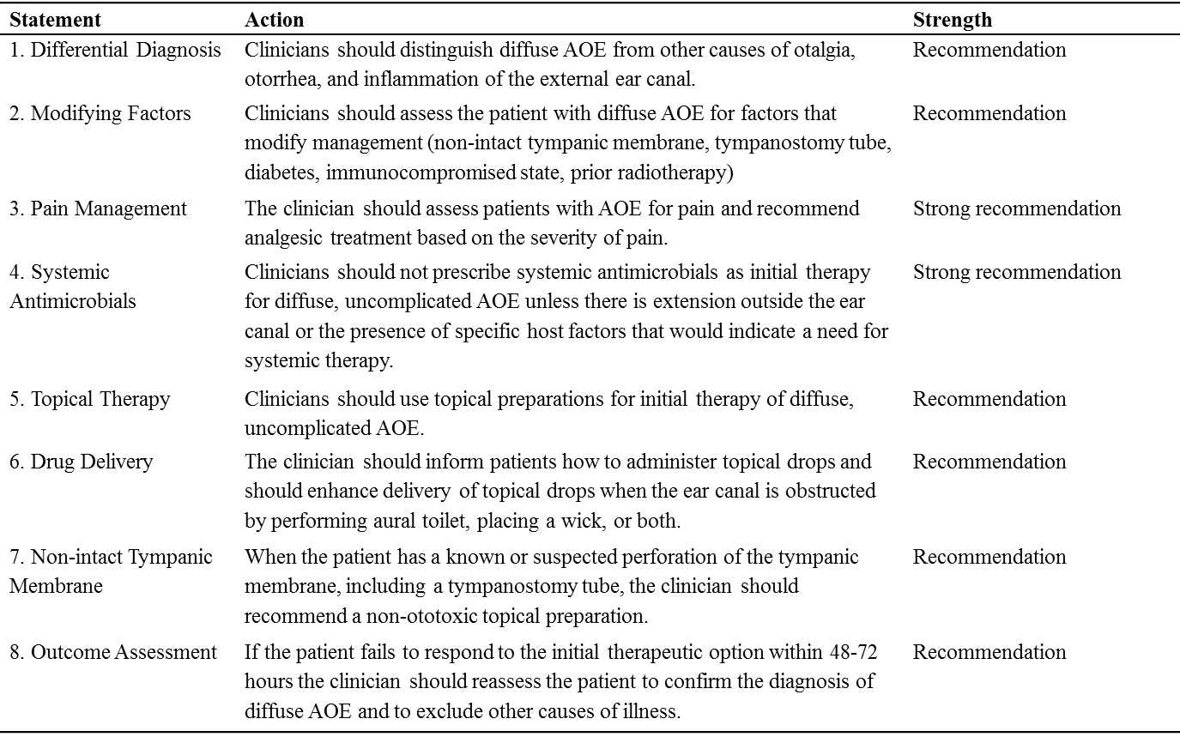
In Summary

Slide 31
Research Needs
RCTs of absolute and comparative clinical efficacy of ototopical therapy of uncomplicated AOE in primary care settings, including the impact of aural toilet on outcomes
Clinical trials to determine the efficacy of topical steroids for relief of pain caused by AOE
Observational studies or clinical trials to determine if water precautions are necessary, or beneficial, during treatment of an active AOE episode
Observational studies or clinical trials to determine optimal time to discontinue water precautions for AOE
Increased ability to distinguish treatment failure from topical sensitivity when a patient with AOE fails to respond to topical therapy

Slide 32
Research Needs (cont’d)
High-quality randomized trials of comparative clinical efficacy for AOE that use an appropriate randomization scheme, use an explicit double-blind protocol, and fully describe dropouts and withdrawals
High-quality randomized trials assessing the benefit of systemic antimicrobial therapy versus topical therapy in patients stratified by severity of signs and symptoms
High-quality randomized trials of comparative clinical efficacy for AOE that provide clinical outcomes early in the course of therapy (eg, after 2-4 days of therapy) and compare time to symptom resolution in addition to categorical responses (eg, cure, improvement, failure) for specific days
Comparative clinical trials of “home therapies” (eg, vinegar, alcohol) versus antimicrobials for treating AOE
Define the optimal duration of topical therapy for AOE and the role of patient preferences

Slide 33
Research Needs (cont’d)
Define with greater precision the indications for aural toilet and wick placement
Determine the efficacy of aural toilet as an independent factor when treating AOE
Comparative clinical trials of wick versus no wick when administering topical therapy
Comparative clinical trials of suction or active debridement of the ear canal versus dry mopping
Define the best methods of teaching clinicians, especially those in primary care settings, how to safely and effectively perform aural toilet and wick insertion
Determine the optimal method to assess tympanic membrane integrity in patients with AOE (eg, what is the utility of tympanometry)
Development of medicated wicks that gradually release drug into the ear canal
Continued monitoring of bacteriology and antibiotic resistance patterns in AOE

Slide 34
Choosing Wisely®
It is an initiative of the American Board of Internal Medicine (ABIM) Foundation.
Aims to encourage discussions between physicians and patients about appropriate care.
Each of the campaign’s organization partners is asked to identify (initially) 5 items within its specialty that physicians and patients should question. The AAO-HNSF list has now grown to 10 items.
The AAO-HNSF’s list of recommendations were carefully selected after a review of the current evidence that included AAO-HNSF clinical practice guidelines.
More information is available at www.entnet.org/ChoosingWisely
What is Choosing Wisely®?

Slide 35
AAO-HNSF List of 10 Things Physicians and Patients Should Question
The Initial List

Slide 36
AAO-HNSF List of 10 Things Physicians and Patients Should Question
The Second List

Slide 37
AAO-HNSF List of 10 Things Physicians and Patients Should Question
Oral antibiotics have significant adverse effects and do not provide adequate coverage of the bacteria that cause most episodes; in contrast, topically administered products do provide coverage for these organisms. Avoidance of oral antibiotics can reduce the spread of antibiotic resistance and the risk of opportunistic infections.
What Statement Relates to this Clinical Practice Guideline?

Slide 38
Thank you for your attention
QUESTIONS?

