Slide 1
AAO-HNSF
Clinical Practice Guideline: Bell’s Palsy
(Published November 2013)

Slide 2
Disclaimer
The clinical practice guideline is not intended as the sole source of guidance in managing patients with Bell’s Palsy. Rather, it is designed to assist clinicians by providing an evidence-based framework for decision-making strategies. The guideline is not intended to replace clinical judgment or establish a protocol for all individuals with this condition and may not provide the only appropriate approach to diagnosing and managing this program of care. As medical knowledge expands and technology advances, clinical indicators and guidelines are promoted as conditional and provisional proposals of what is recommended under specific conditions but are not absolute. Guidelines are not mandates. These do not and should not purport to be a legal standard of care. The responsible physician, in light of all circumstances presented by the individual patient, must determine the appropriate treatment. Adherence to these guidelines will not ensure successful patient outcomes in every situation. The American Academy of Otolaryngology-Head and Neck Surgery Foundation emphasizes that these clinical guidelines should not be deemed to include all proper treatment decisions or methods of care or to exclude other treatment decisions or methods of care reasonably directed to obtaining the same results.

Slide 3
Burden
Bell’s palsy is a relatively uncommon condition, but one that affects people across the age and sex spectrum, with incidence ranging from 11.5 to 53.3 per 100,000 person years in different populations.
Risk factors for Bell’s palsy include the following: Pregnancy, Severe preeclampsia, Obesity, Hypertension and Diabetes.
The psychological burden of facial paralysis can be tremendous.

Slide 4
CPG Leadership
Reginald Baugh, MD (Chair)
Gregory Basura, MD, PhD (Assistant Chair)
Lisa Ishii, MD, MHS (Assistant Chair)
Seth Schwartz, MD, MPH (Methodologist)

Slide 5
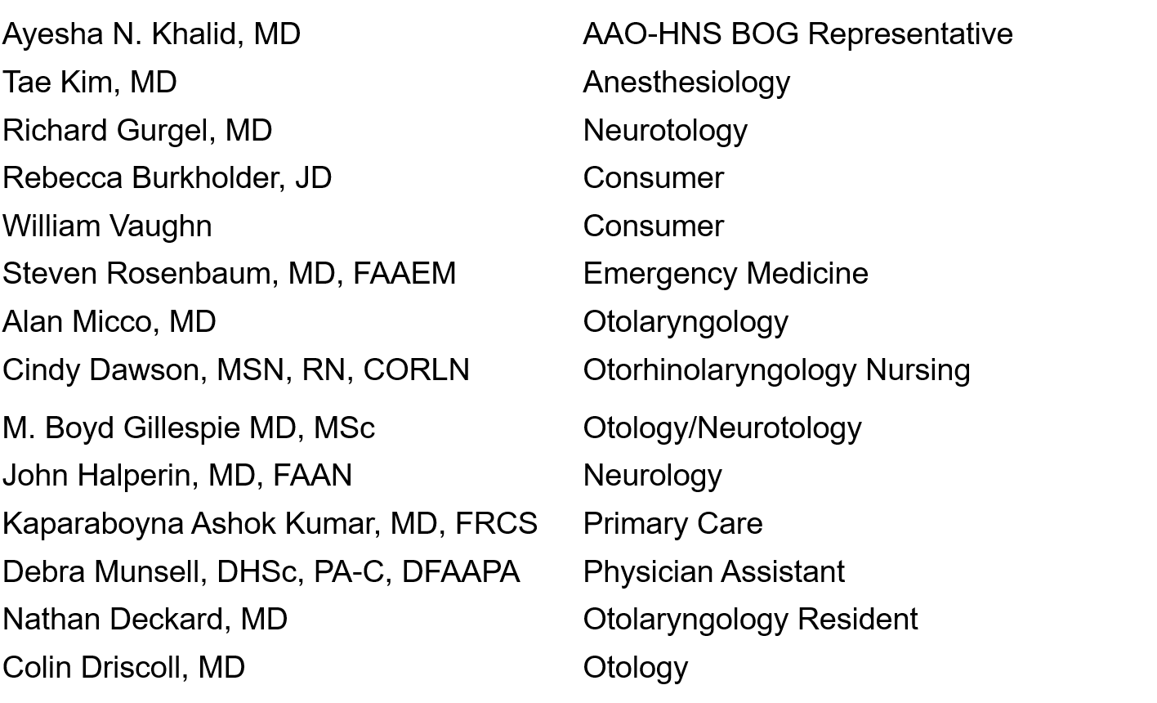
Multi-Disciplinary Panel

Slide 6
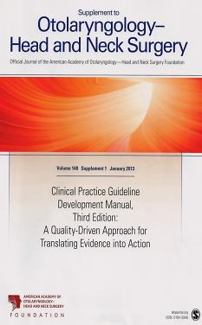
Clinical Practice Guideline Development Manual: Third Edition
Rosenfeld, Shiffman, and Robertson
Pragmatic, transparent approach to creating guidelines for performance assessment
Evidence-based, multidisciplinary process leading to publication in 12-18 months
Emphasizes a focused set of key action statements to promote quality improvement
Uses action statement profiles to summarize decisions in recommendations
Otolaryngol Head Neck Surg 2013; 148(Suppl):S1-55

Slide 7
CPG Goals
Focus on quality improvement opportunities
Define actionable statements for clinicians regardless of discipline to improve care
The guideline is not intended to be comprehensive
The guideline is not intended to limit or restrict care provided by clinicians to individual patients

Slide 8
CPG Development
Developed using an explicit and transparent a priori protocol
Create actionable statements based upon the supporting evidence and associated balance of benefit and harm

Slide 9
Literature Search
Performed by an information specialist
Clinical Practice Guidelines – 1 identified, 1 included in the final CPG
Systematic Reviews – 44 identified, 30 included in the final CPG
Randomized Controlled Trials – 83 identified, 49 included in the final CPG

Slide 10

External Peer Review
27 reviewers from the 16 organizations/committees (listed below) submitted 163 comments. Resulted in 83 edits/changes to the draft CPG.

Slide 11
Target Population
Children and Adults

Slide 12
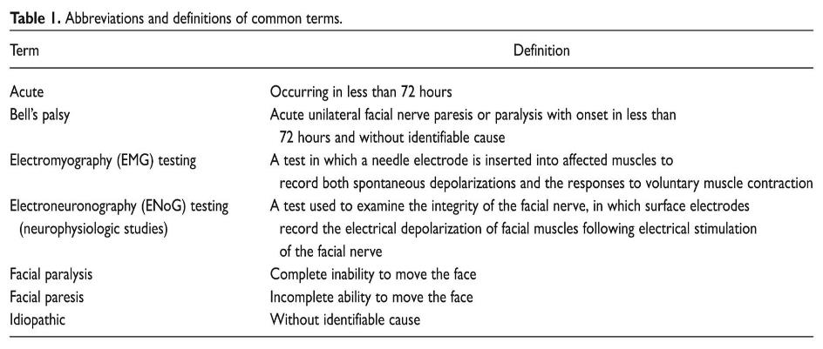
Definitions

Slide 13
Clinical Practice Guideline Development Manual: Third Edition
Rosenfeld, Shiffman, and Robertson
Pragmatic, transparent approach to creating guidelines for performance assessment
Evidence-based, multidisciplinary process leading to publication in 12-18 months
Emphasizes a focused set of key action statements to promote quality improvement
Uses action statement profiles to summarize decisions in recommendations
Otolaryngol Head Neck Surg 2013; 148(Suppl):S1-55

Slide 14
KAS 1: Patient History & Physical Examination
Clinicians should assess the patient using history and physical examination to exclude identifiable causes of facial paresis or paralysis in patients presenting with acute-onset unilateral facial paresis or paralysis. Strong recommendation based on observational studies of alternative causes of facial paralysis and reasoning from first principles, with a preponderance of benefit over harm
Benefits: Identification of other causes of facial paresis/paralysis, enabling accurate diagnosis; avoidance of unnecessary testing and treatment; identification of patients for whom other testing or treatment is indicated; opportunity for appropriate patient counseling
Risks, harms, costs: None

Slide 15
KAS 1: Patient History & Physical Examination
Action Statement Profile
Aggregate evidence quality: Grade C
Level of confidence in evidence: High
Benefit-harm assessment: Preponderance of benefit
Value judgments: The GDG felt that assessment of patients cannot be performed without a history and physical examination and that it wouldn’t be possible to find stronger evidence, as studies excluding these steps cannot ethically be performed. Other causes of facial paresis/paralysis may go unidentified; a thorough history and physical examination will help avoid missed dx or dx delay.
Intentional vagueness: None
Role of patient preferences: None
Exceptions: None
Policy level: Strong recommendation
Differences of opinion: None

Slide 16
KAS 2: Laboratory Testing
Clinicians should not obtain routine laboratory testing in patients with new-onset Bell’s palsy. Recommendation (against) based on observational studies and expert opinion with a preponderance of benefit over harm.
Benefits: Avoidance of unnecessary testing and/or treatment, avoidance of pursuing false positives, cost savings
Risks, harms, costs: Potential missed diagnosis

Slide 17
KAS 2: Laboratory Testing
Action Statement Profile
Aggregate evidence quality: Grade C
Level of confidence in evidence: High
Benefit-harm assessment: Preponderance of benefit
Value judgments: While the GDG felt that there are circumstances where specific testing is indicated in at-risk patients (such as Lyme disease serology in endemic areas), these patients can usually be identified by history.
Intentional vagueness: We used the word routine to specify that under certain circumstances, laboratory testing may be indicated.
Role of patient preferences: Small (there is an opportunity for patient education)
Exceptions: None
Policy level: Recommendation (against)

Slide 18
KAS 3: Diagnostic Imaging
Clinicians should not routinely perform diagnostic imaging for patients with new-onset Bell’s palsy. Recommendation (against) based on observational studies with a preponderance of benefit over harm.
Benefits: Avoidance of unnecessary radiation exposure, avoidance of incidental findings, avoidance of contrast reactions, cost savings
Risks, harms, costs: Risk of missing other cause of facial paresis/paralysis

Slide 19
KAS 3: Diagnostic Imaging
Action Statement Profile
Aggregate evidence quality: Grade C
Level of confidence in evidence: High
Benefit-harm assessment: Preponderance of benefit
Value judgments: None
Intentional vagueness: The word routine was used to indicate there may be some clinical findings that would warrant imaging.
Role of patient preferences: Small, but there is an opportunity for patient education/counseling
Exceptions: None
Policy level: Recommendation (against)

Slide 20
KAS 4: Oral Steroids
Clinicians should prescribe oral steroids within 72 hours of symptom onset for Bell’s palsy patients 16 years and older. Strong recommendation based on high-quality randomized controlled trials with a preponderance of benefit over harm.
Benefits: Improvement in facial nerve function, faster recovery
Risks, harms, costs: Steroid side effects, cost of therapy

Slide 21
KAS 4: Oral Steroids
Action Statement Profile
Aggregate evidence quality: Grade A
Level of confidence in evidence: High
Benefit-harm assessment: Preponderance of benefit
Value judgments: None
Intentional vagueness: None
Role of patient preferences: Small
Exceptions: Diabetes, morbid obesity, previous steroid intolerance, and psychiatric disorders. Pregnant women should be treated on an individualized basis.
Policy level: Strong recommendation
Differences of opinion: None

Slide 22
KAS 5A: Antiviral Monotherapy
Clinicians should not prescribe oral antiviral therapy alone for patients with new-onset Bell’s palsy. Strong recommendation (against) based on high-quality randomized controlled trials with a preponderance of benefit over harm.
Benefits: Avoidance of medication side effects, cost savings
Risks, harms, costs: None

Slide 23
KAS 5A: Antiviral Monotherapy
Action Statement Profile
Aggregate evidence quality: Grade A
Level of confidence in evidence: High
Benefit-harm assessment: Preponderance of benefit
Value judgments: None
Intentional vagueness: None
Role of patient preferences: Small
Exceptions: None
Policy level: Strong recommendation (against)

Slide 24
KAS 5B: Combination Antiviral Therapy
Clinicians may offer oral antiviral therapy in addition to oral steroids within 72 hours of symptom onset for patients with Bell’s palsy. Option based on randomized controlled trials with minor limitations and observational studies with equilibrium of benefit and harm
Benefits: Small potential improvement in facial nerve function
Risks, harms, costs: Treatment side effects, cost of treatment
Avoid unnecessary surgery and its risks, avoid surgery in children for whom RCTs have not demonstrated any benefit for reducing AOM incidence or in children with a condition that has reasonable likelihood of spontaneous resolution, cost savings

Slide 25
KAS 5B: Combination Antiviral Therapy
Action Statement Profile
Aggregate evidence quality: Grade B
Level of confidence in evidence: Medium, because the studies cannot exclude a small effect
Benefit-harm assessment: Equilibrium of benefit and harm
Value judgments: Although the data were weak, the risks of combination therapy were small.
Intentional vagueness: None
Role of patient preferences: Large; significant role for shared decision making
Exceptions: Diabetes, morbid obesity, and previous steroid intolerance. Pregnant women should be treated on an individualized basis.
Policy level: Option
Differences of opinion: None

Slide 26
KAS 6: Eye Care
Clinicians should implement eye protection for Bell’s palsy patients with impaired eye closure. Strong recommendation based on expert opinion and a strong clinical rationale with a preponderance of benefit over harm.
Benefits: Prevention of eye complications
Risks, harms, costs: Cost of eye protection implementation, potential side effects of eye medication

Slide 27
KAS 6: Eye Care
Action Statement Profile
Aggregate evidence quality: Grade X
Level of confidence in evidence: High. Eye protection has been the standard of care, and comparative studies with a no-treatment arm are unethical.
Benefit-harm assessment: Preponderance of benefit over harm
Value judgments: None
Intentional vagueness: None
Role of patient preferences: Small
Exceptions: None
Policy level: Strong recommendation

Slide 28
KAS 7A: Electrodiagnostic Testing with Incomplete Paralysis
Clinicians should not perform electrodiagnostic testing in Bell’s palsy patients with incomplete facial paralysis. Recommendation (against) based on observational studies with a preponderance of benefit over harm.
Benefits: Avoidance of unnecessary testing, cost savings
Risks, harms, costs: None

Slide 29
KAS 7A: Electrodiagnostic Testing with Incomplete Paralysis
Action Statement Profile
Aggregate evidence quality: Grade C
Level of confidence in evidence: High
Benefit-harm assessment: Preponderance of benefit over harm
Value judgments: None
Intentional vagueness: None
Role of patient preferences: None
Exceptions: None
Policy Level: Recommendation (against)

Slide 30
KAS 7B: Electrodiagnostic Testing with Complete Paralysis
Clinicians may offer electrodiagnostic testing to Bell’s palsy patients with complete facial paralysis. Option based on observational trials with equilibrium of benefit and harm
Benefit: Provide prognostic information for the clinician and patient, identification of potential surgical candidates
Risk, harm, cost: Patient discomfort, inconvenience to undergo repeated electrical testing, cost of testing

Slide 31
KAS 7B: Electrodiagnostic Testing with Complete Paralysis
Action Statement Profile
Aggregate evidence quality: Grade C
Level of confidence in evidence: Medium due to variations in patient selection, study design, and heterogeneous results
Benefit-harm assessment: Equilibrium of benefit and harm
Value judgments: None
Intentional vagueness: None
Role of patient preferences: Large role for shared decision making, as electrodiagnostic testing may provide only prognostic information for the patient
Exceptions: None
Policy level: Option

Slide 32
KAS 8: Surgical Decompression
No recommendation can be made regarding surgical decompression for Bell’s palsy patients. No recommendation based on low-quality, nonrandomized trials and equilibrium of benefit and harm.
Benefits: Improved facial nerve functional recovery
Risks, harms, costs: Surgical risks and complications, anesthetic risks, direct and indirect costs of surgery

Slide 33
KAS 8: Surgical Decompression
Action Statement Profile
Aggregate evidence quality: Grade D
Level of confidence in evidence: Low due to insufficient number of patients and poor quality of studies. Low confidence in the evidence led to a downgrade of the aggregate evidence quality from C to D.
Benefit-harm assessment: Equilibrium of benefit and harm
Value judgments: Although the data supporting surgical decompression are not strong, there may be a significant benefit for a small subset of patients who meet eligibility criteria and desire surgical management.
Intentional vagueness: None
Role of patient preferences: Large. The psychological impact of facial paralysis is significant but varies among patients. Concern about the facial deformity may make some patients willing to pursue a major operation for a small increase in the chance of complete recovery, while others may be more willing to accept the chance of poorer outcome to avoid surgery.

Slide 34
KAS 8: Surgical Decompression
Action Statement Profile (cont’d)
Exceptions: None
Policy level: No recommendation
Differences of opinion: Major. The group was divided as to whether the evidence supported no recommendation or an option for surgery. This difference of opinion derived from controversy regarding the strength of evidence (C level evidence vs D level evidence).

Slide 35
KAS 9: Acupuncture
No recommendation can be made regarding the effect of acupuncture in Bell’s palsy patients. No recommendation based on poor-quality trials and an indeterminate ratio of benefit and harm.
Benefits: Acupuncture may provide a potential small improvement in facial nerve function and pain
Risks, harms, costs: Cost of acupuncture therapy, time required for therapy, therapy side effects, and delay in instituting steroid therapy

Slide 36
KAS 9: Acupuncture
Action Statement Profile
Aggregate evidence quality: Grade B
Level of confidence in evidence: Low, due to significant methodological flaws in available evidence
Benefit-harm assessment: Unknown
Value judgments: Due to the poor quality of the data and the inability to determine the harm-to-benefit ratio, the GDG could not make a recommendation.
Intentional vagueness: None
Role of patient preferences: Large
Exceptions: None
Policy level: No recommendation
Differences of opinion: Major. The GDG was divided regarding whether to recommend against acupuncture or to make no recommendation

Slide 37
KAS 10: Physical Therapy
No recommendation can be made regarding the effect of physical therapy in Bell’s palsy patients. No recommendation based on case series and equilibrium of benefit and harm.
Benefits: Potential functional and psychological benefit
Risk, harm, cost: Cost of therapy, time required for therapy

Slide 38
KAS 10: Physical Therapy
Action Statement Profile
Aggregate evidence quality: Grade D
Level of confidence in evidence: Low, due to significant flaws in existing trials
Benefit-harm assessment: Equilibrium of benefit and harm
Value judgments: Patients may benefit psychologically from engaging in physical therapy exercises
Intentional vagueness: None
Role of patient preferences: Large role for shared decision making
Exceptions: None
Policy level: No recommendation
Differences of opinion: None

Slide 39
KAS 11: Patient Follow-Up
Clinicians should reassess or refer to a facial nerve specialist those Bell’s palsy patients with (1) new or worsening neurologic findings at any point, (2) ocular symptoms developing at any point, or (3) incomplete facial recovery 3 months after initial symptom onset. Recommendation based on observational studies with a preponderance of benefit over harm.
Benefits: Reevaluation for alternate diagnoses of facial paralysis, discussion of therapeutic/reconstructive options, psychological support of patient
Risk, harm, cost: Cost of visit, time required to visit

Slide 40
KAS 11: Patient Follow-Up
Action Statement Profile
Aggregate evidence quality: Grade C
Level of confidence in evidence: High
Benefit-harm assessment: Preponderance of benefit over harm
Value judgments: The GDG sought to address the importance of identifying alternate dx in the absence of recovery and potential assessment for rehabilitative options. The GDG recognized a lack of established time for patient follow-up; however, based on the natural history of Bell’s palsy, most patients will show complete recovery 3 months after onset.
Intentional vagueness: Several specialties have the expertise to reevaluate these patients; therefore, the term facial nerve specialist is used to indicate the clinician who could most appropriately assess new or worsening symptoms in these patients.
Role of patient preferences: Small
Policy level: Recommendation

Slide 41
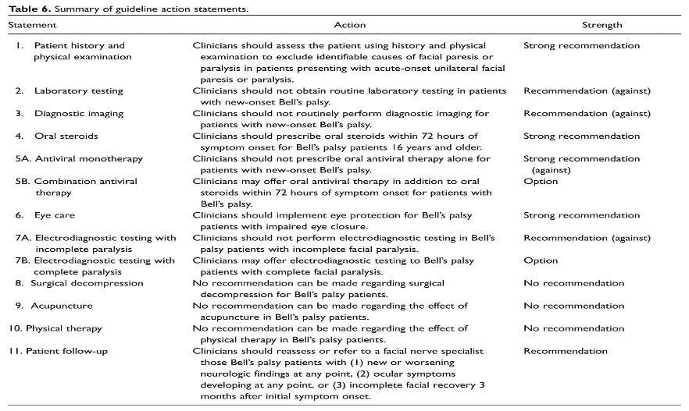
In Summary

Slide 42
Research Needs
Consolidated Standards of Reporting Trials (CONSORT) recommendations should be followed in all RCTs, ensuring valid outcomes measures are employed. The evaluation of patients prior to treatment, during treatment, immediately following treatment, and again months later, as well as collection of quality-of-life data prior to and following treatment, are all key components for a comprehensive RCT.
The timing and outcomes for patients with and without surgical facial nerve decompression need to be compared. More specifically, the surgical approach (ie, middle fossa), age (young vs old), and time to improvement from onset of paresis/paralysis to recovery (with levels of recovery) need to be compared with traditional medical management groups (ie, steroids and/or antivirals).

Slide 43
Research Needs (cont’d)
Future clinical trials should compare eye care tactics for patients with Bell’s palsy to provide the basis for stronger recommendations (eg, comparison of the frequency of treatment or content of ointment).
The benefits and risks of steroid use in children with Bell’s palsy need to be better elucidated.
Further study is needed to more comprehensively compare the concurrent use of combined steroids and antiviral therapy on Bell’s palsy outcomes. Future trials may benefit from designs that allow subgroup analysis to help identify which patients are more likely to benefit from combination therapy.
More rigorous randomized controlled trials are needed to address the effectiveness of acupuncture.
The efficacy of different physical therapy treatment modalities on asymmetry, symmetry of voluntary movement, and synkinesis in patients with Bell’s palsy needs to be elucidated.

Slide 44

Choosing Wisely®
It is an initiative of the American Board of Internal Medicine (ABIM) Foundation.
Aims to encourage discussions between physicians and patients about appropriate care.
Each of the campaign’s organization partners is asked to identify (initially) 5 items within its specialty that physicians and patients should question. The AAO-HNSF list has now grown to 10 items.
The AAO-HNSF’s list of recommendations were carefully selected after a review of the current evidence that included AAO-HNSF clinical practice guidelines.
More information is available at www.entnet.org/ChoosingWisely
What is Choosing Wisely®?

Slide 45


AAO-HNSF List of 10 Things Physicians and Patients Should Question
The Initial List

Slide 46


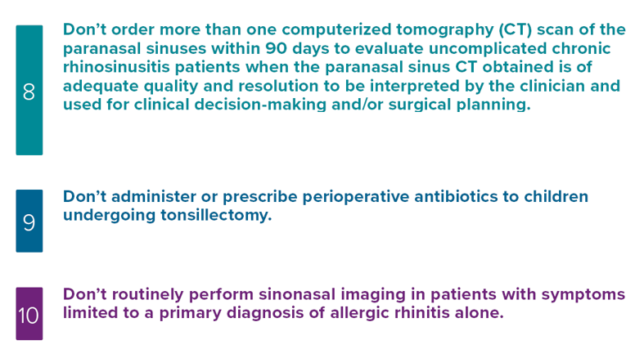
AAO-HNSF List of 10 Things Physicians and Patients Should Question
The Second List

Slide 47
Thank you for your attention
QUESTIONS?

