Slide 1
AAO-HNSF
Clinical Practice Guideline:
Benign Paroxysmal Positional Vertigo (Update)
Published March 1, 2017
Update to the 2008 published CPG
Presented by: TBD

Slide 2
Disclaimer
The clinical practice guideline is not intended as the sole source of guidance in managing patients with BPPV. Rather, it is designed to assist clinicians by providing an evidence-based framework for decision-making strategies. The guideline is not intended to replace clinical judgment or establish a protocol for all individuals with this condition and may not provide the only appropriate approach to diagnosing and managing this program of care. As medical knowledge expands and technology advances, clinical indicators and guidelines are promoted as conditional and provisional proposals of what is recommended under specific conditions but are not absolute. Guidelines are not mandates. These do not and should not purport to be a legal standard of care. The responsible physician, in light of all circumstances presented by the individual patient, must determine the appropriate treatment. Adherence to these guidelines will not ensure successful patient outcomes in every situation. The American Academy of Otolaryngology-Head and Neck Surgery Foundation emphasizes that these clinical guidelines should not be deemed to include all proper treatment decisions or methods of care or to exclude other treatment decisions or methods of care reasonably directed to obtaining the same results.

Slide 3
Burden
BPPV is the most common vestibular disorder across the lifespan (Parnes et al, 2003; Nedzelski et al, 1986; Neuhauser, 2007).
It is estimated that it costs approximately $2000 to arrive at the diagnosis of BPPV and that greater than 65% of patients with this condition will undergo potentially unnecessary diagnostic testing or therapeutic interventions (Wang, et al, 2014).
BPPV is more common in older individuals with a correspondingly more pronounced health and quality-of-life impact. It has been estimated that 9% of elderly patients undergoing comprehensive geriatric assessment for non-balance related complaints have unrecognized BPPV. Older patients with BPPV experience a greater incidence of falls, depression and impairments of their daily activities(Oghalai et el, 2000).

Slide 4
Differences from Prior CPG
Addition of a consumer advocate to the guideline development group
New evidence from 2 clinical practice guidelines, 20 systematic reviews, and 27 randomized controlled trials
Emphasis on patient education and shared decision-making
Expanded action statement profiles to explicitly state quality improvement opportunities, confidence in the evidence, intentional vagueness, and differences of opinion
Enhanced external review process to include public comment and journal peer review
New algorithm to clarify decision making and action statement relationships
New recommendation regarding canalith repostioning post-procedural restrictions.
Expansion of the recommendations regarding radiographic and vestibular testing.
Removal of the “no recommendation” for audiometric testing.
A diagnostic and treatment visual algorithm was added.

Slide 5
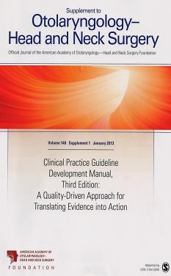
Clinical Practice Guideline Development Manual: Third Edition
Rosenfeld, Shiffman, and Robertson
Pragmatic, transparent approach to creating guidelines for performance assessment
Evidence-based, multidisciplinary process leading to publication in 12-18 months
Emphasizes a focused set of key action statements to promote quality improvement
Uses action statement profiles to summarize decisions in recommendations
Otolaryngol Head Neck Surg 2013; 148(Suppl):S1-55

Slide 6
CPG Goals
Focus on quality improvement opportunities
Define actionable statements for clinicians regardless of discipline to improve care
The guideline is not intended to be comprehensive
The guideline is not intended to limit or restrict care provided by clinicians to individual patients

Slide 7
CPG Leadership
Neil Bhattacharyya, MD, FACS(Chair)
Samuel P. Gubbels, MD, FACS (Assistant Chair)
Seth R. Schwartz, MD MPH (Methodologist)

Slide 8


Stakeholders as authors

Slide 9
Target Population
The target patient for this guideline is aged 18 years or older with a suspected or potential diagnosis of BPPV.

Slide 10
Purpose & Target Audience
Purpose: To improve quality of care and outcomes for BPPV by improving the accurate and efficient diagnosis of BPPV, reducing the inappropriate use of vestibular suppressant medications, decreasing the inappropriate use of ancillary testing such as radiographic imaging and increasing the use of appropriate therapeutic repositioning maneuvers.
Target audience: All clinicians who are likely to diagnose and manage patients with BPPV, and applies to any setting in which BPPV would be identified, monitored, or managed

Slide 11
Strength of Action Terms/Implied Levels of Obligation
Strength | Definition | Implied Obligation
Strong Recommendation | The benefits of the recommended approach clearly exceed the harms (or, in the case of a strong negative recommendation, the harms clearly exceed the benefits) and the quality of the supporting evidence is high (Grade A or B). | In some clearly identified circumstances, strong recommendations may be made based on lesser evidence when high-quality evidence is impossible to obtain, and the anticipated benefits strongly outweigh the harms. Clinicians should follow a strong recommendation unless a clear and compelling rationale for an alternative approach is present.
Recommendation | The benefits exceed the harms (or, in the case of a negative recommendation, the harms exceed the benefits), but the quality of evidence is not as high (Grade B or C). | In some clearly identified circumstances, recommendations may be made based on lesser evidence when high-quality evidence is impossible to obtain, and the anticipated benefits outweigh the harms. Clinicians should generally follow a recommendation but should remain alert to new information and remain sensitive to patient preferences.
Option | Either the quality of evidence is suspect (Grade D) or well-done studies (Grade A, B, or C) show little clear advantage to one approach versus another. | Clinicians should be flexible in their decision making regarding appropriate practice, although they may set bounds on alternatives; patient preference should have a substantial influencing role.

Slide 12
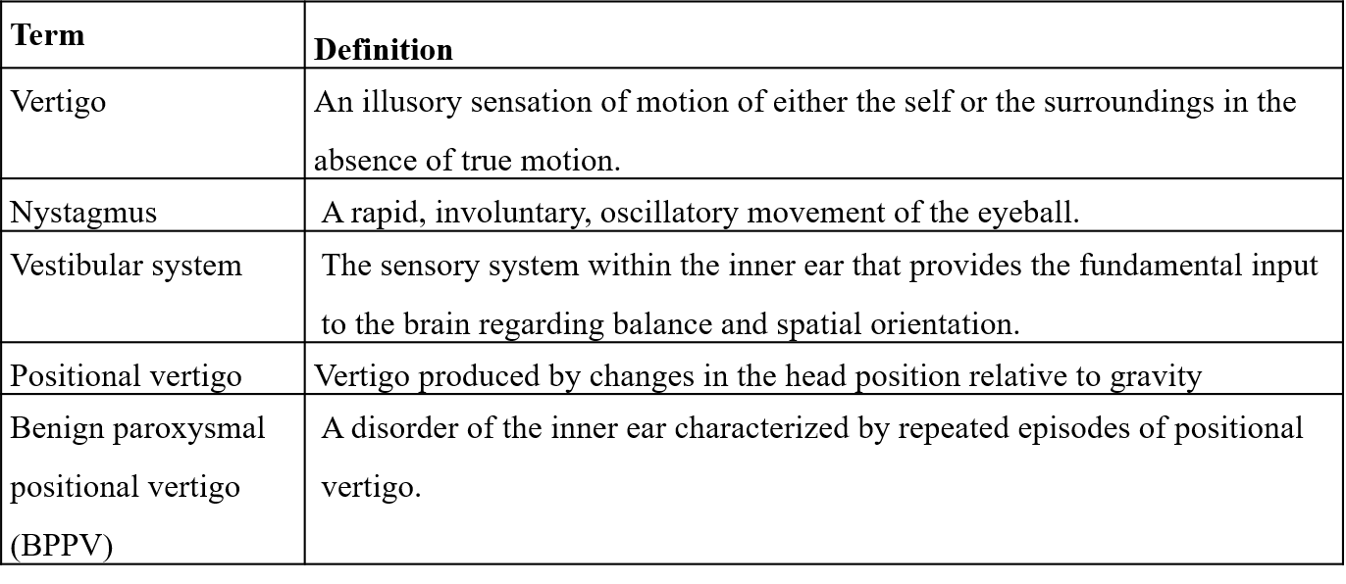
Definitions

Slide 13
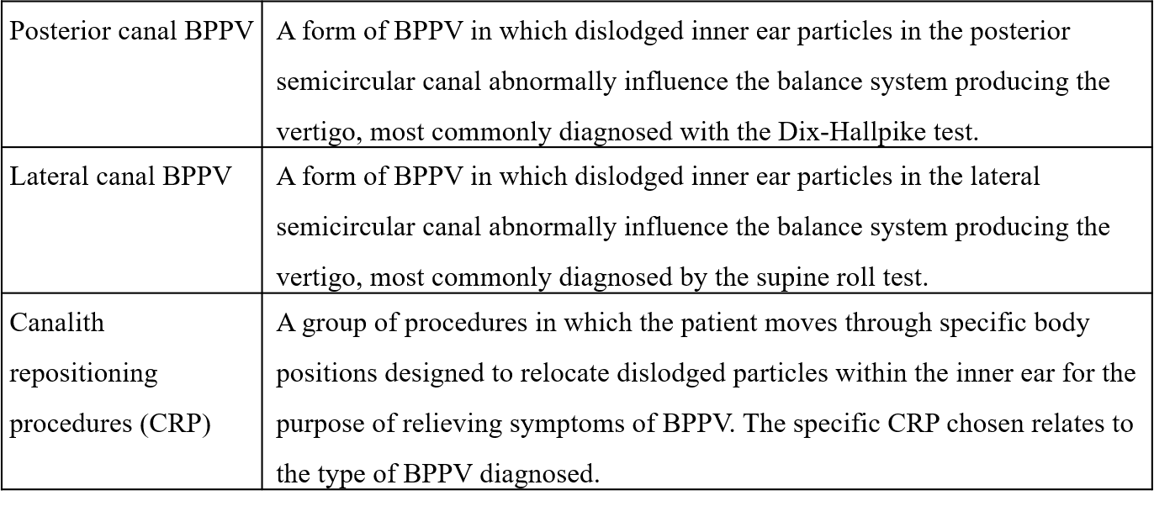
Definitions

Slide 14
CPG Development
Developed using an explicit and transparent a priori protocol
Create actionable statements based upon the supporting evidence and associated balance of benefit and harm

Slide 15
Literature Search
Performed by an information specialist
Clinical Practice Guidelines – 2 included in the final CPG
Systematic Reviews –20 included in the final CPG
Randomized Controlled Trials –27 included in the final CPG

Slide 16
KAS 1A: Diagnosis of Posterior Semicircular Canal BPPV
DIAGNOSIS OF POSTERIOR SEMICIRCULAR CANAL BPPV: Clinicians should diagnose posterior semicircular canal BPPV when vertigo associated with torsional, up-beating nystagmus is provoked by the Dix‑Hallpike maneuver, performed by bringing the patient from an upright to supine position with the head turned 45 degrees to one side and neck extended 20 degrees with the affected ear down. The maneuver should be repeated with the opposite ear down if the initial maneuver is negative. Strong recommendation based on diagnostic studies with minor limitations and a preponderance of benefit over harm.
Benefits: Improved diagnostic accuracy and efficiency
Risks, harms, costs: Risk of provoking temporary symptoms of BPPV

Slide 17
KAS 1A: Diagnosis of Posterior Semicircular Canal BPPV
Action Statement Profile
Quality improvement opportunity: Promoting accurate and efficient diagnosis of BPPV (National Quality Strategy domains: promoting effective prevention/treatments, affordable quality care)
Aggregate evidence quality: Grade B, based on diagnostic studies with minor limitations
Level of confidence in the evidence: High
Benefits-harm assessment: Preponderance of benefit over harm
Value judgments: Conclusion that paroxysmal positional nystagmus induced by the Dix-Hallpike maneuver confirms the diagnosis of BPPV and is the gold standard test for diagnosis. The panel emphasized that a history of positional vertigo alone is not adequate to make the diagnosis of posterior canal BPPV
Role of patient preferences: Minimal
Intentional vagueness: None
Exceptions: Patients with physical limitations including cervical stenosis, severe kyphoscoliosis, limited cervical range of motion, Down’s syndrome, severe rheumatoid arthritis, cervical radiculopathies, Paget’s disease, ankylosing spondylitis, low back dysfunction, spinal cord injuries and the morbidly obese
Policy level: Strong recommendation
Differences of opinion: None

Slide 18
KAS 1B: Diagnosis of Lateral (Horizontal) Semicircular Canal BPPV
DIAGNOSIS OF LATERAL (HORIZONTAL) SEMICIRCULAR CANAL BPPV. If the patient has a history compatible with BPPV and the Dix‑Hallpike test exhibits horizontal or no nystagmus, the clinician should perform, or refer to a clinician who can perform, a supine roll test to assess for lateral semicircular canal BPPV. Recommendation based on diagnostic studies with limitations and a preponderance of benefit over harm.
Benefit: Avoid missed diagnoses of lateral canal BPPV. Allows accurate diagnosis of lateral canal BPPV thereby avoiding unnecessary diagnostic tests and inappropriate treatment. Increased awareness of horizontal canal BPPV
Risks, harms, costs: Risk of provoking temporary symptoms of BPPV

Slide 19
KAS 1B: Diagnosis of Lateral (Horizontal) Semicircular Canal BPPV
Action Statement Profile
Quality improvement opportunity: Improve accurate and efficient diagnosis of lateral canal BPPV (National Quality Strategy domains: promoting effective prevention/treatment, affordable quality care)
Aggregate evidence quality: Grade B based on several RCTs with supine roll test as the reference entry standard
Level of confidence in evidence: High
Benefits-harm assessment: Preponderance of benefit over harm
Value judgments: None
Intentional vagueness: None
Role of patient preferences: Small
Exceptions: Patients with physical limitations including cervical stenosis, severe kyphoscoliosis, limited cervical range of motion, Down’s syndrome, severe rheumatoid arthritis, cervical radiculopathies, Paget’s disease, ankylosing spondylitis, low back dysfunction, spinal cord injuries, and the morbidly obese
Policy level: Recommendation
Differences of opinion: None

Slide 20
KAS 2A: Differential Diagnosis
DIFFERENTIAL DIAGNOSIS: Clinicians should differentiate, or refer to a clinician who can differentiate, BPPV from other causes of imbalance, dizziness and vertigo. Recommendation based on observational studies and a preponderance of benefit over harm.
Benefits: Prevent false positive diagnosis of BPPV when another condition actually exists
Risks, harms, costs: None

Slide 21
KAS 2A: Differential Diagnosis
Action Statement Profile
Quality improvement opportunity: Avoid incorrect diagnosis of BPPV (National Quality Strategy domain: promoting effective prevention/treatment)
Aggregate evidence quality: Grade C, based on observational studies with limitations
Level of confidence in evidence: Medium
Benefits-harm assessment: Preponderance of benefit over harm
Value judgments: None
Intentional vagueness: None
Role of patient preferences: Small
Exceptions: None
Policy level: Recommendation
Differences of opinion: None

Slide 22
KAS 2B: Modifying Factors
MODIFYING FACTORS: Clinicians should assess patients with BPPV for factors that modify management including impaired mobility or balance, central nervous system disorders, a lack of home support, and/or increased risk for falling. Recommendation based on observational and cross-sectional studies and a preponderance of benefit over harm.
Benefits: Allow for management of patients with BPPV with an appropriately structured comprehensive treatment plan. Identify patients at risk for falls and prevent fall related injury
Risks, harms, costs: None

Slide 23
KAS 2B: Modifying Factors
Action Statement Profile
Quality improvement opportunity: Decrease risks for complications from BPPV in at risk populations. (National Quality Strategy domains: safety, coordination of care)
Aggregate evidence quality: Grade C, based on observational and cross-sectional studies
Level of confidence in evidence: Medium
Benefits-harm assessment: Preponderance of benefit over harm.
Value judgments: None
Intentional vagueness: Factors that modify management are intentionally vague as all factors cannot be listed and individual clinical judgment is required
Role of patient preferences: Small
Exceptions: None
Policy level: Recommendation
Differences of opinion: None

Slide 24
KAS 3A: Radiographic Testing
RADIOGRAPHIC TESTING: Clinicians should not obtain radiographic imaging in a patient who meets diagnostic criteria for BPPV in the absence of additional signs and/or symptoms inconsistent with BPPV that warrant imaging. Recommendation against radiographic imaging based on diagnostic studies with limitations and a preponderance of benefit over harm.
Benefits: Facilitate timely treatment by avoiding unnecessary testing associated with low yield and potential false positive diagnoses. Avoid radiation exposure and adverse reactions to testing
Risks, harms, costs: None

Slide 25
KAS 3A: Radiographic Testing
Action Statement Profile
Quality improvement opportunity: Reduce unnecessary testing and costs, reduced unnecessary radiation and radiographic contrast exposure (National Quality Strategy domains: safety, affordable quality care)
Aggregate evidence quality: Grade C, based on observational studies for radiographic imaging
Level of confidence in evidence: Medium
Benefits-harm assessment: Preponderance of benefit over harm
Value judgments: The panel placed heavy value in the accuracy of the BPPV diagnosis at the outset in that a diagnosis made by appropriate history and Dix-Hallpike is adequate to proceed with management without further testing
Intentional vagueness: None
Role of patient preferences: None
Exceptions: Patients who have separate indications for radiographic or vestibular testing aside from confirming a diagnosis of BPPV
Policy level: Recommendation against
Differences of opinion: None

Slide 26
KAS 3B: Vestibular Testing
VESTIBULAR TESTING: Clinicians should not order vestibular testing in a patient who meets diagnostic criteria for BPPV in the absence of additional vestibular signs and/or symptoms inconsistent with BPPV that warrant testing. Recommendation against vestibular testing based on diagnostic studies with limitations and a preponderance of benefit over harm.
Benefits: Facilitate timely treatment by avoiding unnecessary testing associated with low yield and potential false positive diagnoses. Avoid patient discomfort from nausea and vomiting from vestibular testing. Reduced costs from unnecessary testing
Risks, harms, costs: None

Slide 27
KAS 3B: Vestibular Testing
Action Statement Profile
Quality improvement opportunity: Reduce unnecessary testing and costs (National Quality Strategy domains: safety, affordable quality care)
Aggregate evidence quality: Grade C, based on diagnostic studies with limitations in referred patient populations and observational studies for vestibular testing
Level of confidence in evidence: Medium
Benefits-harm assessment: Preponderance of benefit over harm
Value judgments: None
Intentional vagueness: None
Role of patient preferences: None
Exceptions: Patients who have separate indications for vestibular testing aside from confirming a diagnosis of BPPV
Policy level: Recommendation against
Differences of opinion: None

Slide 28
KAS 4A: Repositioning Procedures as Initial Therapy
REPOSITIONING PROCEDURES AS INITIAL THERAPY: Clinicians should treat, or refer to a clinician who can treat, patients with posterior canal BPPV with a canalith repositioning procedure. Strong recommendation based on systematic reviews of randomized controlled trials and a preponderance of benefit over harm.
Benefits: Prompt resolution of symptoms with a relatively low number needed to treat ranging from 1 to 3
Risks, harms, costs: Transient provocation of symptoms of BPPV by the procedure. Risk for falls due to imbalance after the procedure. No serious adverse events reported in RCTs

Slide 29
KAS 4A: Repositioning Procedures as Initial Therapy
Action Statement Profile
Quality improvement opportunity: To promote effective treatment of posterior canal BPPV ((National Quality Strategy domain: promoting effective prevention/treatments)
Aggregate evidence quality: Grade A, based on systematic reviews of randomized controlled trials
Level of confidence in evidence: High for otolaryngology or subspecialty settings. Lower in primary care settings where evidence is more limited
Benefits-harm assessment: Preponderance of benefit over harm
Value judgments: High value ascribed to prompt resolution of symptoms and the ease with which the CRP may be performed
Intentional vagueness: None
Role of patient preferences: Moderate
Exceptions: Patients with physical limitations including cervical stenosis, Down’s syndrome, severe rheumatoid arthritis, cervical radiculopathies, Paget’s disease, morbid obesity, ankylosing spondylitis, low back dysfunction, retinal detachment, and spinal cord injuries may not be candidates for this procedure or may need specialized examination tables for performance of the procedure
Policy level: Strong recommendation
Differences of opinion: None

Slide 30
KAS 4B: Post-Procedural Restrictions
POST-PROCEDURAL RESTRICTIONS: Clinicians should not recommend post‑ procedural postural restrictions after canalith repositioning procedure for posterior canal BPPV. Strong recommendation against restrictions based on randomized controlled trials with minor limitations and a preponderance of benefit over harm.
Benefits: Faster return to normal lifestyle, reduced anxiety, less sleep or work interruption, reduced musculoskeletal discomfort, reduced cost (e.g., of cervical collars)
Risk, harm, cost: Potential risk for increased failure risk in a small subset of patients

Slide 31
KAS 4B: Post-Procedural Restrictions
Action Statement Profile
Quality improvement opportunity: Avoidance of unnecessary interventions, engaging patients, decreasing use of ineffective treatments (National Quality Strategy domain: coordination of care)
Aggregate evidence quality: Grade A
Level of confidence in evidence: High
Benefit-harm assessment: Preponderance of benefit
Value judgments: None
Intentional vagueness: The generic term restrictions is used but that can include sleeping upright, laying on the involved side, use of a cervical collar, or any type of restriction
Role of patient preferences: Small
Exclusions: None
Policy level: Strong Recommendation Against
Differences of opinion: Several panel members had only medium confidence in the evidence

Slide 32
KAS 4C: Observation as Initial Therapy
OBSERVATION AS INITIAL THERAPY: Clinicians may offer observation with follow up as initial management for patients with BPPV. Option based on data from cohort and observational studies with heterogeneity and a relative balance of benefits and harms.
Benefits: Symptom resolution in 15-85% at one month without intervention.
Risks, harms, costs: Prolonged symptoms compared to other interventions that may expose patients to increased risks for falls or lost days of work. Indirect costs of delayed resolution compared to other measures.

Slide 33
KAS 4C: Observation as Initial Therapy
Action Statement Profile
Quality improvement opportunity: Decreased costs due to less intervention and incorporating patient preferences. (National Quality Strategy domains: engaging patients, affordable quality care)
Aggregate evidence quality: Grade B, based on control groups from RCTs and observational studies with heterogeneity in follow-up and outcomes measures
Level of confidence in evidence: High
Benefits-harm assessment: Relative balance of benefits and harms
Value judgments: The panel felt strongly in favor of treatment with CRP rather than observation, particularly with respect to the value of an expedited time to symptom resolution. The panel felt that observation for older patients, patients with preexisting balance disorders or in individuals at high risks for falls may not be suitable for observation
Intentional vagueness: Definition of follow up is not explicitly specified
Role of patient preferences: Large
Exceptions: None
Policy level: Option
Differences of opinion. Some panel members thought that this option was not the optimal choice for management given the data for other interventions

Slide 34
KAS 5: Vestibular Rehabilitation
VESTIBULAR REHABILITATION: The clinician may offer vestibular rehabilitation in the treatment of BPPV. Option based on controlled observational studies and a balance of benefit and harm.
Benefits: Offer additional therapy for patients with additional impairments; prevention of falls, improved return of natural balance function
Risks, harms, costs: No serious adverse events noted in published trials. Transient provocation of BPPV symptoms during rehabilitation exercises. Potential for delayed symptom resolution as compared to particle repositioning maneuvers as a sole intervention. Need for repeated visits if done with clinician supervision. Cost of therapy

Slide 35
KAS 5: Vestibular Rehabilitation
Action Statement Profile
Quality improvement opportunity: Offer additional therapy for patients with additional impairments, who fail initial CRP attempts, who are not candidates for CRP and/or who refuse CRP. Promoting effective therapy and increased patient safety (National Quality Strategy domains: safety, promoting effective prevention/treatment)
Aggregate evidence quality: Grade “B”, based on subset analysis of a SR and limited RCTs
Level of confidence in evidence: Medium
Benefits-harm assessment: Relative balance of benefits and harm
Value judgments: The panel felt that vestibular rehabilitation, as defined in this guideline, may be better as an adjunctive therapy rather than a primary treatment modality. Subsets of patients with preexisting balance deficit, CNS disorders or risk for falls may derive more benefit from VR than the patient with isolated BPPV
Intentional vagueness: Non-specification of type of VR nor timing (initial vs adjunctive) of therapy
Role of patient preferences: Large
Exceptions: Patients with physical limitations such as cervical stenosis, Down’s syndrome, severe rheumatoid arthritis, cervical radiculopathies, Paget’s disease, morbid obesity, ankylosing spondylitis, low back dysfunction, and spinal cord injuries
Policy level: Option
Differences of opinion: None

Slide 36
KAS 6: Medical Therapy
MEDICAL THERAPY: Clinicians should not routinely treat BPPV with vestibular suppressant medications such as antihistamines and/or benzodiazepines. Recommendation against routine medication based on observational studies and a preponderance of benefit over harm.
Benefits: Avoidance of adverse effects from or medication interactions with these medications. Prevention of decreased diagnostic sensitivity from vestibular suppression during performance of the Dix‑Hallpike maneuvers
Risks, harms, costs: None

Slide 37
KAS 6: Medical Therapy
Action Statement Profile
Quality improvement opportunity: Decreased use of unnecessary medications with potentially harmful side effects. Reduced costs. National Quality Strategy domains: safety, promoting effective prevention/treatment, affordable quality care)
Aggregate evidence quality: Grade C based on observational and cross-sectional studies
Level of confidence in evidence: Medium
Benefits-harm assessment: Preponderance of benefit over harm
Value judgments: To avoid harm from ineffective treatments
Intentional vagueness: The panel recognized that there might be a small subgroup of patients with severe symptoms who may need vestibular suppression until more definitive treatment can be offered (e.g. CRP) or immediately after treatment with CRP
Role of patient preferences: Small
Exceptions: Severely symptomatic patients refusing other treatment options and patients requiring prophylaxis for CRP
Policy level: Recommendation against
Differences of opinion: None

Slide 38
KAS 7A: Outcome Assessment
OUTCOME ASSESSMENT: Clinicians should reassess patients within 1 month after an initial period of observation or treatment to document resolution or persistence of symptoms. Recommendation based on observational outcomes studies and expert opinion and a preponderance of benefit over harm.
Benefits: Increased accuracy of BPPV diagnosis. Identify patients initially treated with observation who have persistent symptoms and may benefit from CRP or vestibular rehabilitation to hasten symptom resolution
Risks, harms, costs: Cost of reassessment

Slide 39
KAS 7A: Outcome Assessment
Action Statement Profile
Quality improvement opportunity: Obtain outcomes data for treatment of BPPV; ability to assess treatment effectiveness. (National Quality Strategy domains: safety, engaging patients, coordination of care, promoting effective prevention/treatment)
Aggregate evidence quality: Grade C studies with known significant failure rates for an observation option and lower failure rates for CRP
Level of confidence in evidence: Medium
Benefits-harm assessment: Preponderance of benefit over harm
Value judgments: Panel valued ensuring the accuracy of diagnosis that may be enhanced by follow-up and capturing patients who could benefit from treatment or re-treatment to improve symptom resolution. Panel valued the potential importance of outcomes measures in the overall healthcare data environment
Intentional vagueness: The term reassess could represent various types of follow-up including phone calls from office staff or other methods to document outcome
Role of patient preferences: Minimal
Exceptions: None.
Policy level: Recommendation
Differences of opinion: Some panel members felt there is value in return visits to establish symptom resolution or to document objective improvement. Most other panel members felt that phone contact versus open-ended follow-up if symptoms persist or recur is sufficient

Slide 40
KAS 7B: Evaluation of Treatment Failure
EVALUATION OF TREATMENT FAILURE: Clinicians should evaluate, or refer to a clinician who can evaluate, patients with persistent symptoms for unresolved BPPV and/or underlying peripheral vestibular or central nervous system disorders. Recommendation based on observational studies of diagnostic outcomes in patients with BPPV and a preponderance of benefit over harm.
Benefits: Expedite effective treatment of patients with persistent BPPV and associated co-morbidities. Decrease the potential for missed serious medical conditions that require a different treatment algorithm
Risks, harms, costs: Costs of re-evaluation and the additional testing incurred

Slide 41
KAS 7B: Evaluation of Treatment Failure
Action Statement Profile
Quality improvement opportunity: Capture missed or erroneous diagnoses; offer re-treatment to those patients with early recurrence of BPPV or failed initial CRP (National Quality Strategy domain: safety, promoting effective prevention/treatment)
Aggregate evidence quality: Grade A for treatment of observation failure and Grade B for CRP failure based on RCT and SR examining treatment responses and failure rates
Level of confidence in evidence: Medium
Benefits-harm assessment: Preponderance of benefit over harm
Value judgments: Valued comprehensive treatment of not only BPPV but associated conditions that affect balance and function. The panel also valued expeditiously treating cases of persistent BPPV following observation or vestibular rehabilitation with a CRP as more definitive therapy
Intentional vagueness: Characterization of persistent symptoms was intentionally vague to allow clinicians to determine the quality a degree of symptoms that should warrant further evaluation or re-treatment
Role of patient preferences: Minimal
Exceptions: None
Policy level: Recommendation
Differences of opinion: None

Slide 42
KAS 8: Education
EDUCATION: Clinicians should educate patients regarding the impact of BPPV on their safety, the potential for disease recurrence and the importance of follow‑up. Recommendation based on observational studies of diagnostic outcomes and recurrence in patients with BPPV and a preponderance of benefit over harm.
Benefits: Increased awareness of fall risk potentially decreasing injuries related to falls. Increased patient awareness of BPPV recurrence which allows prompt intervention
Risks, harms, costs: None

Slide 43
KAS 8: Education
Action Statement Profile
Quality improvement opportunity: Education allows patients to understand the implications of BPPV on quality of life and patient safety, especially falls. (National Quality Strategy domains: safety, engaging patients, promoting effective prevention/treatment)
Aggregate evidence quality: Grade C based on observational and cross-sectional studies of recurrence and fall risk
Level of confidence in evidence: Medium
Benefits-harm assessment: Preponderance of benefit over harm
Value judgments: None
Intentional vagueness: None
Role of patient preferences: None
Exceptions: None
Policy level: Recommendation
Differences of opinion: None

Slide 44
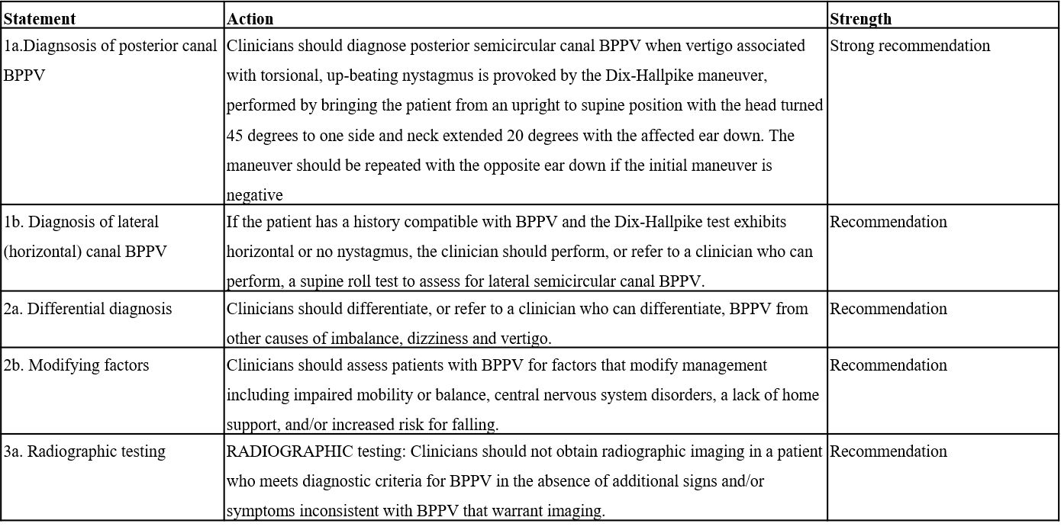
In Summary

Slide 45
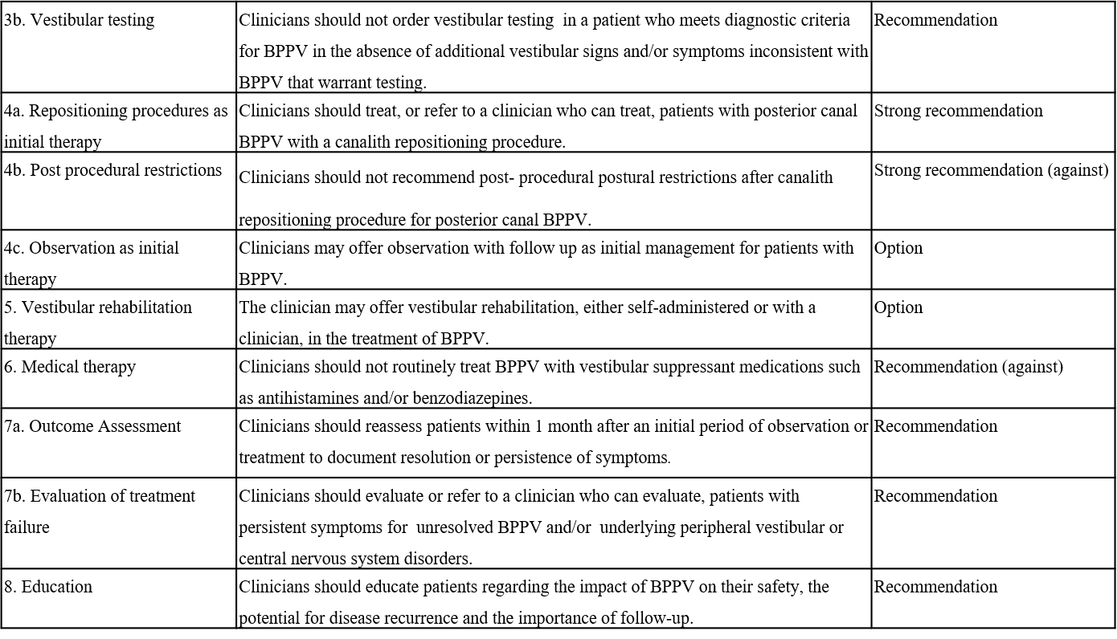
In Summary (cont’d)

Slide 46
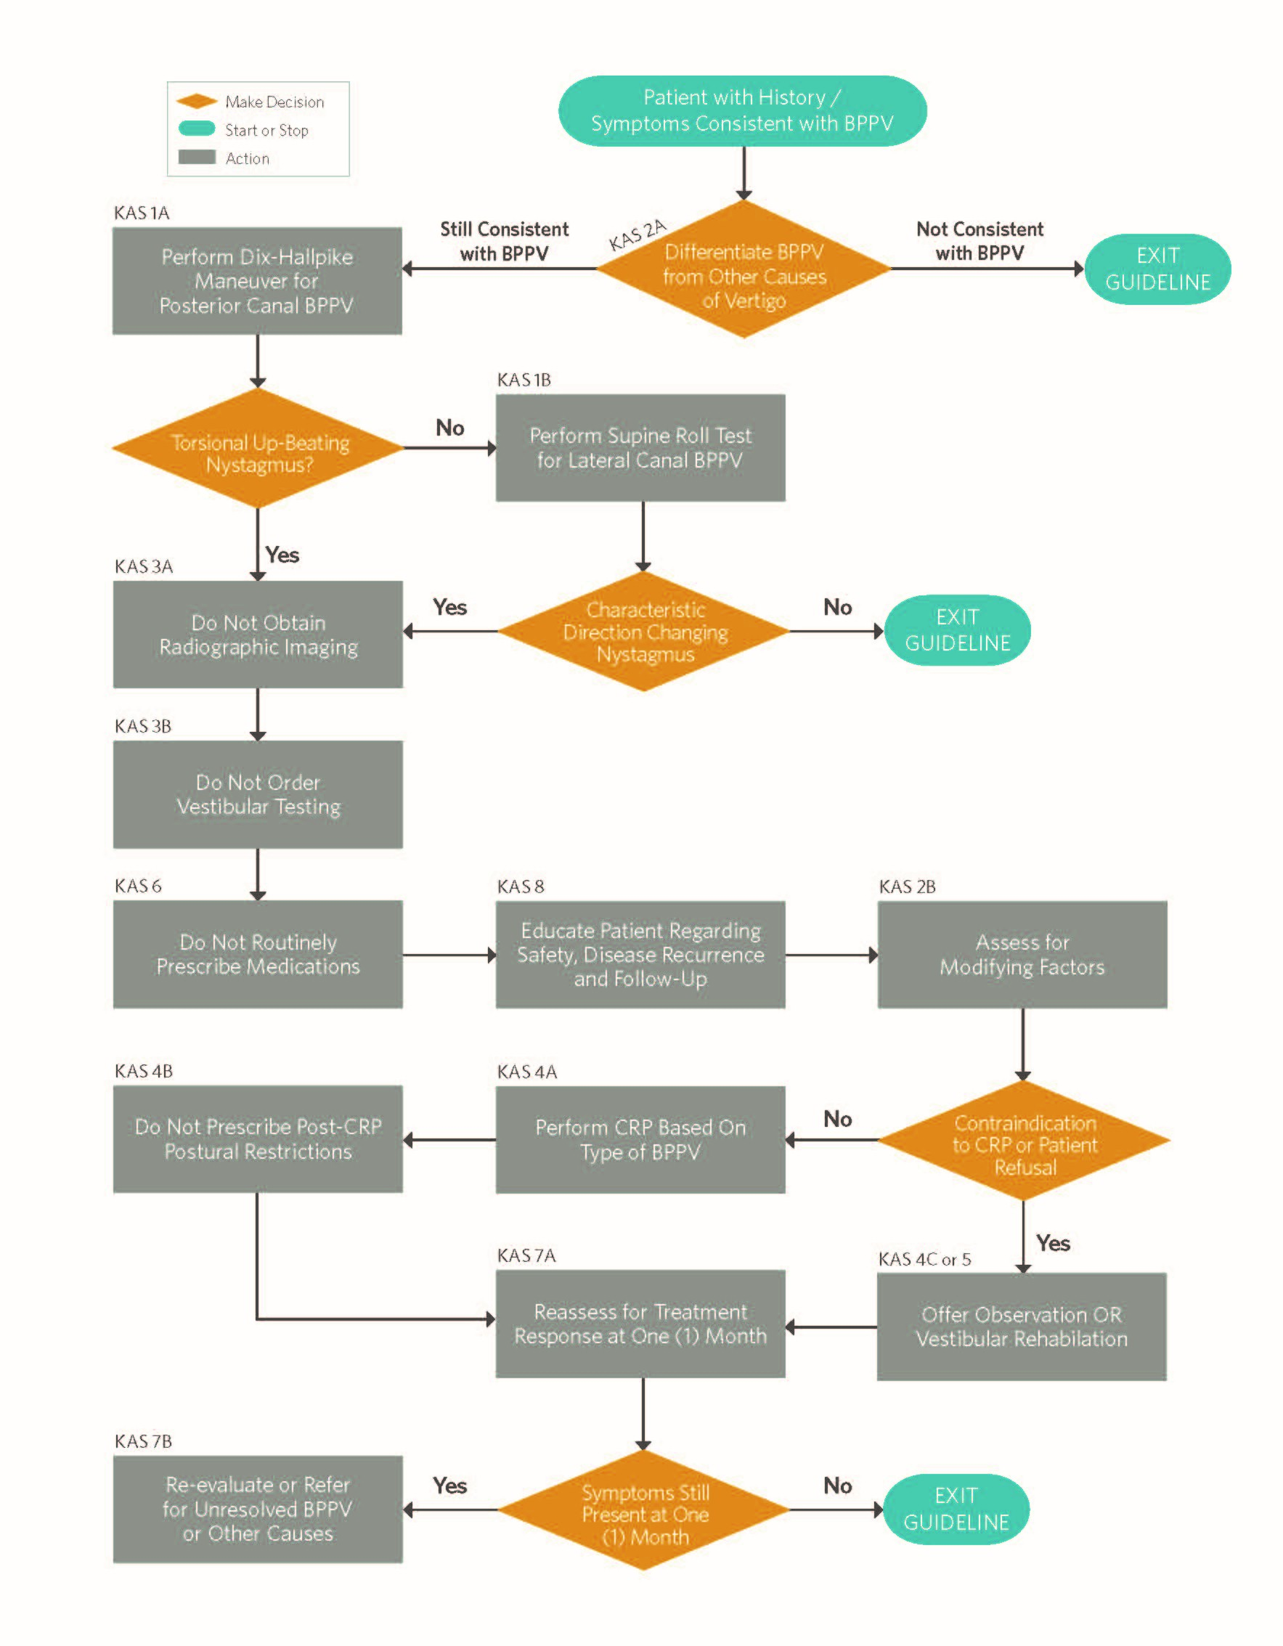
New Algorithm
Algorithm showing the interrelationship of guideline key action statements

Slide 47
Research Needs
Conduct diagnostic and cost-effectiveness studies to identify which subsets of patients, based on specific history or physical examination findings, should be submitted for additional vestibular testing and/or radiographic imaging in the setting of presumed BPPV.
Diagnostic and cost-effectiveness studies evaluating the utility and costs of audiometry in the diagnostic evaluation of BPPV are needed.
Determine whether education and application of clinical diagnostic criteria for BPPV will change physician behavior in terms of anticipated decreases in ordering of diagnostic tests.
Determine the optimal number of CRPs and the time interval between performance of CRP’s for patients with posterior canal BPPV.
Cost-effectiveness studies for the potential advantages of earlier intervention based on earlier diagnosis and earlier symptom resolution with expedient CRP’s for BPPV are needed. Both direct healthcare and global economic costs require assessment.
Extended cohort studies with longer follow-up to determine if measures such as self-performance of CRP or longitudinal vestibular rehabilitation decrease recurrence rates for BPPV or complications from BPPV such as falls.
Determine whether vestibular therapy after the CRP offers additional benefits over CRP alone in select patient populations.
Studies on the functional impact of BPPV as they relate to home safety, work safety and absences and driving risks.

Slide 48
Research Needs (cont’d)
Epidemiological studies on the rates of falls with BPPV as an underlying cause/diagnosis.
Assess the impact of BPPV on quality of life for those affected using general QOL and/or dizziness specific QOL metrics.
Develop and validate a disease specific quality of life measure for BPPV to assess treatment outcomes.
Perform studies to evaluate the effect of structured versus “as needed” follow up regimens on the outcomes of patients with BPPV.
Clarify and standardize the terms used to describe repositioning maneuvers for BPPV of the lateral canal to enable meaningful comparison of their efficacy.
Epidemiological studies to characterize the relative risk of factors associated with the development of BPPV such as osteoporosis, dental procedures and other devices that deliver cranial vibrations (massage devices, motorized toothbrushes,etc).
Identify patient and treatment related risk factors for the development of recalcitrant BPPV.
Perform studies to evaluate the sensitivity, specificity and predictive values of the available exam maneuvers to determine the presence and laterality of BPPV affecting the anterior semicircular canal.
Perform studies to characterize the accuracy of diagnostic maneuvers for posterior and lateral canal BPPV and to evaluate the treatment outcomes for patients with BPPV seen in non-specialty settings.

Slide 49
Thank you for your attention
QUESTIONS?

