Slide 1
AAO-HNSF Clinical Practice Guideline: Improving Nasal Form and Function After Rhinoplasty
(Publication Date: February 1, 2017)

Slide 2
Disclaimer
The clinical practice guideline is not intended as the sole source of guidance in improving nasal form and function after rhinoplasty. Rather, it is designed to assist clinicians by providing an evidence-based framework for decision-making strategies. The guideline is not intended to replace clinical judgment or establish a protocol for all individuals with this condition and may not provide the only appropriate approach to diagnosing and managing this program of care. As medical knowledge expands and technology advances, clinical indicators and guidelines are promoted as conditional and provisional proposals of what is recommended under specific conditions but are not absolute. Guidelines are not mandates. These do not and should not purport to be a legal standard of care. The responsible physician, in light of all circumstances presented by the individual patient, must determine the appropriate treatment. Adherence to these guidelines will not ensure successful patient outcomes in every situation. The American Academy of Otolaryngology-Head and Neck Surgery Foundation emphasizes that these clinical guidelines should not be deemed to include all proper treatment decisions or methods of care or to exclude other treatment decisions or methods of care reasonably directed to obtaining the same results.

Slide 3
Burden
Rhinoplasty, a surgical procedure that alters the shape or appearance of the nose while preserving or enhancing the nasal airway, ranks among the most commonly performed cosmetic procedures in the United States, with over 200,000 procedures reported in 2014.
While it is difficult to calculate the exact economic burden incurred by rhinoplasty patients following surgery with or without complications, the average rhinoplasty procedure typically exceeds $4,000.
The costs incurred due to complications, infections, or revision surgery may include the cost of long-term antibiotics, hospitalization, or lost revenue from hours/days of missed work.
Psychological impact of rhinoplasty; and the health care burden from psychological pressures of nasal deformities/aesthetic shortcomings, surgical infections, surgical pain, side effects from antibiotics and nasal packing materials.

Slide 4
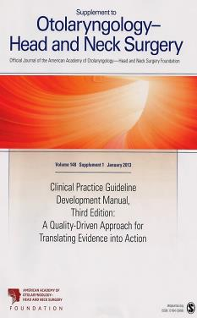
Clinical Practice Guideline Development Manual: Third Edition Rosenfeld, Shiffman, and Robertson
Pragmatic, transparent approach to creating guidelines for performance assessment
Evidence-based, multidisciplinary process leading to publication in 12-18 months
Emphasizes a focused set of key action statements to promote quality improvement
Uses action statement profiles to summarize decisions in recommendations
Otolaryngol Head Neck Surg 2013; 148(Suppl):S1-55

Slide 5
CPG Leadership
Lisa E. Ishii, MD, MHS (Chair)
Travis T. Tollefson, MD, MPH, FACS (Assistant Chair)
Gregory J. Basura, MD, PhD (Assistant Chair)
Richard M. Rosenfeld, MD, MPH (Methodologist)

Slide 6
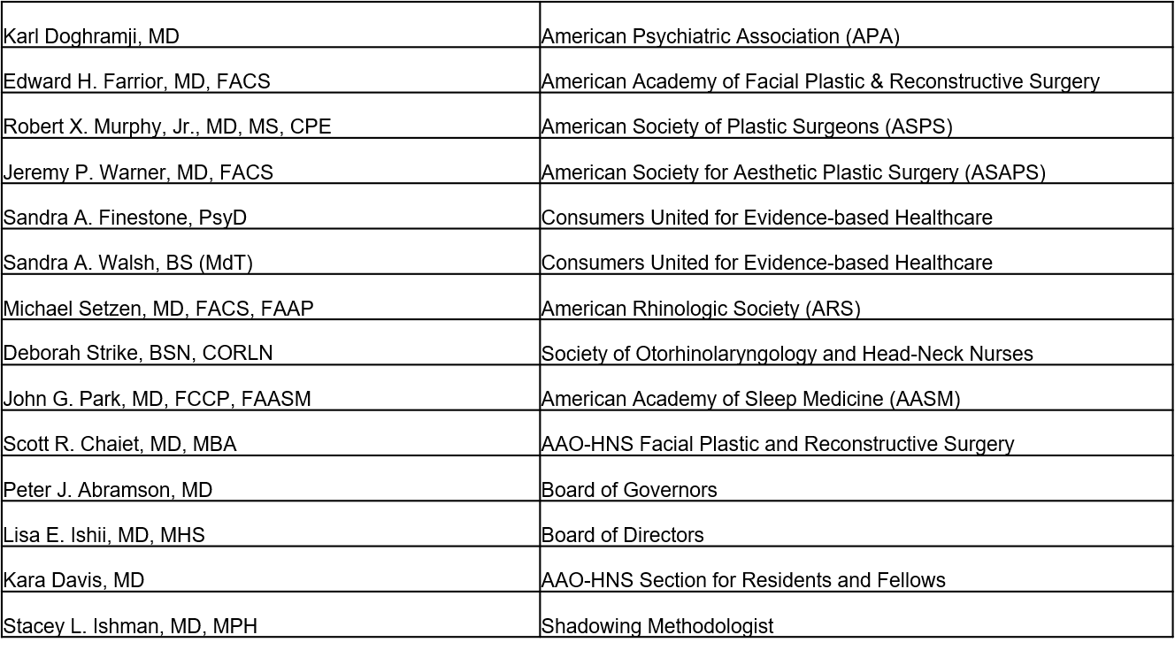
Multi-Disciplinary Panel

Slide 7
CPG Development
Developed using an explicit and transparent a priori protocol
Three systematic literature searches by information specialist (guidelines, SRs, RCTs, lower level evidence as needed) The 21 CPGs, 116 SRs, and 171RCTs were broken down into the 10 key action statement categories. This material was supplemented, as needed, with targeted searches to address specific needs identified in writing the guideline through July, 2016. After assessing quality and relevance, we retained 0 of the CPGs, 25 of the SRs, and 48 of the RCTs.
Creation of actionable quality improvement statements based upon the supporting evidence and weighted by the balance of benefit and harm
Extensive peer review

Slide 8
Purpose
The primary purpose of this guideline is to provide evidence-based recommendations for clinicians, who either perform rhinoplasty or are involved in the care of a rhinoplasty candidate, as well as to optimize patient care, promote effective diagnosis and therapy, and reduce harmful or unnecessary variations in care.

Slide 9
Target Population
The target patient population is all patients age 15 years and older.

Slide 10
Strength of Action Terms/Implied Levels of Obligation
Strength | Definition | Implied Obligation
Strong Recommendation | The benefits of the recommended approach clearly exceed the harms (or, in the case of a strong negative recommendation, the harms clearly exceed the benefits) and the quality of the supporting evidence is high (Grade A or B). | In some clearly identified circumstances, strong recommendations may be made based on lesser evidence when high-quality evidence is impossible to obtain, and the anticipated benefits strongly outweigh the harms. Clinicians should follow a strong recommendation unless a clear and compelling rationale for an alternative approach is present.
Recommendation | The benefits exceed the harms (or, in the case of a negative recommendation, the harms exceed the benefits), but the quality of evidence is not as high (Grade B or C). | In some clearly identified circumstances, recommendations may be made based on lesser evidence when high-quality evidence is impossible to obtain, and the anticipated benefits outweigh the harms. Clinicians should generally follow a recommendation but should remain alert to new information and remain sensitive to patient preferences.
Option | Either the quality of evidence is suspect (Grade D) or well-done studies (Grade A, B, or C) show little clear advantage to one approach versus another. | Clinicians should be flexible in their decision making regarding appropriate practice, although they may set bounds on alternatives; patient preference should have a substantial influencing role.

Slide 11
Definitions

Slide 12
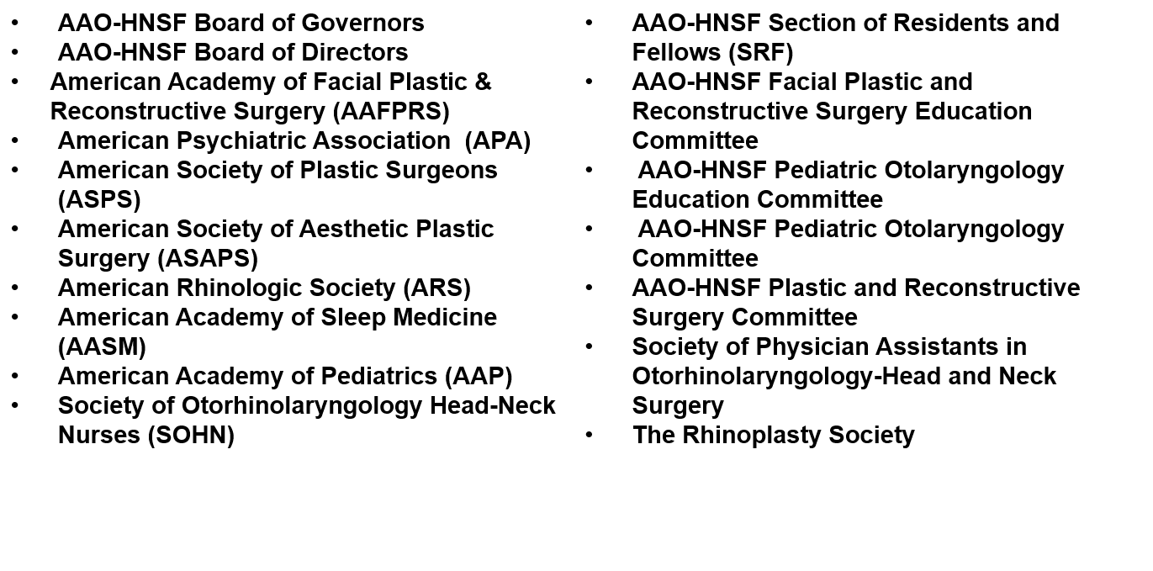
External Peer Review
38 reviewers from the 17 organizations/committees (listed below) submitted 311 comments. Resulted in 136 edits/changes to the draft CPG.

Slide 13
Public Comment
The guideline was accessed by 106 individuals, 18 of whom provided feedback on the draft CPG to the guideline panel, resulting in 13 changes to the guideline.

Slide 14
KAS 1: Communicating Expectations
STATEMENT 1. COMMUNICATING EXPECTATIONS: Clinicians should ask all patients seeking rhinoplasty about their motivations for surgery and their expectations for outcomes, should provide feedback as to whether those expectations are a realistic goal of surgery, and should document this discussion in the medical record. Recommendation based on observational studies, with a preponderance of benefit over harm.
Benefits: Promote realistic expectations of achievable surgical outcomes, avoid surgery in patients with unrealistic expectations, better align clinician and patient expectations, promote enhanced communication, identify underlying psychiatric disorders (e.g., body dysmorphic disorder), promote patient satisfaction
Risk, Harm, Cost: Patient anxiety, time spent in assessing and counseling the patient

Slide 15
KAS 1: Communicating Expectations
Action Statement Profile
QI Opportunity: Avoid poor surgical outcomes in patients with unrealistic expectations (NQS domain: Patient safety; Patient and Family Engagement)
Aggregate Evidence Quality: Grade C, based on observational studies
Level of Confidence in Evidence: Low because of limited evidence
Benefit-Harm Assessment: Preponderance of benefit over harm
Value Judgments: Perception by the GDG that expectations are not always fully considered before rhinoplasty and that explicitly assessing expectations could help improve outcomes and potentially avoid surgery in patients with unachievable goals
Intentional Vagueness: The specifics of the discussion are left to the discretion of the patient and clinician
Role Of Patient Preferences: None
Exceptions: None
Policy Level: Recommendation
Differences of Opinion: None

Slide 16
KAS 2: Comorbid Conditions
STATEMENT 2: COMORBID CONDITIONS: Clinicians should assess rhinoplasty candidates for comorbid conditions that could modify, or contraindicate, surgery that include body dysmorphic disorder, obstructive sleep apnea, bleeding disorders, or chronic use of topical vasoconstrictive intranasal drugs. Recommendation based on observational studies, with a preponderance of benefit over harm.
Benefits: Reduce surgical complications, identify opportunities to optimally prepare patients for surgery, better counsel patients regarding surgical risk, avoid surgery in poor candidates
Risk, Harm, Cost: Time spent in assessing for co-morbid conditions, false positive results from screening surveys, making the patient self-conscious

Slide 17
KAS 2: Comorbid Conditions
Action Statement Profile
Quality Improvement Opportunity: Identify known, and potentially unknown, co-morbid conditions that could result in poor outcomes or complications if not detected prior to surgery (NQS domain: Patient Safety)
Aggregate Evidence Quality: Grade C, based on observational studies
Level of Confidence in Evidence: High
Benefit-Harm Assessment: Preponderance of benefit over harm
Value Judgments: None
Intentional Vagueness: None
Role of Patient Preferences: None
Exceptions: None
Policy Level: Recommendation
Differences of Opinion: None

Slide 18
KAS 3: Nasal Airway Obstructions
STATEMENT 3: NASAL AIRWAY OBSTRUCTION: The surgeon, or the surgeon’s designee, should evaluate the rhinoplasty candidate for nasal airway obstruction during the preoperative assessment. Recommendation based on observational studies, with a preponderance of benefit over harm.
Benefits: Avoid overlooking nasal airway obstruction, refine the surgical plan, identify deviated nasal septum, nasal valve collapse, or both, identify non-anatomic causes of obstruction, including inflammatory disorders, neoplastic disorders, obstructing adenoids, patient engagement and education to set expectations
Risks, harms, costs: Cost and adverse events of diagnostic procedures (endoscopy, imaging), time spent in evaluating the patient, potential for focusing attention on incidental or asymptomatic findings

Slide 19
KAS 3: Nasal Airway Obstruction
Action Statement Profile
QI Opportunity: Call explicit attention to an aspect of rhinoplasty planning that could be overlooked and to identify unrelated causes of nasal airway obstruction. (NQS domain: Clinical Process/Effectiveness)
Aggregate Evidence Quality: Grade C, based on observational studies
Level of Confidence in Evidence: High
Benefit-Harm Assessment: Preponderance of benefit over harm
Value Judgments: Perception by a majority of the GDG that early evaluation for nasal airway obstruction could identify opportunities to surgically improve the airway during rhinoplasty that may have been overlooked if not explicitly assessed prior to surgery
Intentional Vagueness: The method of evaluating for nasal airway obstruction is left to the discretion of the clinician
Role of Patient Preferences: Limited, primary concerns the choice of tests or procedures beyond the basic physical examination
Exceptions: None
Policy Level: Recommendation
Differences of Opinion: Minor differences regarding the inclusion of nasal function versus nasal obstruction in the key action statement resulted in a panel vote. 8 members of the guideline development group voted to include nasal obstruction; 3 voted to include nasal function and 1 did not have an opinion

Slide 20
KAS 4: Preoperative Education
STATEMENT 4. PREOPERATIVE EDUCATION: The surgeon, or the surgeon’s designee, should educate rhinoplasty candidates regarding what to expect after surgery, how surgery might affect the ability to breathe through the nose, potential complications of surgery, and the possible need for future nasal surgery. Recommendation based on observational studies on the benefits, in general, of the value of education and counseling, with a preponderance of benefit over harm.
Benefits: Facilitate shared decision-making, promote realistic expectations, promote informed consent, identify unrealistic expectations, improve quality of care and outcomes
Risks, harms, costs: Time spent with education, patient anxiety

Slide 21
KAS 4: Preoperative Education
Action Statement Profile
QI Opportunity: To facilitate shared decision-making regarding the need for surgery and surgical outcomes (NQS domain: Patient and Family Engagement)
Aggregate Evidence Quality: Grade C, based on observational studies on the benefits, in general, of the value of education and counseling
Level of Confidence in Evidence: High
Benefit-Harm Assessment: Preponderance of benefit over harm
Value Judgments: None
Intentional Vagueness: None
Role of Patient Preferences: None
Exceptions: None
Policy Level: Recommendation
Differences of Opinion: None

Slide 22
KAS 5: Counseling for Obstructive Sleep Apnea Patients
STATEMENT 5. COUNSELING FOR OBSTRUCTIVE SLEEP APNEA PATIENTS. The clinician, or the clinician’s designee, should counsel rhinoplasty candidates with documented obstructive sleep apnea (OSA) about the impact of surgery on nasal airway obstruction and how OSA might affect perioperative management. Recommendation based on systematic reviews or randomized and observational studies with preponderance of benefit over harm.
Benefits: Increase awareness of beneficial effects of rhinoplasty on CPAP compliance and use, increase awareness of rhinoplasty as a means to reduce severity of OSA, facilitates shared decision-making, facilitates coordination of care (primary care clinician, sleep medicine specialist, anesthesiologist, surgeon), plan more effectively for perioperative management
Risks, harms, costs: Time spent counseling, increased patient anxiety

Slide 23
KAS 5: Counseling for Obstructive Sleep Apnea Patients
Action Statement Profile
Quality opportunity: To facilitate informed patient decisions and coordinate care for optimal surgical outcomes (NQS: Patient Safety; Care Coordination)
Aggregate Evidence Quality: Grade B, systematic reviews or randomized and observational studies regarding the positive impact of rhinoplasty on OSA (reduced CPAP pressures, enhanced CPAP compliance, lower apnea hypopnea index); Grade C, observational studies on the benefits, in general, of counseling on shared decision making
Level of Confidence in Evidence: High
Benefit-Harm Assessment: Preponderance of benefit over harm
Value Judgments: None
Intentional Vagueness: None
Role of Patient Preferences: None
Exceptions: None
Policy Level: Recommendation
Differences of Opinion: Minor regarding the need to include a separate statement about counseling for rhinoplasty candidates with OSA; 8 members of the guideline development group voted in favor of a statement; 5 members felt an additional statement was unnecessary

Slide 24
KAS 6: Managing Pain and Discomfort
STATEMENT 6. MANAGING PAIN AND DISCOMFORT: The surgeon, or the surgeon’s designee, should educate rhinoplasty patients before surgery about strategies to manage discomfort after surgery. Recommendation based on studies of the value of education and counseling, with a preponderance of benefit over harm.
Benefits: Establish expectations regarding pain and discomfort, increase patient satisfaction, decrease need for postoperative calls to physician office, raise awareness of intraoperative and postoperative strategies to reduce pain and discomfort, reduce patient anxiety
Risks, harms, costs: Time spent counseling

Slide 25
KAS 6: Managing Pain and Discomfort
Action Statement Profile
Quality Improvement Opportunity: To facilitate informed patient decisions and coordinate care for optimal management of pain and discomfort (NQS domain: Patient and Family Engagement; Clinical Process/Effectiveness)
Aggregate Evidence Quality: Grade C, observational studies on the benefits, in general, of the value of education and counseling, with a preponderance of benefit over harm
Level of Confidence in Evidence: Medium because of the indirectness of evidence and need to extrapolate from other pain management studies
Benefit-Harm Assessment: Preponderance of benefit over harm
Value Judgments: Importance of patient education in promoting optimal outcomes
Intentional Vagueness: None
Role of Patient Preferences: None
Exceptions: None
Policy Level: Recommendation
Differences of Opinion: None

Slide 26
KAS 7: Postoperative Antibiotics
STATEMENT 7. POSTOPERATIVE ANTIBIOTICS: When a surgeon chooses to administer perioperative antibiotics for rhinoplasty, they should not routinely prescribe antibiotic therapy for a duration of more than 24 hours after surgery. Recommendation against prescribing based on randomized controlled trials and systematic reviews, with a preponderance of benefit over harm.
Benefits: promote selective use of antibiotics after surgery, reducing induced bacterial resistance, reduce antibiotic adverse effects, reduce cost
Risks, harms, costs: Potential for infection in patients who might have benefitted from more than 24 hours of antibiotic therapy but did not receive it

Slide 27
KAS 7: Postoperative Antibiotics
Action Statement Profile
Quality improvement opportunity: Reduce antibiotic prescribing after rhinoplasty and promote antibiotic stewardship (NQS domain: Patient Safety)
Aggregate Evidence Quality: Grade B, Randomized controlled trials and systematic reviews with a preponderance of benefit over harm
Level of Confidence in Evidence: Medium based on indirectness of evidence about benefits beyond 24 hours and absence of evidence concerning benefits of antibiotic prophylaxis for rhinoplasty patients
Benefit-Harm Assessment: Preponderance of benefit over harm
Value Judgments: Perception by the GDG that antibiotics are commonly prescribed after rhinoplasty despite a lack of evidence to consistently support benefits of administering antibiotics beyond a single, intraoperative dose or more than 24 hours after surgery; a desire to avoid reflex, or automatic, prescribing of antibiotics after 24 hours
Intentional Vagueness: The word “routine” is used to avoid setting a legal standard of care and to reflect that there may be individual patient situations that warrant antibiotic prescribing
Role of Patient Preferences: Small
Exceptions: Revision surgery; complicated rhinoplasty; patients receiving nasal implants; patients with postoperative nasal packing; patients with baseline nasal colonization with MRSA; immunocompromised patients; concurrent medical condition requiring antibiotics (e.g., rhinosinusitis)
Policy Level: Recommendation against
Differences of Opinion: None

Slide 28
KAS 8: Perioperative Steroids
STATEMENT 8. PERIOPERATIVE STEROIDS: The surgeon, or the surgeon’s designee, may administer perioperative systemic steroids to the rhinoplasty patient. Option based on systematic review of randomized controlled trials with limitations and a balance of benefits and harms.
Benefits: Reduced perioribital ecchymosis and edema, reduced discomfort, less postoperative nausea and vomiting
Risks, harms, costs: Cost, Adverse events of systemic steroids (which include bone weakening, avascular necrosis of the femur, adverse effect on diabetes, nervousness or anxiety, etc.), potential impact on wound healing

Slide 29
KAS 8: Perioperative Steroids
Action Statement Profile
QI opportunity: Promote awareness of the benefits and risks of systemic steroids; engage patients in shared decisions; emphasize a need for future research to increase our confidence in the effect of perioperative steroids on the rhinoplasty patient (NQS domain: Patient Safety; Clinical Process/Effectiveness)
Aggregate Evidence Quality: Grade B, based on systematic review of randomized controlled trials
Level of Confidence in Evidence: Low, because of small randomized trials with heterogeneity in drug dosing, administration, and assessment of clinical outcomes; low precision in systematic review pooled estimates of treatment effect
Benefit-Harm Assessment: Balance of Benefits and Harms
Value Judgments: None
Intentional Vagueness: The specifics of dosing and timing of steroid administration are at the discretion of the clinician
Role Of Patient Preferences: Moderate role in deciding whether or not to receive steroids
Exceptions: Patients for whom systemic steroids are contraindicated
Policy Level: Option
Differences of Opinion: None

Slide 30
KAS 9: Nasal Packing
STATEMENT 9. NASAL PACKING: Surgeons should not routinely place packing in the nasal cavity of rhinoplasty (with or without septoplasty) patients at the conclusion of surgery. Recommendation against, based on systematic reviews and randomized controlled trials with a preponderance of benefit over harm and a lack of studies regarding the benefits of nasal packing after rhinoplasty.
Benefits: Improved patient comfort, decreased pain after surgery, lower incidence of infection (toxic shock), decreased patient anxiety, improved nasal airway, avoiding respiratory compromise, improved CPAP compliance in patients with OSA
Risks, harms, costs: Risk of epistaxis

Slide 31
KAS 9: Nasal Packing
Action Statement Profile
Quality improvement opportunity: Improve patient comfort and outcomes by avoiding routine nasal packing in the absence of documented benefits (NQS domain: Patient Safety; Clinical Process/Effectiveness)
Aggregate Evidence Quality: Grade C, based on systematic reviews and randomized controlled trials
Level of Confidence in Evidence: Low, due to lack of studies
Benefit-Harm Assessment: Preponderance of benefit over harm
Value Judgments: Perception by the GDG that nasal packing is frequently used after rhinoplasty despite no published evidence documenting benefits, but significant evidence of potential harms; perception by the GDG that the use of nasal packing, in general, is declining among rhinoplasty surgeons and that when packing is used it is limited to 24 hours
Intentional Vagueness: The word “routinely” is used to avoid establishing a legal precedent and to allow clinicians discretion to identify patients that might benefit from nasal packing on an individualized basis
Role of Patient Preferences: Moderate; the patient may have strong preferences about nasal packing that create an opportunity for shared decision making
Exceptions: Patients with epistaxis that requires packing for control; patients with complex, unstable nasal fractures that require packing for stability; patients with a known bleeding/clotting disorder
Policy Level: Recommendation against
Differences of Opinion: None regarding the recommended action but some concern as to whether a simple cotton ball or other temporary object in the nasal vestibule after nasal surgery could be misconstrued as packing

Slide 32
KAS 10: Outcome Assessment
STATEMENT 10. OUTCOME ASSESSMENT: Clinicians should document patient satisfaction with their nasal appearance and with their nasal function at a minimum of 12 months after rhinoplasty. Recommendation based on observational studies, with a preponderance of benefit over harm.
Benefits: Empower the patient to communicate meaningful outcomes and express unmet expectations, provide feedback information on patient satisfaction to the surgeon, call explicit attention to the importance of assessing both cosmetic and function outcomes, identify patients who might benefit from additional counseling or management, identify causes of nasal obstruction unrelated to the original rhinoplasty that could be managed and corrected
Risks, harms, costs: Time spent assessing outcomes, administrative burden of outcome measurements

Slide 33
KAS 10: Outcome Assessment
Action Statement Profile
Quality improvement opportunity: Incorporate patient-reported outcome measures in rhinoplasty surgery; empower the patient to express satisfaction and communicate with the clinician (NQS domain: Patient and Family Engagement; Clinical Process/Effectiveness)
Aggregate Evidence Quality: Grade C, based on observational studies
Level of Confidence in Evidence: Medium based on limited evidence concerning the optimal timeframe to assess outcomes and the wide range of outcome measurements available
Benefit-Harm Assessment: Preponderance of benefit over harm
Value Judgments: The content experts in the GDG felt that 12 months was the minimal acceptable time for a reasonable stable outcome assessment of nasal appearance. While earlier assessment and documentation may be useful for counseling, the final assessment should ideally be done at 12 months or later
Intentional Vagueness: The method of assessing satisfaction is not specified and is at the discretion of the clinician; the precise timing of the final outcome assessment is not specified but should be no sooner than 12 months
Role of Patient Preferences: Small
Exceptions: None
Policy Level: Recommendation
Differences of Opinion: None

Slide 34
Summary of Guideline Key Action Statements

Slide 35
Research Needs
The GDG identified the following research needs as a result of writing this guideline.
Communicating Expectations:
What are the short (<12 months) and long-term (>12 months) metrics showing patient satisfaction and functional outcome improvement following rhinoplasty?
Comorbid Conditions:
What is the best pre-operative assessment to evaluate patients for pre-operative co-morbidities including OSA (i.e., STOP-BANG; BDD-Q)?
3. Nasal Airway Obstruction:
What is the best measure to evaluate and objectify airway obstruction in rhinoplasty patients?
What is the optimal time to evaluate nasal airway obstruction following rhinoplasty?

Slide 36
Research Needs (cont’d)
Preoperative Education:
What are the data on revision rhinoplasty that includes outcomes as they relate to patient expectation and pre-operative counseling?
What are the rates of litigation in rhinoplasty and revision rhinoplasty?
What are patients specifically told about surgical expectations?
What mechanism can be used to provide the patients with a tool to measure their outcomes versus patient satisfaction?
What is the sustained long-term benefit of using a tool to measure outcomes versus patient satisfaction?
Obstructive Sleep Apnea:
What are the best CPAP appliances to use following rhinoplasty as they relate to patient comfort, and optimal surgical healing while treating OSA?
When specifically, should CPAP be reinstated after rhinoplasty?

Slide 37
Research Needs (cont’d)
Managing Pain and Discomfort:
What is the optimal duration and dosage of pain medication including NSAIDS to use after rhinoplasty?
What is the optimal intra-operative pain medication?
Can the management of acute postoperative pain improve the overall outcomes and patient satisfaction following rhinoplasty?
What are the long-term outcomes of improved patient satisfaction of their rhinoplasty as it relates to the acute management of pain and discomfort?
Antibiotics:
What is the optimal prophylactic antibiotic to be given prior to rhinoplasty?
When used post-operatively, what is the best antibiotic and what is the data showing optimal efficacy?

Slide 38
Research Needs (cont’d)
Steroids:
What should be the specific steroid and dose given pre- and post-operatively?
Are there increased wound complications or delays in wound healing when steroids are used post-operatively?
Should steroids be given in immune-compromised patients after rhinoplasty?
Nasal Packing:
What specific packing materials and duration of time are used by rhinoplasty surgeons?
What are the long-term functional and cosmetic outcomes as they are related to the use of nasal packing in the post-operative period?
What are the specific benefits of nasal packing?
Outcomes Assessment:
What is the long-term data on validated metrics for patient satisfaction and functional outcome?

Slide 39
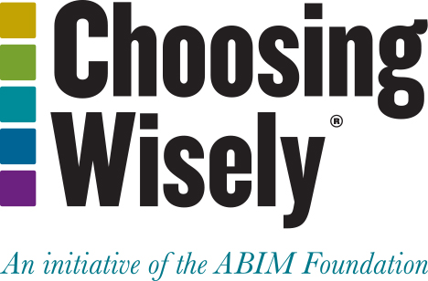
Choosing Wisely®
It is an initiative of the American Board of Internal Medicine (ABIM) Foundation.
Aims to encourage discussions between physicians and patients about appropriate care.
Each of the campaign’s organization partners is asked to identify (initially) 5 items within its specialty that physicians and patients should question. The AAO-HNSF list has now grown to 10 items.
The AAO-HNSF’s list of recommendations were carefully selected after a review of the current evidence that included AAO-HNSF clinical practice guidelines.
More information is available at www.entnet.org/ChoosingWisely
What is Choosing Wisely®?

Slide 40
AAO-HNSF List of 10 Things Physicians and Patients Should Question
The Initial List

Slide 41
AAO-HNSF List of 10 Things Physicians and Patients Should Question
The Second List

Slide 42
Thank you for your attention
QUESTIONS?

