Slide 1

State and Local OTO Society Management
Tool Kit
Created by BOG’s
Governance and Society Engagement Committee

Slide 2
Acknowledgements
Cristina Baldassari, MD
Karen Hawley, MD
Eileen M. Raynor, MD
Max D. Pusz, MD
Daniel Wohl, MD

Slide 3
About the BOG’s Governance and Society Engagement Committee
The BOG’s Governance and Society Engagement Committee (GoSE) is charged with the periodic review of the BOG’s Rules and Regulations, regular review of constituent and provisional societies, the proposal of revisions or new regulations when deemed desirable, the selection of the Practitioner Excellence and Model Society Awardees and development of tools for the use of BOG member societies to facilitate and optimize their formation, organization, operation and engagement with the BOG.
Disclaimer: Any reference in this website to any person, organization, activities, products, or services related to such person or organization, or any linkages from this web site to the web site of another party, do not constitute or imply the endorsement, recommendation, or favoring of the American Academy of Otolaryngology – Head and Neck Surgery/Foundation (AAO-HNS/F), the AAO-HNS Board of Governors, or any of its other entities, employees or contractors acting on its behalf.

Slide 4
Toolkit
Toolkit Purpose
The toolkit was developed to assist clinicians in establishing, developing, and creating growth of state societies.
Toolkit development
The toolkit was developed by the BOG Governance and Society Engagement Committee with input from BOG leadership and AAO staff
How to use the toolkit
The toolkit is divided into several sections. Within each section are links to relevant resources that allow the users to easily sign up for information, find out about ongoing issues that can affect our specialty at a state and national level, learn how to lobby effectively, become a trusted resource for our elected officials and advocate on behalf of the members’ state or specialty BOG societies.

Slide 5
Table of Contents
Society Administration
  Initial setup
  Expansion
  Liaison with Board of Governors
  Resources
Legislative and Government relations
  Terms and Definitions
  Video for best practices meeting with lawmakers and their staff
  Getting started
  Getting more involved
  How to disseminate information to your members
Education/CME Programming
  Types of CME
  Venues for education
  Meeting planning
  Engaging Residents and Medical Students
FAQs and Additional Resources

Slide 6
Outline
Section 1: Society Administration
Section 2: Legislative Affairs
Section 3: Education/CME.

Slide 7
Society Administration
1. Initial Setup
a. Structure
b. Finances
2. Expansion
a. Website Design/Maintenance
b. Member recruitment/engagement
c. Education
d. Procuring corporate sponsorship
e. Staffing
f. Organizational Membership
3. Connection to the AAO-HNS Board of Governors
a. AAO-HNS BOG Bylaws
b. Minimum requirements
c. Structural format for integration into BOG
4. Other Online Resources/Thoughts

Slide 8
Section 1: Society Administration
Initial Setup

Slide 9
Initial Setup:Structure
Structure:
Membership:
Determine who is eligible for membership:
Otolaryngologists, advanced practice providers, trainees, ancillary providers
Administrator designation:
Determine core group: manage contact lists, society structure, finances and communication to BOG.
Leadership structure:
Determine officers:
President, Secretary-Treasurer, Program Chair, Member-at-Large, BOG Governor and Alternate Governor(s)
Determine nomination and election process
Determine Standing Committees:
By-laws, Membership, Annual Meeting Program

Slide 10
Initial Setup:Structure
Establish objectives/goals and mission statement:
Clarify purpose and determine direction: educate the membership, educate the public, advocacy
Strategic planning by-laws:
Encourage the use of templates: Appendices A and B for sample by-laws (VA and NM State Society Bylaws)

Slide 11
Initial Set-up - Finances
Finances:
Obtain Employer Identification Number (EIN)/Tax ID:
Required form: IRS Form SS-4: https://www.irs.gov/pub/irs-pdf/fss4.pdf
Banking:
Find the right bank: FAQs on choosing your bank
Identify requirements to establish a bank account
a. By-laws and/or Founding board articles of incorporation
b. Corporate status at state level
Access to assistance through local bank business manager, person/practice accountant, personal or practice attorney
Identify online banking options

Slide 12
Initial Set-up - Finances
Finances:
501(c)(3): complete IRS Form 1023EZ (<$50,000 income)
https://www.irs.gov/forms-pubs/about-form-1023-ez
Business Plan/Budget:
Determine Membership fees
Determine Meeting outline; i.e. dinner costs, travel/honorarium for speaker, audio-visual equipment
Consider donations from vendors

Slide 13
Section 1 : Society Administration
Expansion

Slide 14
Expansion- Website Design/Maintenance
Web design platforms
Website design can be done while setting up your society and will allow you to more easily disseminate information, apply for a bank account, and create your society email address.
Examples of web design platforms:
SquareSpace – https://www.squarespace.com
WordPress – https://www.wordpress.org

Slide 15
Expansion- Member Recruitment/Engagement
Member Recruitment/Engagement
Create a list of local/state-wide otolaryngologists:
Academy members, Subspecialty societies, State medical board, Internet
Create a membership application form : Appendix C for a sample form [New Mexico Application Link]
Engage with other local societies:
-Assistance with resources and partnerships
-Local/regional member/leadership attend State meetings connect with State society leadership
-State leadership attends national meetings connect with National organization leadership
Consider options for communication tools/strategies:
-website, email lists, USPS, personalized faxes, personal phone calls
- Local/regional societies engage other local/regional medical leaders and resources
- BOG’s Complimentary Society Blast Email Service: Contact GOSE Academy Support Staff
Create newsletter: can disseminate State and National email blasts

Slide 16
Expansion- Education/CME
See Section 3: Education/CME Programming for content related to education expansion.

Slide 17
Expansion- Corporate Sponsorship
Corporate Sponsorship
Collect vendor contact information
Engage with equipment and pharmaceutical representatives
Reach out for donation/sponsorship leads from all society members
    Determine if your events will provide CME credits
    Be aware of appropriate conflict of interests
    Try to establish an annual corporate funded educational activity without restriction
    May need to send vendors a Form W-9, which provides your EIN.

Slide 18
Expansion- Staffing/Organizational membership
Staffing:
Professional lobbyist: be mindful of the 501(c)(3) or 501(c)(6) requirements
Professional administrator
Chief of Education
Organizational membership:
AAO-HNS Board of Governors (BOG) representation:
Governor and Alternate Governors
BOG Committee Involvement: Invite society members to join a BOG meeting as our guest
Inter/intrastate society involvement

Slide 19
Section 1 : Society administration
Liaison with AAO-HNS BOG

Slide 20
Liaison with AAO-HNS BOG
BOG By-laws: https://www.entnet.org/sites/default/files/updated_bog_bylaws.pdf
Minimum requirements for a Society to be established by the BOG:
- At least 30 members
- Annual submission of society members and officers
- Attendance by BOG Society Governor (or Alternative Governor) at 50% of BOG General Assembly over 3-yrs
- Attendance at annual meetings with ability to furnish a list of meetings to the Governance and Society Engagement Committee upon request

Slide 21
Liaison with AAO-HNS BOG
Structural format for the integration of a society into the BOG:
- Identify Governor and 2 Alternative Governors to attend BOG General Assembly meetings.
- Legislative Affairs Committee Representative:
- Socioeconomic and Grassroots Representative
Related BOG Toolkits:
Leg Affairs Information/Toolkit:
https://www.entnet.org/sites/default/files/uploads/bog_legislative_representatives_toolkit_122019.pdf
SEGR Toolkit:
https://www.entnet.org/sites/default/files/uploads/bog_segr_toolkit_122019.pdf

Slide 22
Section 1 : Society Administration
Other resources

Slide 23
Other resources
Mentorship/contacts from successful established societies:
- Top performing societies over the past 20 years based on the BOG Model Society Award:
1. Virginia Society of Otolaryngology – Head and Neck Surgery (VSO-HNS)
https://www.vso-hns.org
Contact: Isabelle Folmer, VSO Administrator, Ifolmer@ramdocs.org
2. Connecticut Ear, Nose & Throat Society
https://www.ctentsociety.org
Contact: Debbie Osborn, Executive Director, dosborn@ctentsociety.org
Phone: (860) 567-3787
-More recently formed society
1. New Mexico Society of Otolaryngology
https://nmotohns.org
Contact: kahawley@salud.unm.edu

Slide 24
Other resources
Insurance:
Nonprofit Directors’ and Officers’ (D&O)
Event Cancellation Insurance
Errors & Omissions
Office Insurance
Lobbyists:
Hiring a lobbyist
1. Services offered:
a. Creating new/monitoring existing legislation
b. Funding experts
c. Strategic communications
d. Grassroots organization
2. Find a lobbyist
a. Obtain a list of registered lobbyists from your state’s register of lobbyists
https://www.acr.org/Advocacy-and-Economics/State-Issues/Advocacy-Resources/Managing-Contract Lobbyist

Slide 25
Other resources
Fund a lobbyist
Determine need to form a Political Action Committee (PAC)
Utilize strategies for raising lobbying funds
Peers, Local vendors, Companies affected by your legislation change
Discuss with other state societies who have hired lobbyists
a. Connecticut Ear, Nose & Throat Society
https://www.ctentsociety.org
Debbie Osborn, Executive Director, (860) 567-3787, dosborn@ctentsociety.org
b. Michigan Otolaryngology Society
https://www.Michiganoto.org
Karen Carter, Society Administrator, (313) 874-1360, ext. 303, kcarter@wcmssm.org

Slide 26
Other resources
Separating smaller grassroots societies from larger state societies
- Identify need/compelling for additional societies
- Apply through BOG to be considered as member society: Appendix E for BOG member society application form

Slide 27
Section 2
Legislative Affairs and Government Relations

Slide 28
Legislative Affairs
1. Getting Started
2. Getting Involved
3. Becoming a Trusted Source of Information

Slide 29
Legislative Affairs and Government Relations: Introduction
Purpose
Assist AAO-HNS/F members, BOG societies and committees to readily find information that will allow them to build legislative relationships, become a resource for governmental leaders and stay abreast of developing issues that impact our specialty.

Slide 30
Legislative Affairs and Government Relations: Terms and Definitions
The ENT Advocacy Network sends information via email to members regarding legislative action in all 50 states as well as national legislation. They may request sign-on letters in favor of, or in opposition to specific pieces of legislation that impact our specialty. They may ask members to call or email their legislators about a bill or issue.
BOG interactive map was created in 2019 to allow members easy access to their BOG representatives and society administrators along with their contact information.
Project 535 is the AAO-HNSF’s mechanism of pairing Members of Congress to Otolaryngologists (key contacts) from their districts so that these Members have a “go-to” resource when questions arise.
State Trackers are AAO members who sign up to participate in scheduled conference calls when their state legislature is in session. These individuals are informed about pending legislation and may be asked to provide input to their elected officials regarding those bills.

Slide 31
Legislative Affairs and Government Relations: Terms and Definitions
ENT PAC is a non-partisan PAC that provides funding for political candidates who are in support of issues that are beneficial to physicians and our patients.
I-GO (In-district Grassroots Outreach) is the Academy’s term for creating opportunities for Otolaryngologists to meet with representatives when they are back in their home districts. These can include individual or group meetings, political fund raisers or social events.

Slide 32
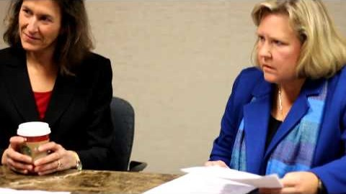
Legislative Affairs and Government Relations: Before You Go Any Farther…
An instructional video by the Massachusetts Medical Society via the Massachusetts Society of Otolaryngology

Slide 33
Legislative Affairs and Government Relations
BOG leaders
Know state and national reps
Advocate
BOG spring leadership meeting
I-Go in district visit with senators and representatives
Expert Source
ENT advocacy network
Project 535
State Trackers
Follow action alerts and inform reps
BOG legislative affairs committee
Get involved with ENT PAC
Host a fundraiser
Participate in "hill days"
Establish
relationships with reps

Slide 34
Section 2:Legislative Affairs and Government Relations
Getting Started

Slide 35


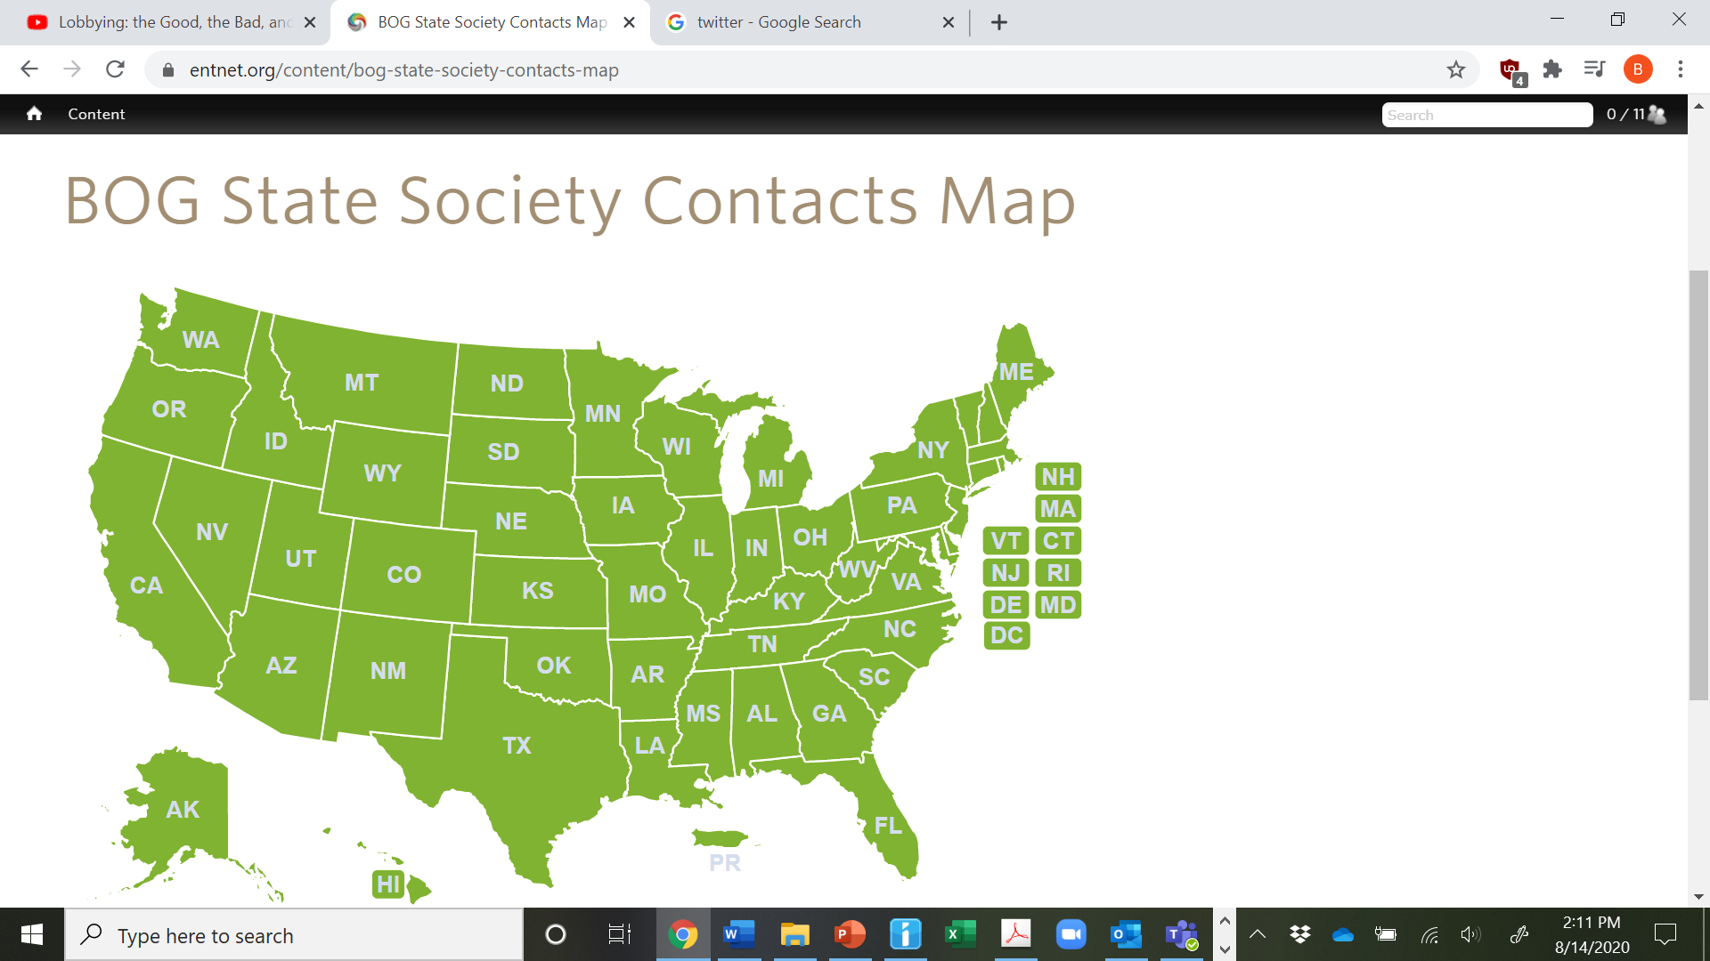
Get Started
  Join the ENT Advocacy Network:
    https://www.entnet.org/?q=content/ent-advocacy-network
    Text “otoadvocate” to 313131 for legislative alerts
  Identify state and U.S. House and Senate Members:
    https://www.govtrack.us/congress/members/map
  Identify your BOG state society leaders with the BOG Interactive Map:
    https://www.entnet.org/content/bog-state-society-contacts-map
  Find out who the AAO lobbyists are:
    https://www.entnet.org/
  Utilize the BOG Legislative Affairs Toolkit:
  https://www.entnet.org/sites/default/files/uploads/GetInvolved/BoardOfGovernors/_files/bog_leg_affairs_toolkit_9.2018.pdf

Slide 36




Get Started
  Sign up for Project 535 to be a go-to when there are bills that need advocating
    https://myspecialty.entnet.org/MySpecialty/Contact_Management/Preference_AAO/Project_535.aspx
  Join State Trackers to find out about bills impacting your state
    https://www.entnet.org/content/state-legislative-advocacy
  Follow the AAO-HNS Advocacy team on Twitter
    @AAOHNSGovtAffrs
  Contribute to the ENT PAC
    https://www.entpac.org/

Slide 37
Legislative Affairs and Government Relations

Slide 38
Section 2:Legislative Affairs and Government Relations
Getting Involved

Slide 39
Get Involved
  Attend the AAO-HNS/F Leadership Forum and BOG Spring Meeting:
  Register via www.entnet.org. Registration is free to Academy members.
  Sign up for an in-district visit with your Representative(s)
  https://www.entnet.org//content/district-grassroots-outreach-i-go
  Host or participate in a fundraiser for your Representative: I-Go
  Work with state BOG society and state medical society to visit legislators in state capital:
  Use the online interactive map to identify your BOG representatives at
  https://www.entnet.org/content/bog-state-society-contacts-map

Slide 40
Get Involved
  Download prepared form letters which describe how a particular issue affects our specialty
  https://www.entnet.org/content/template-appeal-letters-and-advocacy-statements
  Call or email state/US legislators when action alerts are sent out:
  https://entadvocacy.org/
  Join the BOG Legislative Affairs Committee:
  Apply through the AAO-HNS/F website https://www.entnet.org/committees

Slide 41
Legislative Affairs and Government Relations

Slide 42
Section 2:Legislative Affairs and Government Relations
Becoming a Trusted Source of Information

Slide 43
Become a Trusted Source of Information
  Establish relationship with your local Representative
  Contact your state medical society and get connected with their lobbyists
  Participate in a “Hill Day” at your state legislative offices
  Use the AAO-HNS resources to help craft responses to questions
  Utilize online information, ENT CONNECT
  ENT PAC:
  Non-partisan support of candidates who support favorable positions on issues impacting physicians and patients
  https://entpac.org
  Become a resource for other otolaryngologists

Slide 44
Legislative Affairs and Government Relations

Slide 45
Section 3
Education/CME Programming

Slide 46
Education/CME programming
Continuing Medical Education (CME)
Formats
Venues
Resident & Medical Student Engagement

Slide 47
Section 3: Education/CME Programming
Continuing Medical Education (CME)

Slide 48
Continuing Medical Education (CME)
Knowledge Needs Assessment
Examples of courses:
  Hands-On/Kinetic Learning
    Ultrasound course
    Temporal bone course
  New Device Training
    Eustachian Tube Balloon Dilation
    Absorbable Nasal Valve Implantation
    Hypoglossal Nerve Stimulation

Slide 49
Relevant Non-CME Education
Local and State Elected Officials
Insurance Payor Medical Directors
Practice Management
Financial Planning
Coding Workshops

Slide 50
Section 3: Education/CME Programming
Education Format

Slide 51
Educational Formats
Recurring Meetings +/- Annual Event
Podium Presentation/Webinar
Journal Club
Case Conference
Audience Participation
Whiteboard Session/SWOT Analysis

Slide 52
Annual Meeting Planning
Funding
Venues
Meeting Planner
Meeting types
  Dinner
  Large CME Event

Slide 53
Section 3: Education/CME Programming
Education Venues

Slide 54
Venues for Education
Virtual ENT! (The New Normal?)
  Social Media: Facebook Groups/Google Hangouts
  Adobe Connect
  Zoom (free or licensed version < $20/month)
  Webex ($13-27/mo)
Podcasts
  Getting Started
    https://www.sidehustlenation.com/how-much-does-it-cost-to-start-a-podcast/
  Example: #ShesOnCall
    https://www.youtube.com/channel/UCG28wxulaakxclaonGBZOuA
Practice Office Space/Conference Room
Community & University Spaces
Hotels & Restaurant

Slide 55
Section 3: Education/CME Programming
Engagement of Trainees

Slide 56
Resident & Medical Student Engagement
Subsidized or Waived Fees
Mentorship – Private, Hospital/Employed, & Academic
    ABOHNS Mock Oral Boards
    Boot Camp Training EX
Executive Training

Slide 57
Contact Information
Thomas L. Stefaniak, MBA, CAE
Senior Manager, Member Networks and Engagement
  tstefaniak@entnet.org
  Board of Governors Email
  bog@entnet.org

Slide 58
Society Management and Administration:
FAQs
Legal/Financial
- SS-4 Application - Link to instructions: https://www.irs.gov/instructions/iss4
a. Question 7a/7b asks for a responsible party and an SSN/EIN. Who/What should I put here? Unless the applicant is a government entity, the responsible party must be an individual.
b. For Question 9a you are best to choose “other non-profit organization” (see 1023/1023EZ below)
- Banking: How do I choose the right bank for our society - Depending on the geography of your society, you will want a bank that will be accessible to all members. Banking access may be in person or online and if you’d like rotating officers (Treasurer) to have access to the account, you may need to sign paperwork in person to change the access. Certain features to ask your bank representative if you desire: Do you have any assistance/access to online BillPay? What are your baseline fees? Do you have a minimum balance? Are there any breaks/discounts for non-profit organizations?

Slide 59
Society Management and Administration:
FAQs continued
Legal/Financial
- Why should we apply for 501(c)(3) status? It may assist you in various discounts such as banking or print shops. It will make donations tax exempt and thus more appealing for sponsors/vendors/donors, including members.
- Why should we apply for 501(c)(6) status? A trade association is not limited in the amount of lobbying it may do in pursuing its members' interests, while a charity may lobby only so long as it is not a substantial portion of its activities. A (c)(6) may endorse or oppose candidates for public office, while a (c)(3) could lose its exempt status for doing so.
- What is the difference between a 501(c)3 and 501(c)6? 501(c)(3)s are organized and operated primarily for religious, charitable, scientific, educational, and certain other purposes. In contrast, 501(c)(6)s are business leagues or associations that are organized and operated primarily to promote the common business interests of its members.

Slide 60
Society Management and Administration:
Appendices
Appendix A: Sample bylaws of the Virginia Society of Otolaryngology
Appendix B: Sample bylaws of the New Mexico Society of Otolaryngology Head and Neck Surgery
Appendix C: Sample membership application form
Appendix D: Sample sponsorship program
Appendix E: BOG Member Society application form

Slide 61
Continuing Medical Education (CME)
Resources
  ACGME
    https://www.accme.org/accreditation-rules/accreditation-criteria
  AAO-HNS FAQ on CME
    https://www.entnet.org/node/1619
  American College of Surgeons (ACS)
    https://www.facs.org/education/cme-platform/resources
  American Medical Association (AMA)
    https://edhub.ama-assn.org/pages/become-our-partner

Slide 62
Continuing Medical Education (CME)
Resources (Continued)
  University & Non-University Affiliated Hospitals
    Parker FW, Mazmanian PE. Commitments, learning contracts, and seminars in hospital‐based CME: Change in knowledge and behavior. Journal of Continuing Education in the Health Professions. doi: 10.1002/chp.4750120109
  State Medical Societies
    https://edhub.ama-assn.org/state-cme
  FSMB State Resource Guide
    https://www.fsmb.org/siteassets/advocacy/pdf/states-modifying-continuing-medical-education-requirements.pdf

Slide 63
Sample Agenda

