Slide 1
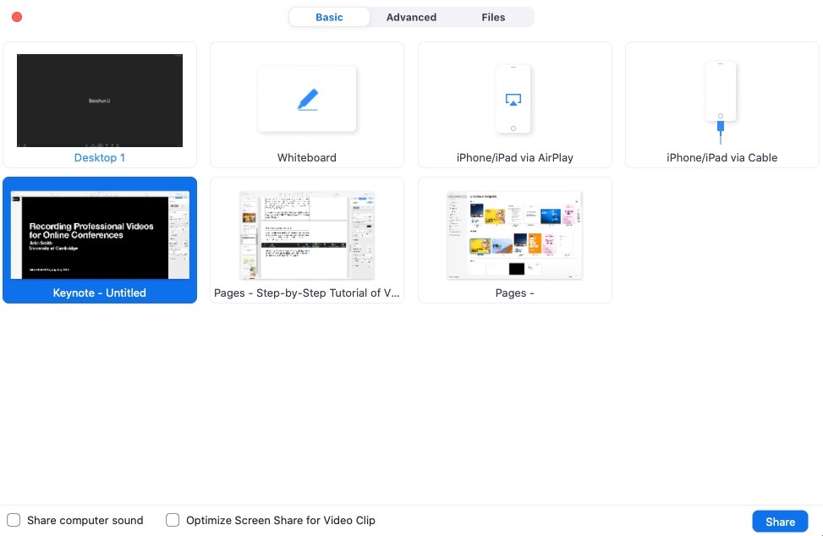
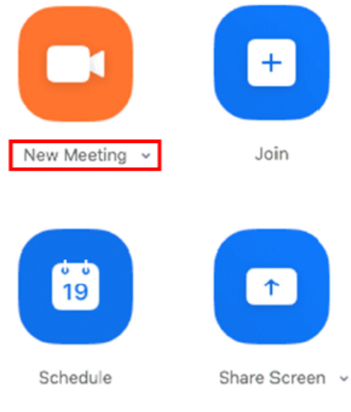
RECORDING YOUR PRESENTATION USING ZOOM
Be sure you are using a computer with front-facing camera and a built-in microphone and that your PowerPoint presentation is open in slideshow mode.
Open the Zoom Application
Select “New Meeting”
After selecting New Meeting, you should get a pop-up window asking if you want to “Join with Computer Audio”, click Yes.
Click the “Start Video” icon to start video from your camera.
Click “Share Screen”.
Choose the screen you want to share. Please do not select “Share Computer Sound” (unless you are planning to show a video) or “Optimize Screen Share for Video Clip” at the bottom.
Click “Share”.

Slide 2
RECORDING YOUR PRESENTATION USING ZOOM Cont.
At the bottom right of the zoom window you should see a button marker “Record”. Click it and then select “Record on this Computer”
You are now recording. You can pause and/or stop the recording with the buttons on the zoom window.
That’s it! Your video presentation IS NOW READY TO BE UPLOADED.
After you stop the recording, end the meeting and Zoom will create an MP4 video file and store it in a local folder (typically documents/Zoom).
We recommend making a short test video and checking your results to ensure both audio and video is in sync and the sound quality is good before recording your full presentation.
If you have another recording software, you are familiar with please feel free to use it. The final recording should be in MP4 format, with a resolution of 1920 X 1080.

