Slide 1
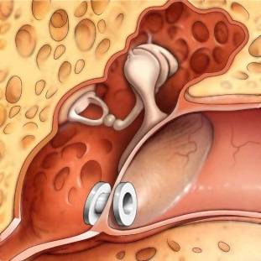
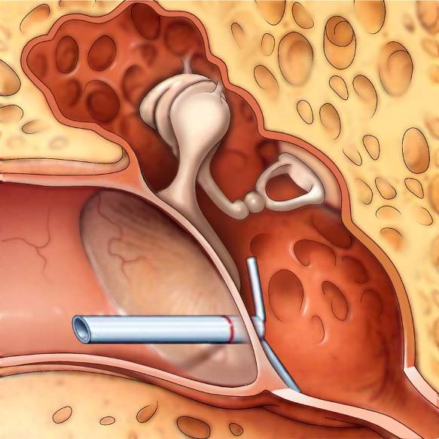
Clinical Practice Guideline: Tympanostomy Tubes in Children (Update)
Published February 2022

Slide 2
Disclaimer
The clinical practice guideline is provided for information and educational purposes only. It is not intended as a sole source of guidance in managing children with tympanostomy tubes or being considered for tympanostomy tubes. Rather, it is designed to assist clinicians by providing an evidence-based framework for decision-making strategies.
The guideline is not intended to replace clinical judgment or establish a protocol for all individuals with this condition and may not provide the only appropriate approach to diagnosing and managing this program of care. As medical knowledge expands and technology advances, clinical indicators and guidelines are promoted as conditional and provisional proposals of what is recommended under specific conditions but are not absolute.
Guidelines are not mandates; these do not and should not purport to be a legal standard of care. The responsible physician, in light of all circumstances presented by the individual patient, must determine the appropriate treatment. Adherence to these guidelines will not ensure successful patient outcomes in every situation.
The AAO-HNS, Inc emphasizes that these clinical guidelines should not be deemed to include all proper treatment decisions or methods of care or to exclude other treatment decisions or methods of care reasonably directed to obtaining the same results.

Slide 3

AAO-HNSF Guideline Update Group
Leadership: Richard M. Rosenfeld, MD, MPH, MBA, Chair; David E. Tunkel, MD, Assistant Chair; Seth R. Schwartz, MD, MPH, Methodologist
AAO-HNS Members: Samantha Anne, MD, MS, AAO-HNSF Board of Governors (BOG);
Daniel C. Chelius, MD, AAO-HNS Board of Directors (BOD);Ana H. Kim, MD, American Otological Society (AOS); Matthew T. Maksimoski, MD, Section for Residents and Fellows-in-Training (SRF); Diego A. Preciado, MD, PhD, International Society for Otitis Media (ISOM); Nikhila P. Raol, MD, MPH, American Society of Pediatric Otolaryngology (ASPO); Taskin M. Monjur, AAO-HNSF Staff Liaison
External Stakeholders: Charles E. Bishop, AuD, PhD, CCC-A, American Speech-Language Hearing Association; Jesse Hackell, MD, FAAP, American Academy of Pediatrics (AAP); Lisa L. Hunter, PhD, American Academy of Audiology (AAA); Kristina L. Keppel, DNP, RN, APNP, Society of Otorhinolaryngology Head-Neck Nurses (SOHN); Tae W. Kim, MD, MEHP, Society of Pediatric Anesthesia (SPA); Jack W. Levine, MD, American Academy of Pediatrics (AAP); Denee J. Moore, MD, American Academy of Family Physicians (AAFP); William K. Vaughan, Consumers United for Evidence-Based Healthcare (CUE); Elizabeth A. Walker, PhD, CCC-A/SLP, American Speech-Language-Hearing Association (ASHA)

Slide 4
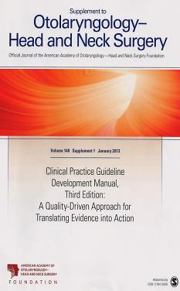
Clinical Practice Guideline Development Manual: Third Edition
Rosenfeld, Shiffman, and Robertson
Pragmatic, transparent approach to creating guidelines for performance assessment
Evidence-based, multidisciplinary process leading to publication in 12-18 months
Emphasizes a focused set of key action statements to promote quality improvement
Uses action statement profiles to summarize decisions in recommendations

Slide 5

Clinical Practice Guidelines (CPG) Goals
Focus on quality improvement opportunities
Define actionable recommendations for clinicians regardless of discipline to improve care
The guideline is not intended to be comprehensive
The guideline is not intended to limit or restrict care provided by clinicians to individual patients

Slide 6
Tympanostomy Tubes: Healthcare Burden
Insertion of tympanostomy tubes is the most common ambulatory surgery performed on children in the United States
Most children have experienced at least 1 acute otitis media episode by age 3 years, and by age 6 years nearly 40% have experienced 3 or more infections
At any given time, approximately 20% of young school-aged children have middle ear effusion with nearly all school-aged children having at least 1 episode during in childhood
In a study of National Health Interview Survey data from 2014, 8.6% of children under age 18 years had prior tympanostomy tubes
Annual health costs of $1.8 billion from 670,000 tympanostomy tube insertions annually in children in the United States and an average cost of $2,700 per procedure

Slide 7
Purpose and Target Audience
Purpose: The purpose of this clinical practice guideline update is to reassess and update recommendations in the prior guideline from 2013 and to provide clinicians with trustworthy, evidence-based recommendations on patient selection and surgical indications for managing tympanostomy tubes in children
Target Patient: Children aged 6 months to 12 years with tympanostomy tubes or being considered for tympanostomy tubes in any care setting as an intervention for otitis media of any type
Target Audience: The target audience includes specialists, primary care clinicians, and allied health professionals, as represented by this multidisciplinary guideline update group
Exclusions: Children younger than 6 months are excluded from this guideline … and the guideline also does not pertain to children diagnosed as having retraction-type ear disease (atelectasis or adhesive otitis media), complications of AOM, or barotrauma, nor to children who have tubes placed for drug delivery to the middle ear

Slide 8
Literature Search
Performed by an information specialist
Evidence included:
  Clinical Practice Guidelines: 6
  Systematic Reviews and Meta Analyses: 18
  Randomized Control Trials: 27
286 references in the final CPG document

Slide 9
Strength of Action Terms/Implied Levels of Obligation
Strength | Definition | Implied Obligation
Strong Recommendation | The benefits of the recommended approach clearly exceed the harms (or that the harms clearly exceed the benefits in the case of a strong negative recommendation) and that the quality of the supporting evidence is excellent (Grade A or B) | In some clearly identified circumstances, strong recommendations may be made based on lesser evidence when high-quality evidence is impossible to obtain, and the anticipated benefits strongly outweigh the harms. Clinicians should follow a strong recommendation unless a clear and compelling rationale for an alternative approach is present.
Recommendation | A recommendation means the benefits exceed the harms (or that the harms exceed the benefits in the case of a negative recommendation), but the quality of evidence is not as strong (Grade B or C) | In some clearly identified circumstances, recommendations may be made based on lesser evidence when high-quality evidence is impossible to obtain and the anticipated benefits outweigh the harms. Clinicians should also generally follow a recommendation but should remain alert to new information and sensitive to patient preferences.
Option | An option means that either the quality of evidence that exists is suspect (Grade D) or that well-done studies (Grade A, B, or C) show little clear advantage to one approach versus another. | Clinicians should be flexible in their decision making regarding appropriate practice, although they may set bounds on alternatives. Patient preference should have a substantial influencing role.

Slide 10
Tympanostomy Tubes CPG Update:
Summary of Key Action Statement Strength
Recommendations: 11
  OME of Short Duration; Hearing Evaluation; Chronic Bilateral OME with Hearing Difficulty; Surveillance of Chronic OME; Recurrent AOM without MEE; Recurrent AOM with MEE; At-Risk Children; Long-term Tubes; Perioperative Education; Perioperative Ear Drops; Water Precautions
Strong Recommendations: 2
  Acute Tympanostomy Tube Otorrhea; Follow-Up
Options: 3
  Chronic OME with Symptoms; Tympanostomy Tubes in At-Risk Children; Adjuvant Adenoidectomy

Slide 11
External Review & Public Comment
External Review (May – June 2021)
  14 organizations/AAO-HSNF committees
  26 individuals
  341 comments
  152 subsequent changes
Public Comment (August 2021)
  5 individuals
  19 comments
  5 subsequent changes

Slide 12
What’s New?
New evidence from 6 clinical practice guidelines, 18 systematic reviews, and 27 randomized controlled trials (RCTs)
Emphasis on patient education and shared decision-making with new tables of counseling opportunities and frequently asked questions
Expanded action statement profiles to explicitly state quality improvement opportunities and implementation considerations
New flowchart to clarify decision making and show the relationships between key action statement recommendations
A new strong recommendation that the surgeon, or designee, should examine the ears of a child within 3 months after tympanostomy tube insertion to assess outcomes and should educate families regarding the need for routine, periodic follow-up to examine the ears until the tubes extrude
A new option for the clinician to perform adenoidectomy as an adjunct to tympanostomy tube insertion for children with symptoms directly related to the adenoid (adenoid infection or nasal obstruction) or in children aged 4 years or older to reduce future incidence of recurrent otitis media or the need for repeat tube insertion
A new recommendation against placing long-term tubes as initial surgery for children who meet criteria for tube insertion unless there is an anticipated need for prolonged middle ear ventilation beyond that of a short-term tube
A new recommendation against routinely prescribing prophylactic antibiotic ear drops after tympanostomy tube surgery to prevent or reduce otorrhea
Addition of intellectual disability, learning disorder, or attention deficit hyperactivity disorder to the list of risk factors that place children who have otitis media with effusion (OME) at increased risk for developmental difficulties (at-risk child)
Updated categories of normal to mild hearing loss in children, with normal hearing as 0 to 15 decibels (dB), slight hearing loss as 16 to 25 dB, and mild hearing loss as 26 to 40 dB

Slide 13
Statement 1: OME of Short Duration
STATEMENT 1. OME OF SHORT DURATION: Clinicians should not perform tympanostomy tube insertion in children with a single episode of OME of less than 3 months’ duration, from the date of onset (if known) or from the date of diagnosis (if onset is unknown). Recommendation against based on systematic review of observational studies of natural history and an absence of any randomized controlled trials on efficacy of tubes for children with OME less than 2 to 3 months’ duration and a preponderance of benefit over harm.
Change from 2013: Statement is unchanged
Benefits: Avoid unnecessary surgery and its risks, avoid surgery in children for whom the benefits of tympanostomy tubes have not been studied and are uncertain, avoid surgery in children with a condition that has reasonable likelihood of spontaneous resolution, cost savings
Risks, harms, costs: Delayed intervention in children who do not recover spontaneously and/or in children who develop recurrent episodes of OME

Slide 14
Statement 1: OME of Short Duration
Action Statement Profile
Quality improvement opportunity: Prevent overuse of tympanostomy tubes in children unlikely to derive benefit from surgery (National Quality Strategy Priorities: Patient Safety, Effective Prevention and Treatment)
Aggregate evidence quality: Grade C, based on a systematic review of observational studies and control groups in RCTs on the natural history of OME and an absence of any RCTs on efficacy of tympanostomy tubes for children with OME less than 2 months’ duration
Level of confidence in evidence: High
Benefit-harm assessment: Preponderance of benefit over harm
Value judgments: Exclusion of children with OME of less than 2 months’ duration from all published RCTs of tube efficacy was considered compelling evidence to question the value of surgery in this population, especially considering the known risks of tympanostomy tube surgery
Intentional vagueness: None
Role of patient (caregiver) preferences: Limited, because of good evidence that otherwise healthy children with OME of short duration do not benefit from tympanostomy tube insertion
Exceptions: At-risk children (Table 2); refer to Statements 8 and 9 for explicit information on at-risk children
Policy level: Recommendation
Differences of opinion: None
Implementation considerations: None

Slide 15
Statement 2. Hearing Evaluation
STATEMENT 2. HEARING EVALUATION: Clinicians should obtain a hearing evaluation if OME persists for 3 months or longer OR prior to surgery when a child becomes a candidate for tympanostomy tube insertion. Recommendation based on observational and cross-sectional studies with a preponderance of benefit over harm.
Change from 2013: Statement now refers to “hearing evaluation” instead of “hearing testing” and normal hearing now up to 15 dB HL (20 dB HL prior)
Benefits: Documentation of hearing status, improved decision making regarding the need for surgery in chronic OME, establishment of baseline hearing prior to surgery, detection of coexisting mixed or sensorineural hearing loss
Risks, harms, costs: Cost of the audiologic assessment

Slide 16
Statement 2. Hearing Evaluation
Action Statement Profile
Quality improvement opportunity: Facilitate informed care decisions based on hearing levels; engage caregivers in decisions; detect preexisting hearing loss; (National Quality Strategy Domain: Effective Communication and Care Communication; Person- and Family-Centered Care)
Aggregate evidence quality: Grade C, based on observational and cross-sectional studies assessing the prevalence of conductive hearing loss with OME
Level of confidence in evidence: High
Benefit-harm assessment: Preponderance of benefit over harm
Value judgments: None
Intentional vagueness: The words hearing evaluation refer to audiologic testing, typically performed by an audiologist, but the specific methods will vary with the age of the child, and a full discussion of the specifics of testing is beyond the scope of this guideline
Role of patient (caregiver) preferences: Some caregivers may decline testing
Exceptions: None
Policy level: Recommendation
Differences of opinion: None
Implementation considerations: Resource limitations and access to care may only allow for a single perioperative audiogram; if resources permit only a single audiometric assessment this would ideally be performed after tympanostomy tube insertion to assess for normal hearing (following resolution of OME) or to identify any residual, or underlying, hearing loss

Slide 17
Statement 3: Chronic Bilateral OME with Hearing Difficulty
STATEMENT 3. CHRONIC BILATERAL OME WITH HEARING DIFFICULTY: Clinicians should offer bilateral tympanostomy tube insertion to children with bilateral OME for 3 months or longer AND documented hearing difficulties. Recommendation based on randomized controlled trials and observational studies, with a preponderance of benefit over harm.
Change from 2013: Statement is unchanged; new questions to assess for hearing difficulties
Benefits: Reduced prevalence of MEE, improved hearing, improved child and caregiver QOL, optimization of auditory access for speech and language acquisition, elimination of a potential barrier to focusing and attention in a learning environment
Risks, harms, costs: Risk of anesthesia, sequelae of the indwelling tympanostomy tubes (eg, otorrhea, granulation tissue, obstruction), complications after tube extrusion (myringosclerosis, retraction pocket, persistent perforation), failure of or premature tympanostomy tube extrusion, tympanostomy tube medialization, procedural anxiety and discomfort, and direct procedural costs

Slide 18
Statement 3: Chronic Bilateral OME with Hearing Difficulty
Action Statement Profile
Quality improvement opportunity: Promote effective treatment and focus attention on hearing difficulties, in addition to audiometric hearing thresholds, as a criterion for tube insertion; (National Quality Strategy Domain: Effective Communication and Care Coordination and Promoting Effective Prevention/Treatments; Patient Safety; Person and Family Centered Care)
Aggregate evidence quality: Grade B, based on well-designed RCTs showing reduced MEE prevalence and improved hearing after tympanostomy tube insertion; observational studies documenting improved QOL; and extrapolation of research and basic science principles for optimizing auditory access
Level of confidence in the evidence: High
Benefit-harm assessment: Preponderance of benefit over harm
Value judgments: Assumption that optimizing auditory access would improve speech and language outcomes, despite inconclusive evidence regarding the impact of MEE on speech and language development
Intentional vagueness: The term hearing difficulty is used instead of hearing loss to emphasize that a functional assessment of how a child uses hearing and engages in their environment is important, regardless of what specific threshold is used to define hearing loss based on audiologic criteria
Role of patient (caregiver) preferences: Substantial role for shared decision making regarding the decision to proceed with, or to decline, tympanostomy tube insertion
Exceptions: None
Policy level: Recommendation
Differences of opinion: Minor differences regarding the role of caregiver report as a surrogate for audiologic assessment and whether the action taken by the clinician should be to “recommend” tubes (minority opinion) versus to “offer” tubes (majority opinion)
Implementation considerations: None

Slide 19
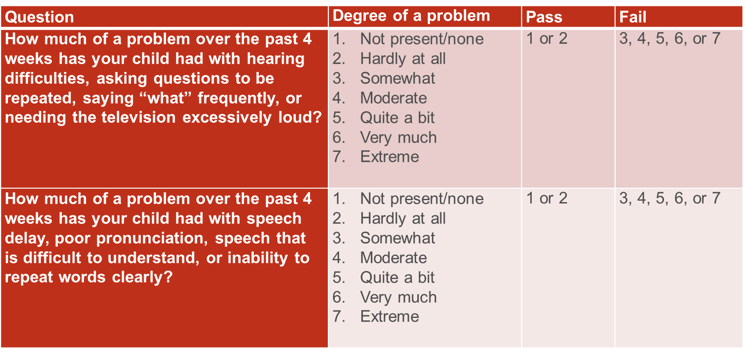
Statement 3: Validated Questions for Assessing Hearing Difficulty by Caregiver Report
Adapted from: Rosenfeld RM, et al. Arch Otolaryngol Head Neck Surg 1997; 123:1049-54

Slide 20
Statement 4. Chronic OME with Symptoms
STATEMENT 4. CHRONIC OME WITH SYMPTOMS: Clinicians may perform tympanostomy tube insertion in children with unilateral or bilateral OME for 3 months or longer (chronic OME) AND symptoms that are likely attributable, all or in part, to OME that include, but are not limited to, balance (vestibular) problems, poor school performance, behavioral problems, ear discomfort, or reduced quality of life. Option based on randomized controlled trials and before-and-after studies with a balance between benefit and harm.
Change from 2013: Statement of “likely attributable” now qualified by “all or in part”
Benefits: Reduced prevalence of MEE, possible relief of symptoms attributed to chronic OME, elimination of MEE as a confounding factor from efforts to understand the reason or cause of a vestibular problem, poor school performance, behavioral problem, or ear discomfort
Risks, harms, costs: None related to offering surgery, but if performed, tympanostomy tube insertion includes risks from anesthesia, sequelae of the indwelling tympanostomy tubes (otorrhea, granulation tissue, obstruction), complications after tube extrusion (myringosclerosis, retraction pocket, persistent perforation), premature tympanostomy tube extrusion, retained tympanostomy tube, tympanostomy tube medialization, procedural anxiety and discomfort, and direct costs of surgery and follow-up care

Slide 21
Statement 4. Chronic OME with Symptoms
Action Statement Profile
Quality improvement opportunity: promote effective care and improve child quality of life; (National Quality Strategy Domain: Effective communication and Care Coordination, Person and Family Centered Care; Promoting Effective Prevention/Treatments)
Aggregate evidence quality: Grade C, based on before-and-after studies on vestibular function and QOL, RCTs on reduced MEE prevalence after tubes for chronic OME, and observational studies regarding the impact of MEE on children as related, but not limited to, school performance, behavioral issues, and speech delay
Level of confidence in evidence: High for vestibular problems and QOL; medium for poor school performance, behavioral problems, and ear discomfort, because of study limitations and the multifactorial nature of these issues
Benefit-harm assessment: Equilibrium (balance) of benefit vs. harm
Value judgments: Chronic MEE has been associated with problems other than hearing loss; intervening when MEE is identified can reduce symptoms. The group’s confidence in the evidence of a child benefitting from intervention was insufficient to conclude a preponderance of benefit over harm and instead found at equilibrium
Intentional vagueness: The words likely attributable are used to reflect the understanding that the symptoms listed may have multifactorial causes, of which OME may be only one factor, and resolution of OME may not necessarily resolve the problem
Role of patient (caregiver) preferences: Substantial role for shared decision making regarding the decision to proceed with, or to decline, tympanostomy tube insertion
Exceptions: None
Policy level: Option
Differences of opinion: None.
Implementation considerations: availability of audiology; access/familiarity with office-based measures to assess behavior, speech, language, or other aspects of child development; ability to assess vestibular issues and OME-related quality of life deficits Refer to comments above.

Slide 22
Statement 5: Surveillance of Chronic OME
STATEMENT 5. SURVEILLANCE OF CHRONIC OME: Clinicians should reevaluate, at 3- to 6-month intervals, children with chronic OME who do not receive tympanostomy tubes, until the effusion is no longer present, significant hearing loss is detected, or structural abnormalities of the tympanic membrane or middle ear are suspected. Recommendation based on observational studies, with a preponderance of benefit over harm.
Change from 2013: Statement is unchanged
Benefits: Detection of structural changes in the tympanic membrane that may require intervention, detection of new hearing difficulties or symptoms that would lead to reassessing the need for tympanostomy tube insertion, discussion of strategies for optimizing the listening-learning environment for children with OME, as well as ongoing counseling and education of parents/caregiver
Risks, harms, costs: Cost of examination(s)

Slide 23
Statement 5: Surveillance of Chronic OME
Action Statement Profile
Quality improvement opportunity: Promote continuity of care; avoid preventable complications through surveillance; gain insight into natural history of chronic middle ear fluid; (National Quality Strategy Domain: Promoting Effective Prevention/Treatments; Person and Family Centered Care; Effective Communication and Care Coordination; Patient Safety)
Aggregate evidence quality: Grade C, based on observational studies
Level of confidence in evidence: High
Benefit-harm assessment: Preponderance of benefit over harm
Value judgments: Untreated OME can cause progressive changes in the tympanic membrane that require surgical intervention, including atelectasis, retraction pocket, or cholesteatoma. There was an implicit assumption that surveillance and early detection/intervention could prevent these, and other, complications and would also provide opportunities for ongoing education and counseling of caregivers
Intentional vagueness: The surveillance interval is broadly defined at 3 to 6 months to accommodate provider and patient preference; “significant” hearing loss is broadly defined as one that is noticed by the caregiver, reported by the child, or interferes in school performance or quality of life
Role of patient (caregiver) preferences: Opportunity for shared decision making regarding the surveillance interval
Exceptions: None
Policy level: Recommendation
Differences of opinion: None
Implementation considerations: None

Slide 24
Statement 6: Recurrent AOM without MEE
STATEMENT 6. RECURRENT AOM WITHOUT MEE: Clinicians should not perform tympanostomy tube insertion in children with recurrent AOM who do not have middle-ear effusion (MEE) in either ear at the time of assessment for tube candidacy. Recommendation against based on systematic reviews and randomized controlled trials with a preponderance of benefit over harm.
Change from 2013: Statement unchanged; new patient information sheet
Benefits: Avoid unnecessary surgery and its risks, avoid surgery in children for whom RCTs have not demonstrated any benefit for reducing AOM incidence or in children with a condition that has reasonable likelihood of spontaneous resolution, cost savings
Risks, harms, costs: Delay in intervention for children who eventually require tympanostomy tubes, need for systemic antibiotics among children who continue to have episodes of recurrent AOM

Slide 25
Statement 6: Recurrent AOM without MEE
Action Statement Profile
Quality improvement opportunity: Avoid ineffective care; promote appropriate care (watchful waiting); (National Quality Strategy Domain: Promoting Effective Prevention/Treatments; Patient Safety; Effective Communication and Care Coordination)
Aggregate evidence quality: Grade A, based on a meta-analysis of RCTs, a systematic review of RCT control groups regarding the natural history of recurrent AOM, and other RCTs
Level of confidence in evidence: High
Benefit-harm assessment: Preponderance of benefit over harm
Value judgments: Implicit in this recommendation is the ability to reassess children who continue to have AOM despite observation and to perform tympanostomy tube insertion if MEE is present (Statement 7); risk of complications or poor outcomes from delayed tube insertion for children who continue to have recurrent AOM is minimal
Intentional vagueness: The method of confirming the absence of MEE should be based on clinician experience and may include tympanometry, simple otoscopy, and/or pneumatic otoscopy. The timing to otolaryngology assessment of effusion after initial referral has been widely variable across studies and remains open to clinician experience and system-based scheduling patterns.
Role of patient (caregiver) preferences: Limited, because of favorable natural history and good evidence that otherwise healthy children with recurrent AOM without MEE do not have a reduced incidence of AOM after tympanostomy tube insertion
Exceptions: At-risk children (refer to Table 2), children with histories of severe or persistent AOM, immunosuppression; prior complication of otitis media (mastoiditis, meningitis, facial nerve paralysis); multiple antibiotic allergy or intolerance
Policy level: Recommendation
Differences of opinion: None
Implementation considerations: Fact sheet explaining to families and primary care clinicians: 1) why tube insertion for recurrent AOM in the absence of MEE is unlikely to benefit their child and 2) what role patient preference and future infections might have in altering this decision (refer to Figure 5 below)

Slide 26
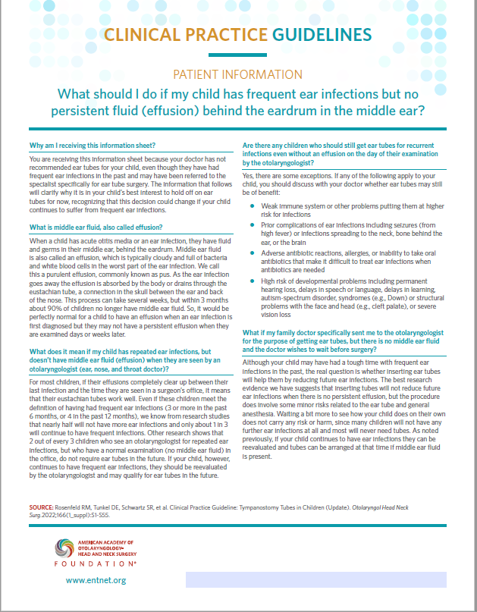
Statement 6: Recurrent AOM without MEE

Slide 27
Statement 7: Recurrent AOM with MEE
STATEMENT 7. RECURRENT AOM WITH MEE: Clinicians should offer bilateral tympanostomy tube insertion in children with recurrent AOM who have unilateral or bilateral MEE at the time of assessment for tube candidacy. Recommendation based on randomized controlled trials with minimal limitations and a preponderance of benefit over harm.
Change from 2013: Statement is unchanged
Benefits: Mean decrease of approximately 3 episodes of AOM per year, ability to treat future episodes of AOM with topical antibiotics instead of systemic antibiotics, reduced pain with future AOM episodes, improved hearing during AOM episodes
Risks, harms, costs: Risks from anesthesia, sequelae of the indwelling tympanostomy tubes (otorrhea, granulation tissue, obstruction), complications after tube extrusion (myringosclerosis, retraction pocket, persistent perforation), tube medialization, procedural anxiety and discomfort, and direct procedural costs

Slide 28
Statement 7: Recurrent AOM with MEE
Action Statement Profile
Quality improvement opportunity: Promote effective care with improved quality of life by reducing the need for systemic antibiotics by facilitating topical antibiotic therapy of future infections; (National Quality Strategy Domain: Promoting Effective Prevention/Treatments; Person and Family Centered Care; Effective Communication and Care Coordination; Promoting Patient Safety by Reducing Harm)
Aggregate evidence quality: Grade B, based on RCTs with minor limitations
Level of confidence in evidence: Medium; some uncertainty regarding the magnitude of clinical benefit and importance, because of heterogeneity in the design and outcomes of clinical trials
Benefit-harm assessment: Preponderance of benefit over harm
Value judgments: In addition to the benefits seen in RCTs, the presence of effusion at the time of assessment served as a marker of diagnostic accuracy for AOM
Intentional vagueness: The method of confirming the presence of MEE should be based on clinician experience and may include tympanometry, simple otoscopy, and/or pneumatic otoscopy
Role of patient (caregiver) preferences: Substantial role for shared decision making regarding the decision to proceed with, or to decline, tympanostomy tube insertion
Exceptions: None
Policy level: Recommendation
Differences of opinion: None
Implementation considerations: None

Slide 29
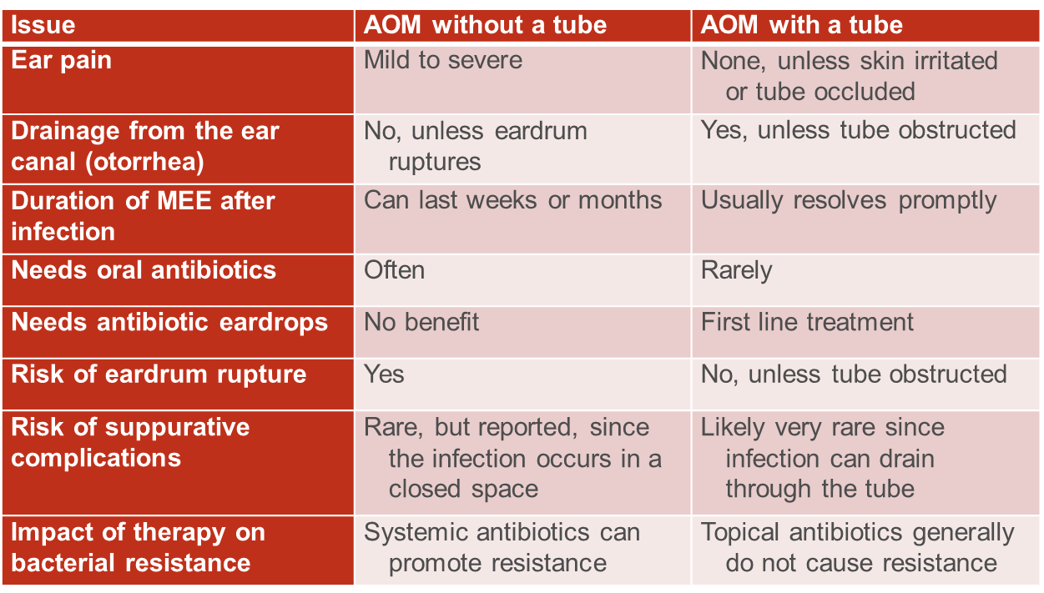
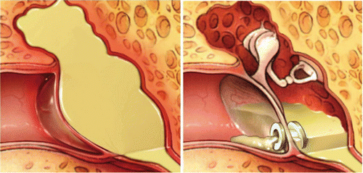
Statement 7: Recurrent AOM with MEE
Comparison of AOM With and Without a Tympanostomy Tube

Slide 30

Statement 8: At-risk Children
Risk Factors for Developmental Difficulties
Permanent hearing loss, not from OME
Suspected or confirmed speech and
language disorder
Autism spectrum disorder
Syndromes (e.g., Down) or craniofacial disorders that include developmental delays
Blindness or uncorrectable visual impairment
Cleft palate ± associated syndrome
Developmental delay
Intellectual disability, learning disorder,
or attention deficit hyperactivity disorder
STATEMENT 8. AT-RISK CHILDREN: Clinicians should determine if a child with recurrent AOM or with OME of any duration is at increased risk for speech, language, or learning problems from otitis media because of baseline sensory, physical, cognitive, or behavioral factors (refer to Table 2). Recommendation based on observational studies with a preponderance of benefit over harm.
Change from 2013: Statement is unchanged; at-risk criteria expanded
Benefits: Facilitate future decisions about tube candidacy, identify children who might benefit from early intervention (including tympanostomy tubes), identify children who might benefit from more active and accurate surveillance of middle ear status or require more prompt evaluation of hearing, speech, and language
Risks, harms, costs: None

Slide 31
Statement 8: At-risk Children
Action Statement Profile
Quality improvement opportunity: Raise awareness of underlying conditions that might lower the threshold for tube insertion; ensure clinician awareness of, and attention, to these conditions when making decisions about tube insertion; (National Quality Strategy Domain: Patient Safety; Effective Communication and Care Coordination)
Aggregate evidence quality: Grade C, based on observational studies
Level of confidence in evidence: High for children with Down syndrome, cleft palate, and/or permanent hearing loss; medium for other at-risk groups
Benefit-harm assessment: Preponderance of benefit over harm
Value judgments: Despite the limited high-quality evidence about the impact of tubes for these populations (nearly all RCTs exclude children who are at risk), the panel considered it important to use at-risk status as a factor in decision making about tube candidacy, building on recommendations made in the OME guideline.21 The panel assumed that most at-risk children would be less likely to tolerate OME or recurrent AOM than would the otherwise healthy child
Intentional vagueness: None
Role of patient (caregiver) preferences: None, since this recommendation deals only with acquiring information to assist in decision making
Exceptions: None
Policy level: Recommendation
Differences of opinion: None
Implementation considerations: Potential to add this list of conditions to the electronic health record to facilitate identifying at-risk children when OME is diagnosed

Slide 32
Statement 9: Tympanostomy Tubes and At-risk Children
STATEMENT 9. TYMPANOSTOMY TUBES AND AT-RISK CHILDREN: Clinicians may perform tympanostomy tube insertion in at-risk children with unilateral or bilateral OME that is likely to persist as reflected by a type B (flat) tympanogram or a documented effusion for 3 months or longer. Option based on a systematic review and observational studies with a balance between benefit and harm.
Change from 2013: Statement is unchanged; new text on cochlear implantation
Benefits: Improved hearing, resolution of MEE in at-risk children who would otherwise have a low probability of spontaneous resolution, mitigates a potential obstacle to child development
Risks, harms, costs: Risk of anesthesia, sequelae of the indwelling tympanostomy tubes (otorrhea, granulation tissue, obstruction), complications after tube extrusion (myringosclerosis, retraction pocket, persistent perforation), failure of or premature tympanostomy tube extrusion, tympanostomy tube medialization, procedural anxiety and discomfort, and direct procedural costs

Slide 33
Statement 9: Tympanostomy Tubes and At-risk Children
Action Statement Profile
Quality improvement opportunity: Optimize the acoustic signal for children at-risk for behavioral, learning, or developmental issues from middle ear fluid; (National Quality Strategy Domain: Promoting Effective Prevention/Treatments; Effective Communication and Care Coordination; Person and Family Centered Care)
Aggregate evidence quality: Grade C based on a systematic review of cohort studies regarding natural history of type B tympanograms and observational studies examining the impact of MEE on at-risk children
Level of confidence in evidence: Moderate to low, because of methodological concerns with the conduct, outcome reporting, follow-up of available observational studies, and uncertainty regarding the importance of hearing loss as a mediating factor.
Benefit-harm assessment: Equilibrium (balance) of benefits vs. harms
Value judgments: Despite the absence of controlled trials identifying benefits of tympanostomy tube placement in at-risk children (such children were excluded from the reviews cited), the panel agreed that tympanostomy tubes were a reasonable intervention for reducing the prevalence of MEE that would otherwise have a low likelihood of prompt spontaneous resolution. Untreated persistent MEE would place the child at high risk for hearing loss from suboptimal conduction of sound through the middle ear, which could interfere with subsequent speech and language progress
Intentional vagueness: None
Role of patient (caregiver) preferences: Substantial role for shared decision making with caregivers regarding whether or not to proceed with tympanostomy tube insertion
Exceptions: None
Policy level: Option
Differences of opinion: None regarding the action statement; a minor difference of opinion about whether children with Down syndrome or cleft palate should be considered independently of children with speech and language delays/disorders
Implementation considerations: greater difficulty in accurately documenting middle ear fluid in at-risk children with sensory, tactile, or behavioral issues

Slide 34
Statement 10: Long-term Tubes
STATEMENT 10. LONG-TERM TUBES: The clinician should not place long-term tubes as initial surgery for children who meet criteria for tube insertion unless there is a specific reason based on an anticipated need for prolonged middle ear ventilation beyond that of a short-term tube. Recommendation against based on observational studies, with a preponderance of benefit over harm.
Change from 2013: New statement for 2022
Benefits: Avoid unnecessary adverse events that are more common with long-term tubes, including a higher incidence of otorrhea, granulation tissue, TM perforation; reduce the need for long-term follow-up; reduce the risk of having a retained tube beyond the necessary period of ventilation
Risk, harm, cost: None related to initial management; some potential for repeat tubes in children that may have been avoided if a long-term tube had been used; risk of missing or delayed diagnosis of OME after short term tube extrudes.

Slide 35
Statement 10: Long-term Tubes
Action Statement Profile
Quality improvement opportunity: To reduce perceived overuse of long-term tubes, which have higher adverse event rates than short-term tubes, as initial surgery for children who meet criteria for tube insertion (National Quality Strategy Domain: Promoting Effective Prevention/Treatments)
Aggregate evidence quality: Grade B, based on observational studies
Level of confidence in evidence: High
Benefit-harm assessment: Preponderance of benefit
Value judgments: Perception that long-term tubes are overused by some clinicians for treating recurrent AOM or chronic OME when tube insertion is first performed and that this overuse results in preventable tympanic membrane perforations and other sequelae.
Intentional vagueness: Clinicians must make an informed prediction, based on the child’s history and status of the tympanic membrane and middle ear, as to whether a period of ventilation beyond that of a short-term tube is required.
Role of patient (caregiver) preferences: Small to moderate, based on family history and on values related to the potential need for further surgery and anesthesia.
Exceptions: None
Policy level: Recommendation
Differences of Opinion: No differences of opinion on the statement as written, but 4 of 16 panel members (25%) felt that this statement could have the unintended consequence of increasing the use of long-term tubes because of intentional vagueness in determining a need for ventilation beyond the duration of a short-term tube.
Implementation considerations: Should provide guidance on reasonable indications for initial use of a long-term tube; table comparing the duration and outcomes of long- vs short-term tubes

Slide 36
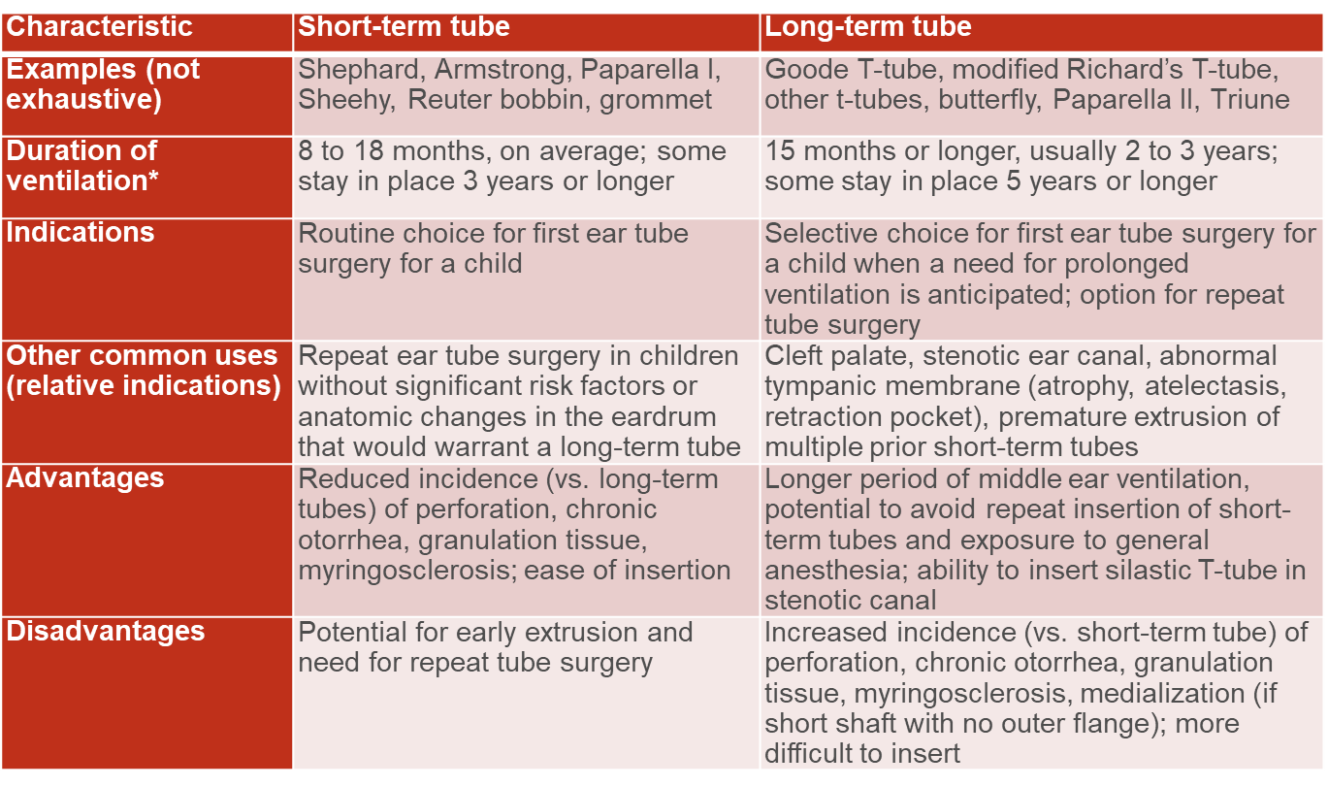
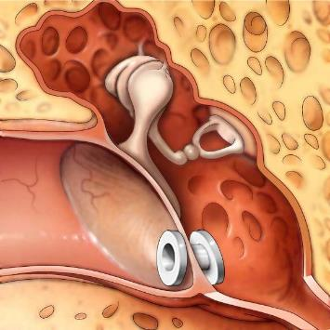

Statement 10: Long-term Tubes

Slide 37
Statement 11: Adjuvant Adenoidectomy
STATEMENT 11. ADJUVANT ADENOIDECTOMY: Clinicians may perform adenoidectomy as an adjunct to tympanostomy tube insertion for children with symptoms directly related to the adenoids (adenoid infection or nasal obstruction) OR in children aged 4 years or older to potentially reduce future incidence of recurrent otitis media or the need for repeat tube insertion. Option based on randomized controlled trials, meta-analyses, and population-level studies, with a balance of benefits and harms.
Change from 2013: New statement for 2022
Benefits: Optimize management of adenoid related disease (nasal obstruction, bacterial infection, chronic rhinitis); reduce need for further surgery and anesthesia; optimize hearing outcomes; decreased persistence of MEE after surgery.
Risk, harm, cost: Surgical risks of adenoidectomy, additional anesthetic risk related to need for intubation during procedure, bleeding, hypernasality, velopharyngeal insufficiency, nasopharyngeal scarring/stenosis, Grisel’s syndrome, longer recovery

Slide 38
Statement 11: Adjuvant Adenoidectomy
Action Statement Profile
Quality improvement opportunity: To discourage adenoidectomy for treating or preventing otitis media in children under age 4 years, for whom efficacy has not been established (National Quality Strategy Domains: Promoting Effective Prevention/Treatments)
Aggregate evidence quality: Grade B, based on RCTs for persistence of OME post-surgically, rate of repeat tube insertion, and hearing outcomes; observational studies regarding the rate of tube re-insertion and hearing outcomes; and meta-analyses on the benefit of adenoidectomy in patients greater than 4 years of age compared to those younger than 4 years of age.
Level of confidence in evidence: High for symptoms related to adenoids and children over age 4 years; medium for role as primary treatment in select populations, and role in second tube insertion procedures in patients younger than 4 years old.
Benefit-harm assessment: Equilibrium (balance) of benefits vs. harms
Value judgments: None
Intentional vagueness: None
Role of patient (caregiver) preferences: Large role as to whether to perform adenoidectomy as an adjunctive procedure based on the preferences of the patient and family.
Exceptions: Contraindications to adenoidectomy (eg, cleft palate, velopharyngeal insufficiency, bleeding disorder).
Policy level: Option
Differences of opinion: None
Implementation considerations: Education materials for otolaryngologists and other clinicians who have traditionally used adenoidectomy as a primary surgical treatment for middle ear disease

Slide 39
Statement 12: Perioperative Education
STATEMENT 12. PERIOPERATIVE EDUCATION: In the perioperative period, clinicians should educate caregivers of children with tympanostomy tubes regarding the expected duration of tube function, recommended follow-up schedule, and detection of complications. Recommendation based on observational studies, with a preponderance of benefit over harm.
Change from 2013: Statement is unchanged; expanded and enhanced caregiver information sheets
Benefits: Improve health literacy and shared decision making, define appropriate caregiver expectations at the time of and after surgery, reduce family anxiety, optimize outcomes, avoid complications, and improve caregiver understanding of the importance of follow-up.
Risks, harms, costs: Time required for education

Slide 40
Statement 12: Perioperative Education
Action Statement Profile
Quality improvement opportunity: To emphasize and facilitate caregiver engagement in their child’s care with the goal of improved outcomes, better communication, and reduced complications (National Quality Strategy Domain: Effective Communication and Care Coordination; Person and Family Centered Care)
Aggregate evidence quality: Grade C, based on observational studies with limitations
Level of confidence in evidence: Medium; there is good evidence and strong consensus on the value of patient education and counseling, in general, but evidence on how this education and counseling affect outcomes of children with tympanostomy tubes is limited
Benefit-harm assessment: Preponderance of benefit over harm
Value judgments: Importance of patient education in promoting optimal outcomes
Intentional vagueness: None
Role of patient (caregiver) preferences: None, since this recommendation deals only with providing information that will aid in the family’s decision to proceed with surgical intervention and for proper management and care following tympanostomy tube placement.
Exceptions: None
Policy level: Recommendation
Differences of opinion: None
Implementation considerations: Can enhance adherence with visual aids, customizable patient information sheets, and online resources

Slide 41
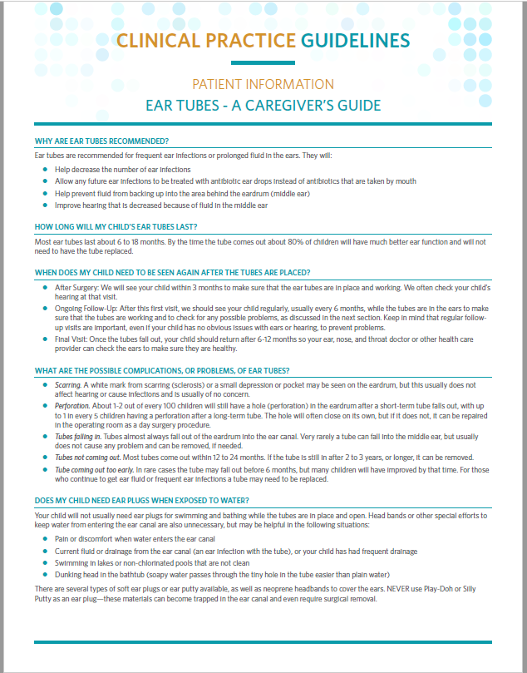
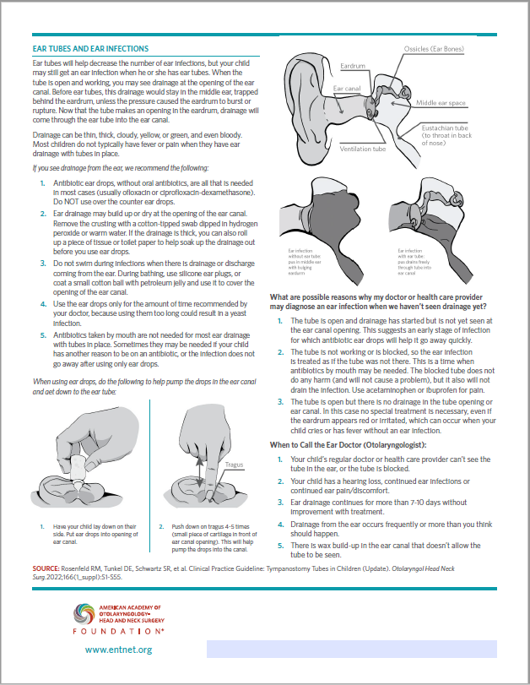

Slide 42
Statement 13: Perioperative Ear Drops
STATEMENT 13. PERIOPERATIVE EAR DROPS: Clinicians should not routinely prescribe postoperative antibiotic ear drops after tympanostomy tube placement. Recommendation against prescribing based on systematic reviews and randomized controlled trials with a preponderance of benefit over harm.
Change from 2013: New statement for 2022
Benefits: Avoidance of unnecessary antibiotics, cost savings, reduced local side effects (skin irritation, allergic reactions, fungal overgrowth), simplification of postoperative care
Risk, harm, cost: Potential for perioperative TTO or tube occlusion that may need subsequent treatment, no cost in not prescribing

Slide 43
Statement 13: Perioperative Ear Drops
Action Statement Profile
Quality improvement opportunity: Reduce overuse, and routine use, of antibiotic ear drops after tympanostomy tube surgery (National Quality Strategy Domains: Prevention and Treatment of Leading Causes of Morbidity and Mortality; Promote Effective Prevention/Treatments)
Aggregate evidence quality: Grade B, based on systematic reviews, randomized controlled trials and before-and-after studies with a balance between benefit and harm, with a preponderance of benefit over harm
Level of confidence in evidence: Moderate
Benefit-harm assessment: Preponderance of benefit over harm
Value judgments: The GUG perceived an overuse of perioperative antibiotic drops, which are often administered during surgery and then prescribed routinely for all children after the procedure; in contrast, saline irrigation (washout) during surgery and saline drops after surgery were perceived as underused, despite comparable efficacy in reducing otorrhea
Intentional vagueness: The word routinely is used to acknowledge that there are specific circumstances that might require or would benefit from antibiotic ear drops (refer to text)
Role of patient preferences: None to small depending on previous patient experience (allergic reaction or any type of adverse side effects)
Exceptions: Purulent middle ear fluid or acute OM at the time of tube placement
Policy level: Recommendation
Differences of opinion: None
Implementation considerations: Describe how to use saline irrigation at the time of tube placement; some electronic medical records may already have tools to ensure routine use of drops that will require change or the ability for the clinician to override; educational materials to change established perioperative routine use of drops and instruct about intraoperative saline washout.

Slide 44
Statement 14: Acute Tympanostomy Tube Otorrhea
STATEMENT 14. ACUTE TYMPANOSTOMY TUBE OTORRHEA: Clinicians should prescribe topical antibiotic ear drops only, without oral antibiotics, for children with uncomplicated acute tympanostomy tube otorrhea. Strong recommendation based on randomized controlled trials with a preponderance of benefit over harm.
Change from 2013: Statement is unchanged; new text on tissue spears
Benefits: Increased efficacy by providing appropriate coverage of otorrhea pathogens, including Pseudomonas aeruginosa and methicillin-resistant Staphylococcus aureus (MRSA), avoiding overuse and adverse effects of systemic antibiotics, including bacterial resistance
Risks, harms, costs: Additional expense of antibiotic ear drops (if not generic) compared with systemic antibiotics, potential difficulties in drug delivery to the middle ear if presence of obstructing debris or purulence in the ear canal

Slide 45
Statement 14: Acute Tympanostomy Tube Otorrhea
Action Statement Profile
Quality improvement opportunity: Discourage inappropriate, and ineffective, overuse of systemic antibiotics, with attendant adverse effects, in treating uncomplicated TTO; (National Quality Strategy Domain: Promoting Effective Prevention/Treatments; Patient Safety)
Aggregate evidence quality: Grade B, based on RCTs demonstrating superior efficacy of topical versus oral antibiotic therapy for otorrhea as well as improved outcomes with topical antibiotic therapy when different topical preparations are compared
Level of confidence in evidence: High
Benefit-harm assessment: Preponderance of benefit over harm
Value judgments: Emphasis on avoiding systemic antibiotics due to known adverse events and potential for induced bacterial resistance
Intentional vagueness: None
Role of patient (caregiver) preferences: Limited, because ear drops are safer and more effective than oral antibiotics
Exceptions: Children with complicated otorrhea, cellulitis of adjacent skin, concurrent bacterial infection requiring antibiotics (eg, bacterial sinusitis, group A strep throat), or those children who are immunocompromised
Policy level: Strong recommendation
Differences of opinion: None
Implementation considerations: Illustrations for caregivers showing proper administration of ear drops for children with TTO (eg, “pumping” the tragus) and using tissue spears for home cleaning of obstructing discharge in the ear canal; clarification for clinicians as to why the typical antibiotic resistance levels for bacterial pathogens, based on serum concentrations, do not apply when topical antibiotic ear drops are administered; education materials aimed at primary care settings where acute TTO is often treated.

Slide 46
Statement 15: Water Precautions
STATEMENT 15. WATER PRECAUTIONS: Clinicians should not encourage routine, prophylactic water precautions (use of earplugs or headbands, avoidance of swimming or water sports) for children with tympanostomy tubes. Recommendation against based on systematic reviews and randomized controlled trials with consistent effects and a preponderance of benefit over harm.
Change from 2013: Statement is unchanged; one new RCT added
Benefits: Allows for normal activity and swimming, reduced anxiety, cost savings
Risk, harm, cost: Potential for slight increase in otorrhea rates in some children

Slide 47
Statement 15: Water Precautions
Action Statement Profile
Quality improvement opportunity: Avoid unnecessary restrictions on child activity and water avoidance that may decrease quality of life or lead to ongoing concerns by the child beyond the period of intubation (National Quality Strategy Priorities: Person- and Family-Centered Care, Care Coordination, Effective Prevention and Treatment)
Aggregate evidence quality: Grade B, based on systematic reviews, randomized controlled trials and multiple observational studies with consistent effects
Level of confidence in evidence: High
Benefit-harm assessment: Preponderance of benefit over harm
Value judgments: Importance of not restricting or limiting children’s water activity in the absence of proven, clinically significant benefits of routine water precautions
Intentional vagueness: The word routine is used to allow water precautions to be advised for subgroups who may benefit from water precautions in specific situations (eg, lake swimming, deep diving, history of recurrent otorrhea, head dunking in the bathtub, or otalgia from water entry into the ear canal)
Role of patient (caregiver) preferences: Large; significant role in deciding whether to use water precautions based on the child’s specific needs, comfort level, and tolerance of water exposure.
Exceptions: Children with tympanostomy tubes and an active episode of TTO, recurrent or prolonged otorrhea episodes, and those with a history of problems with prior water exposure
Policy level: Recommendation
Differences of opinion: None
Implementation considerations: None

Slide 48
Statement 16: Follow-up
STATEMENT 16. FOLLOW-UP: The surgeon or designee should examine the ears of a child within 3 months of tympanostomy tube insertion AND should educate families regarding the need for routine, periodic follow-up to examine the ears until the tubes extrude. Strong recommendation based on randomized controlled trials, a systematic review, and observational studies with a preponderance of benefit over harm.
Change from 2013: New statement for 2022
Benefits: Identify and manage tube obstruction, early extrusion, granulation tissue, perforation, or failure to extrude (retained tube); assure tubes are functional; opportunity to reassess hearing; opportunity to educate caregivers on otorrhea, unnecessary water precautions, and the importance of regular follow-up visits until the tubes extrude.
Risk, harm, cost: Direct cost of care; indirect costs of time, travel, and work absence

Slide 49
Statement 16: Follow-up
Action Statement Profile
Quality improvement opportunity: Encourage timely documentation of tube outcomes; promote adherence to routine, follow-up care to optimize tube function and care; reduce incidence of unrecognized tympanostomy tube complications (National Quality Strategy Domains: Effective Communication and Care Coordination; Person and Family Centered Care, Promoting Patient Safety by Reducing Harm)
Aggregate evidence quality: Grade B, based on RCTs with limitations of tube outcomes, systematic review of consensus of opinion on recommended tube follow-up, and observational studies on tube complication rates.
Level of confidence in evidence: Medium; there is good evidence and strong consensus on the value of follow-up, based on observational studies and RCTs exploring differences among tube types; however, evidence on timing of first follow-up and subsequent visits is largely driven by consensus opinion and may be affected by access to care, insurance restrictions, and proximity to office.
Benefit-harm assessment: Preponderance of benefit over harm
Value judgments: There is a perception that timely follow-up after surgery, to document outcomes, and during intubation may not be routinely occurring in children with tympanostomy tubes; assumption that regular follow-up visits, even for asymptomatic children, can reduce tube sequelae or complications
Intentional vagueness: Within 3 months of tympanostomy tube insertion is intended to set an upper limit for initial follow-up, but earlier assessment is permitted; the intervals for subsequent follow-up are at the discretion of the clinician but should continue until the tubes have extruded.
Role of patient (caregiver) preferences: Limited, although a caregiver may decline follow-up visits, which should be documented in the medical record
Exceptions: None
Policy level: Strong recommendation
Differences of opinion: None
Implementation considerations: Supporting materials to facilitate documentation of follow-up findings, as well as to educate caregivers and patients

Slide 50
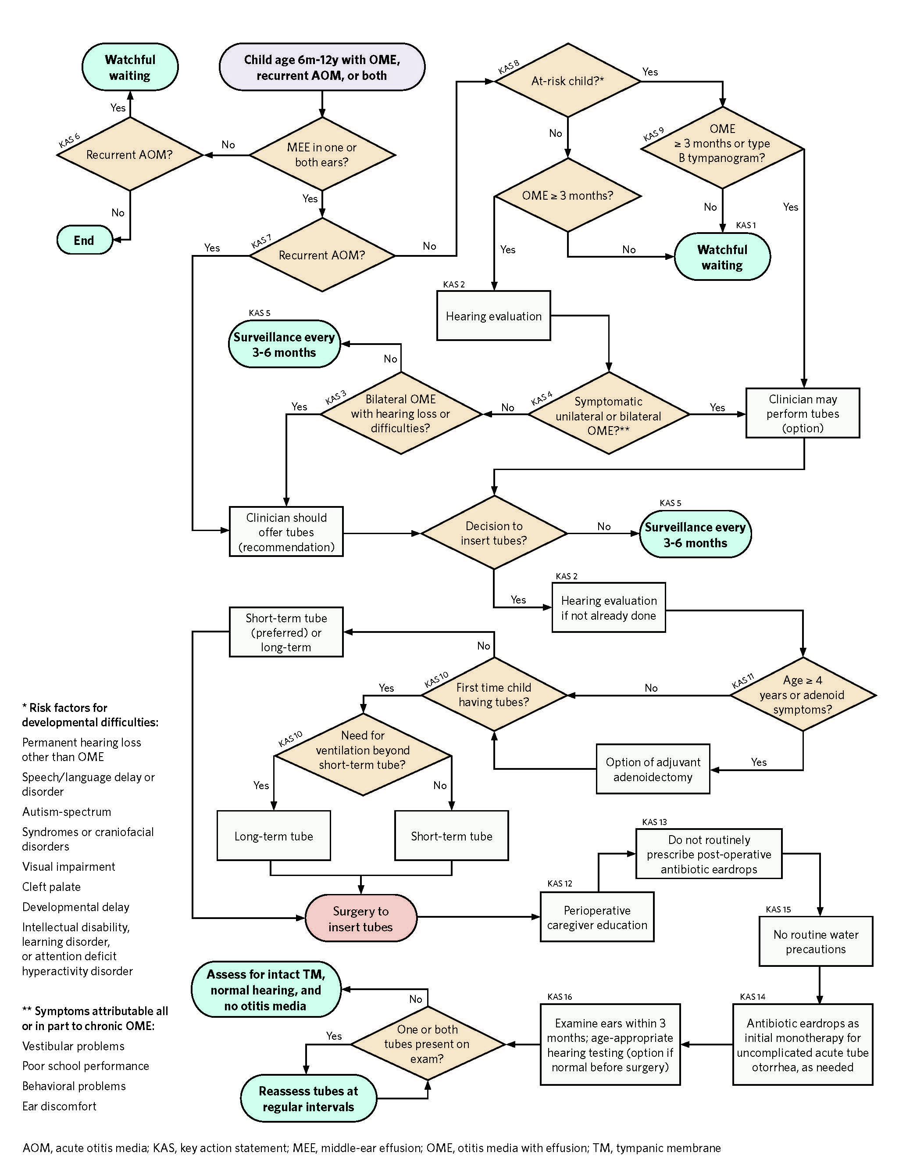
CPG Algorithm
Algorithm showing the interrelationship of guideline key action statements

Slide 51
Research Needs
Can we identify clinical factors that predict persistence of MEE in children who present with effusions of short duration?
What is the ideal timing of audiologic testing for a child being considered for tubes--before surgery, after surgery, or both?
If resources are limited, and audiologic testing is done only after tube placement, how will this affect surgical decision making or counseling about “permanent” hearing loss diagnosed only after surgery?
Are there any caregiver questions, in addition to the two proposed in this CPG, that can predict hearing difficulties and quantify severity, without formal audiologic testing, in patients considered for tubes?
Can we identify the children with OME and speech/language delays who will benefit from tympanostomy tube placement?
What is the relationship of MEE and balance abnormalities, and how do these balance abnormalities change after tympanostomy tube placement?

Slide 52
Research Needs (Cont.)
Are there behavioral problems that correlate with the presence and duration of middle ear fluid problems, and can we screen for these problems in children who have OME?
What is the best time to evaluate children referred for possible surgical treatment of recurrent AOM with relation to the last episode of AOM?
Can we quantify the predictive value of presence of middle ear fluid in one or both ears for likelihood of more episodes of AOM in children with a history of recurrent AOM?
What are the benefits of tympanostomy tube placement on frequency of AOM, prevalence of OME, and speech/language development for children in specific at-risk populations?
Does tympanostomy tube surgery present unique risks or greater complications in some of the at-risk groups?
What is the actual frequency of AOM and prevalence of OME in specific at-risk groups?
Is there the potential for underdiagnosis of OME because of attention to other conditions, or over-diagnosis of OME because of greater clinical exposure, for some of the at-risk populations?
How strongly is abnormal tympanometry at initial clinical encounter associated with persistence of OME?

Slide 53
Research Needs (Cont.)
What are the clinical indicators that best predict the need for repeated tympanostomy tube placement?
What is the role of allergy testing in children with recurrent tube otorrhea or a need for repeated tympanostomy tube placement, and can managing allergy, if present, result in beneficial outcomes?
Are there certain types of long-term tubes that are more often associated with complications such as granulation or otorrhea?
Which subgroups of children should be considered for adenoidectomy at the time of the first set of tubes or when younger than age 4 years?
How do “face-to face” counseling, written materials, and online resources best inform parents and caregivers and facilitate shared surgical decision making?
What are the indications to prescribe postoperative ototopical antibiotics at the time of surgery?
Will the incidence of postoperative otorrhea, and the causative microbiology, change with adoption of the recommendation to limit routine drop use after surgery?
Are there predictors for failure of ototopical therapy as initial treatment for TTO?
Can we identify the children at risk for otorrhea, as well as other clinical indicators for post tympanostomy water precautions?

Slide 54
Research Needs (Cont.)
To what extent can recommendations regarding water precautions for children with tympanostomy tubes be generalized to adults with tympanostomy tubes?
What is the ideal follow-up schedule for examining patients with tubes?
How often should children be assessed in primary care settings, and, how often should children be assessed by otolaryngologists, after tympanostomy tubes are placed?
How often should hearing be formally assessed after tympanostomy tubes are placed?
What is the duration of intubation that is associated with eardrum complications if the tube is not removed?
If a child has a retained tympanostomy tube for more than three years and has normal hearing, an otherwise normal eardrum, and no symptoms, should the tube be removed or is additional observation a preferred option?
If the decision is made to remove a retained tympanostomy tube, when should a myringoplasty be performed?

Slide 55
Research Needs (Cont.)
If a myringoplasty is performed at time of tube removal, is there a preferred artificial or autograft material for this repair?
What is the best management for an asymptomatic child with normal hearing who on examination has a tympanostomy tube that is medialized into the middle ear behind an intact eardrum?
Are there differences in access to surgical treatment of otitis media, as well as differences in surgical decision making, across socioeconomic, ethnic, and racial groups?
The lists of research needs identified by guideline development groups can be found at https://www.entnet.org/resource/clinical-practice-guideline-research-needs/

Slide 56
The AAO-HNSF Maureen Hannley Research Grant
Mechanism of the CORE Grants Program
$50,000 over one year
Purpose:
  Designed to fill research needs identified by the AAO-HNSF clinical practice guideline panels.
  Support the career development of investigators who have made a commitment to focus their research endeavors on patient-oriented research.
If you are interested in applying for an AAO-HNSF Maureen Hannley Research Grant, visit www.entnet.org/core

Slide 57
For more information and additional resources, visit
https://www.entnet.org/quality-practice/quality-products/clinical-practice-guidelines/tympanostomy-tubes-in-children/

